Slide 1
SemQuest: University of Houston’s Semantics-based Question Answering System
Rakesh Verma
University of Houston
Team: Txsumm
Joint work with Araly Barrera and
Ryan Vincent

Slide 2
Guided Summarization Task
Given: Newswire sets of 20 articles, each set belongs to 1 category out of 5 categories
Produce: 100-word summaries that answer specific aspects for each category.
Part A - A summary of 10 documents
Topic*
Part B - A summary of 10 documents with knowledge of Part A.
* Total of 44 topics in TAC 2011

Slide 3
Aspects
Topic Category | Aspects
1) Accidents and Natural Disasters | what when where why who affected damages countermeasures
2) Attacks | what when where perpetrators who affected damages countermeasures
3) Health and Safety | what who affected how why countermeasures
4) Endangered Resources | what importance threats countermeasures
5) Investigations and Trials | who/who involved what importance threats countermeasures
Table 1. Topic categories and required aspects to answer in a summary

Slide 4
SemQuest
2 Major Steps
Data Cleaning
Sentence Processing
Sentence Preprocessing
Information Extraction

Slide 5
SemQuest: Data Cleaning
Noise Removal – removal of tags, quotes and some fragments.
Redundancy Removal – removal of sentence overlap for Update Task (part B articles).
Linguistic Preprocessing – named entity, part-of-speech and word sense tagging.

Slide 6
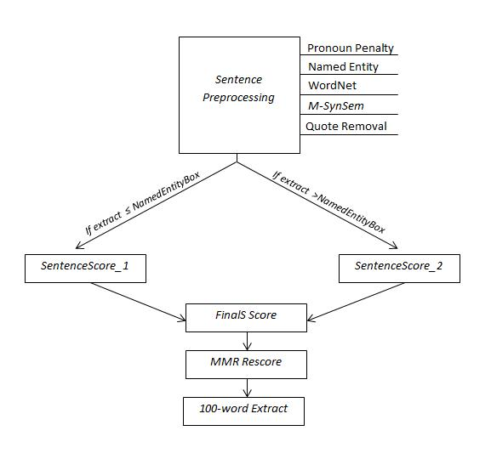
SemQuest: Sentence Processing
Figure 1. SemQuest Diagram

Slide 7
SemQuest: Sentence Preprocessing
SemQuest

Slide 8
SemQuest: Sentence Preprocessing
1) Problem:
“They should be held accountable for that”
Our Solution: Pronoun Penalty Score
2) Observation:
“Prosecutors alleged Irkus Badillo and Gorka Vidal
wanted to “sow panic” in Madrid after being caught in
possession of 500 kilograms 1,100 pounds of explosives,
and had called on the high court to hand down 29-year
sentences.”
Our method: Named Entity Score

Slide 9
SemQuest: Sentence Preprocessing
3) Problem: Semantic relationships need to be established between sentences and the aspects!
Our method: WordNet Score
affect, prevention, vaccination, illness, disease, virus, demographic
Figure 2. Sample Level 0 words considered to answer aspects from ‘’Health and Safety’’ topics.
Five of synonym-of-hyponym levels for each topic were produced using WordNet [4].

Slide 10
SemQuest: Sentence Preprocessing
4) Background:
Previous work on single document summarization (SynSem) has demonstrated successful results on past DUC02 and magazine-type scientific articles.
Our Method:
Convert SynSem into a multi-document acceptor, naming it M-SynSem ,and reward sentences with best M-SynSem scores

Slide 11
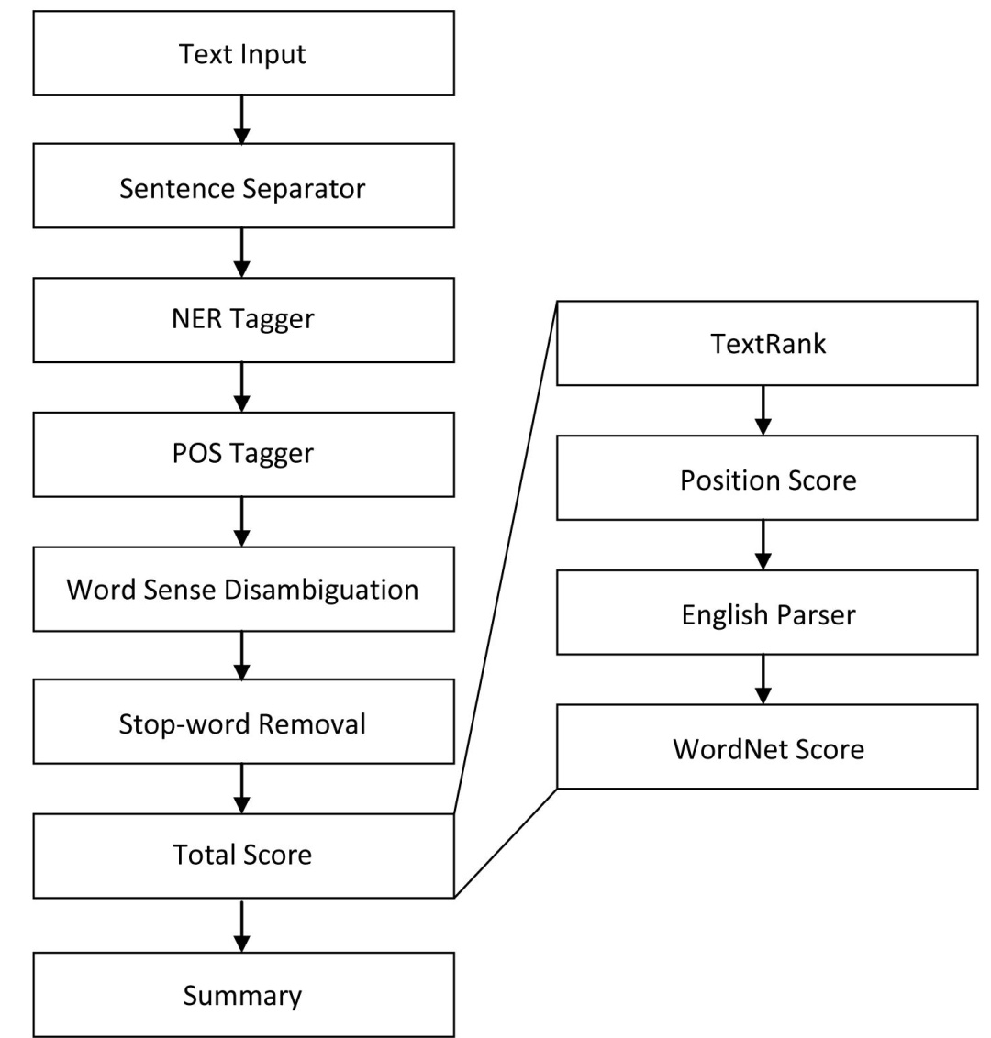
SynSem – Single Document Extractor
Figure 3. SynSem diagram for single document extraction

Slide 12
SynSem
Datasets tested: DUC 2002 and non-DUC scientific articles
DUC02 | ROUGE 1-gram scores
System | Recall | Precision | F-mea.
S28 | .47813 | .45779 | .46729
SynSem | .48159 | .45062 | .46309
S19 | .45563 | .47748 | .46309
Baseline | .47788 | .44680 | .46172
S21 | .47543 | .44680 | .46172
TextRank | .46165 | .43234 | .44640
Sample Scientific Article | ROUGE 1-gram scores
System | Recall | Precision | F-mea.
SynSem | .74897 | .69202 | .71973
Baseline | .39506 | .61146 | .48000
MEAD | .52263 | .42617 | .46950
TextRank | .59671 | .36341 | .45172
(a) (b)
Table 2. ROUGE evaluations for SynSem on DUC and nonDUC data

Slide 13
M-SynSem

Slide 14
M-SynSem
Two M-SynSem Keyword Score approaches:
TextRank [2]
LDA [3]
M-SynSem version (weights) | ROUGE-1 | ROUGE-2 | ROUGE-SU4
TextRank (.3) | 0.33172 | 0.06753 | 0.10754
TextRank (.3) | 0.32855 | 0.06816 | 0.10721
LDA (0) | 0.31792 | 0.07586 | 0.10706
LDA (.3) | 0.31975 | 0.07595 | 0.10881
(a) Part A evaluation results
M-SynSem version (weights) | ROUGE-1 | ROUGE-2 | ROUGE-SU4
TextRank (.3) | 0.31792 | 0.06047 | 0.10043
TextRank (.3) | 0.31794 | 0.06038 | 0.10062
LDA (0) | 0.29435 | 0.05907 | 0.09363
LDA (.3) | 0.30043 | 0.06055 | 0.09621
(b) Part B evaluation results
Table 3. SemQuest evaluations on TAC 2011 using various M-SynSem keyword versions and weights.

Slide 15
SemQuest: Information Extraction
SemQuest

Slide 16
SemQuest: Information Extraction
1.) Named Entity Box
Summary:
Named Entity
Box
Figure 4. Sample summary and Named Entity Box

Slide 17
SemQuest: Information Extraction
1.) Named Entity Box
Topic Category | Aspects | Named Entity Possibilities | Named Entity Box
1) Accidents and Natural Disasters | what when where why who affected damages countermeasures | -- date location -- person/organization -- money | 5/7
2) Attacks | what when where perpetrators who affected damages countermeasures | -- date location person person/organization -- money | 5/8
3) Health and Safety | what who affected how why countermeasures | -- person/organization -- -- money | 3/5
4) Endangered Resources | what importance threats countermeasures | -- -- -- money | 1/4
5) Investigations and Trials | who/who involved what importance threats countermeasures | person/organization -- -- -- -- | 2/6
Table 4. TAC 2011 Topics, aspects to answer, and named entity associations

Slide 18
SemQuest: Information Extraction
2) We utilize all linguistic scores and Named Entity Box
requirements for the computation of a final sentence score,
FinalS for an extract, E:
$SentenceScore_1(S)=\left(WN\left(S\right)×NE\left(S\right)\right)−P(S)$
$SentenceScore_2(S)=\left(WN\left(S\right)×M–SynSem\left(S\right)\right)−P(S)$
where WN represents WordNet Score, NE represents NamedEntity Score, and
P represents the Pronoun Penalty.
$$FinalS\left(S\right)=\left\{\begin{aligned}SentenceScore_1 if |E|≤NEBox \\ \\ SentenceScore_2 if \left|E\right|>NEBox \\ \end{aligned}\right.$$
where |E| is the size, in words, of the candidate extract.

Slide 19
SemQuest: Information Extraction
2) MMR procedure:
Originally used for document reordering, the Maximal Marginal Relevancy (MMR) procedure involves a linear combination of relevancy and novelty measures as a way to re-order extract candidate sentences determined from the FinalS score for the final 100-word extract.
$MMR\left(S\right)= \max_{s_{i}∉E}λ{Sim}_{1}−\left(1−λ\right)\max_{S_{E}∈E}{Sim}_{2}(S_{i},S_{E})$
${Sim}_{1}= R_{i},$a candidate sentence score
${Sim}_{2}=$ Stemmed word-overlap between $S_{i}$ (candidate sentence) and $S_{E}∈E$ (sentence selected in extract $E$).
$λ=$ Novelty parameter. $λ=$0 => High novelty, $λ=$1 => No Novelty

Slide 20
Our Results
Submission Year | ROUGE-2 | ROUGE-1 | ROUGE-SU4 | BE | Linguistic Quality
2 2011 | 0.06816 | 0.32855 | 0.10721 | 0.03312 | 2.841
1 2011 | 0.06753 | 0.33172 | 0.10754 | 0.03276 | 3.023
2 2010 | 0.05420 | 0.29647 | 0.09197 | 0.02462 | 2.870
1 2010 | 0.05069 | 0.28646 | 0.08747 | 0.02115 | 2.696
(a) Part A Evaluation results for Submissions 1 and 2 of 2011 and 2010
Submission Year | ROUGE-2 | ROUGE-1 | ROUGE-SU4 | BE | Linguistic Quality
1 2011 | 0.06047 | 0.31792 | 0.10043 | 0.03470 | 2.659
2 2011 | 0.06038 | 0.31794 | 0.10062 | 0.03363 | 2.591
2 2010 | 0.04255 | 0.28385 | 0.08275 | 0.01748 | 2.870
1 2010 | 0.04234 | 0.27735 | 0.08098 | 0.01823 | 2.696
(b) Part B Evaluation results for Submissions 1 and 2 of 2011 and 2010
Table 5. Evaluations scores for SemQuest submissions for Average ROUGE-1, ROUGE-2, ROUGE-SU4, BE, and Linguistic Quality for Parts A & B

Slide 21
Our Results
Performance:
Higher overall scores for both submissions from participation in TAC 2010
Improved rankings by 17% in Part A and by 7% in Part B.
We beat both baselines for the B category in overall responsiveness score and one baseline for the A category.
Our best run is better than 70% of participating systems for the linguistic score.

Slide 22
Analysis of NIST Scoring Schemes
Evaluation correlations between ROUGE/BE scores to average manual scores for all participating systems of TAC 2011:
Evaluation method | Average Manual Scores for Part A
 | Modified pyramid | Num SCU’s | Num Repetitions | Modified with 3 models | Linguistic Quality | Overall responsiveness
ROUGE-2 | 0.9545 | 0.9455 | 0.7848 | 0.9544 | 0.7067 | 0.9301
ROUGE-1 | 0.9543 | 0.9627 | 0.6535 | 0.9539 | 0.7331 | 0.9126
ROUGE-SU4 | 0.9755 | 0.9749 | 0.7391 | 0.9753 | 0.7400 | 0.9434
BE | 0.9336 | 0.9128 | 0.7994 | 0.9338 | 0.6719 | 0.9033
Evaluation method | Average Manual Scores for Part B
 | Modified pyramid | Num SCU’s | Num Repetitions | Modified with 3 models | Linguistic Quality | Overall responsiveness
ROUGE-2 | 0.8619 | 0.8750 | 0.7221 | 0.8638 | 0.5281 | 0.8794
ROUGE-1 | 0.8121 | 0.8374 | 0.6341 | 0.8126 | 0.4915 | 0.8545
ROUGE-SU4 | 0.8579 | 0.8779 | 0.7017 | 0.8590 | 0.5269 | 0.8922
BE | 0.8799 | 0.8955 | 0.7186 | 0.8810 | 0.4164 | 0.8416
Table 6. Evaluation correlations between ROUGE/BE and manual scores.

Slide 23
Future Work
Improvements to M-SynSem
Sentence compression

Slide 24
Acknowledgments
Thanks to all the students:
Felix Filozov
David Kent
Araly Barrera
Ryan Vincent
Thanks to NIST!

Slide 25
References
[1] J.G. Carbonell, Y. Geng, and J. Goldstein. Automated Query-relevant Summarization and Diversity-based Reranking. In 15th International Joint Conference on Artificial Intelligence, Workshop: AI in Digital Libraries, 1997.
[2] R. Mihalcea and P. Tarau. TextRank: Bringing Order into Texts. In Proceedings of the Conference on Empirical Methods in Natural Language Processing (EMNLP). March 2004.
[3] David M. Blei, Andrew Y. Ng,. And Michael I. Jordan. Latent Dirichlet Allocation. Journal of Machine Learning Research, 2:993-1022, 2003.
[4] WordNet: An Electronic Lexical Database, Edited by Christiane Fellbaum, MIT Press, 1998.

Slide 26
Questions?

