Slide 1
Intelius-NYU Cold Start System
Ang Sun, Xin Wang, Sen Xu, Yigit Kiran, Shakthi Poornima, Andrew Borthwick
(Intelius Inc.)
Ralph Grishman (New York University)

Slide 2
Outline
Cold Start Slot Filling System
Entity Linking for Person and Organization
Entity Linking for Geo-Political Entity (GPE)
Experiments

Slide 3
Outline
Cold Start Slot Filling System
Entity Linking for Person and Organization
Entity Linking for Geo-Political Entity (GPE)
Experiments

Slide 4
Cold Start Slot Filling System
The NYU 2011 Regular Slot Filling System

Slide 5
Cold Start Slot Filling System
Adapt the NYU system to Cold Start
Within document coreference
extract entities for a single document
extract the longest name mention as the canonical mention
canonical mention: Maurice Sercarz
mention: Sercarz
Slot filling for GPEs
infer slot fills from the extractions of person and organization entities

Slide 6
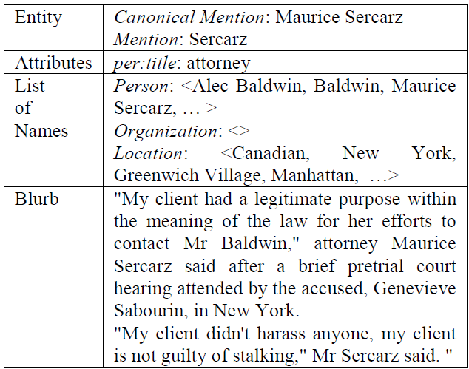
Cold Start Slot Filling System
Adapt the NYU system to Cold Start
Contextual information extraction

Slide 7
Outline
Cold Start Slot Filling System
Entity Linking for Person and Organization
Entity Linking for Geo-Political Entity (GPE)
Experiments

Slide 8
Intelius Entity Linking Pipeline
Records
Blocking
Top Level Blocking
Goal:
Conflate billions of entities
Map Reduce Based
Sequential file access
Optimized for batch processing billions of records sequentially
Optimization and compromises crucial to success
Sub-blocking
Machine Learning based Link Scoring
Clustering
Transitive Closure
Graph Partition
Coalesce
Person Profiles

Slide 9
Blocking
Bring together records likely to belong to the same entity
Blocking Keys
Hash functions
Hand crafted and domain specific
Equivalent classes of names and titles
Contextual PER, ORG and GPE Keywords (TFIDF)
Dynamically selected

Slide 10
Link Scoring
ADTree-based supervised model
Training examples:
Sample selection: randomly and selectively (through active learning)
Labeling process:
Three phases:
Amazon Mechanical Turk Labeling
Internal Data Rater Inspection
Researchers
Multi-round of relabeling and inspection are needed if the quality of labels from Turkers is low
Size:
50,000 pairs for PER and 4,000 pairs for ORG

Slide 11
Features
PER Feature Types (116 features):
General Demographic:
Name frequency
Birthday
Location
Population
Combinations
Comparing KBP specific slots:
Jobs
Educations
TFIDF and N-gram:
for contextual text information
ORG Feature Types (60 features):
Location based
Comparing KBP specific slots
TFIDF and N-gram
for contextual text information

Slide 12
ORG ADTree Model (Partial)

Slide 13
Outline
Cold Start Slot Filling System
Entity Linking for Person and Organization
Entity Linking for Geo-Political Entity (GPE)
Experiments

Slide 14
GPE Disambiguation
GPE (Toponyms) can be ambiguous
China: Country or Town in Maine, US
Georgia: Country or State in the US
Springfield: exists in more than 10 US States
Berlin: Capital of Germany, State in Germany, also common city name in the US
Over 5,000 ambiguous toponyms from geonames.org
Use contextual GPE to disambiguate
Candidates with least cumulative spatial distance (Buscaldi and Rosso, 2008)
Voting schema with a hierarchical gazetteer

Slide 15
Hierarchical Gazetteer
Gazetteer Sample
Key | Value
China | Country_POP_1,330,044,000; City_InState_Maine_InCountry_US
Seattle | City_InState_Washington_InCountry_US
Georgia | Country_POP_4,630,000; State_POP_8,975,842_InCountry_US
… | …
Country
State/Province
City/Town

Slide 16
Voting Schema
$Score\left(CandidateTopo_{i}\right)= \sum_{j≠i}{\left.Vote(CandidateTopo_{j}\right)}$
+3: if Topo_{i} and Topo_{j} are sibling cities
e.g.: Austin, TX and Houston, TX
+5: if Topo_{i} and Topo_{j} are sibling States
e.g.: Georgia and Alabama
+10: if Topo_{i} is offspring of Topo_{j}
e.g.: Austin, TX and Texas
+5: if Topo_{i} is parent of Topo_{j}
e.g.: Washington and Seattle, WA
Topo_{j}’s Vote for
Candidate Topo_{i}
Notes:
Topo i is the ambiguous toponym

Slide 17
Outline
Cold Start Slot Filling System
Entity Linking for Person and Organization
Entity Linking for Geo-Political Entity (GPE)
Experiments

Slide 18
Link News Profiles to Intelius Profiles
74+ million Topix News/blog articles
167+ million People
Entities
Turker/Data Rater Evaluate: 8.06% were incorrectly conflated
Records
Records
Blocking
Top Level Blocking
26.5 million Conflated
Blocking
Top Level Blocking
671 million Intelius People
Profiles
Sub-blocking
Sub-blocking
Machine Learning based Link Scoring
Machine Learning based Link Scoring
Clustering
Clustering
Transitive Closure
Transitive Closure
Graph Partition
Graph Partition
Coalesce
Coalesce
Person Profiles

Slide 19
Thanks!

Slide 20
?

