Slide 1
Cold-Start KBP Something from Nothing
Sean Monahan, Dean Carpenter Language Computer

Slide 2
What is Cold-Start KBP?
Corpus of interest
Read about one entity
Want to know information about that entity
E.g. spouse, employment
Search the corpus for other mentions
Extract the relevant facts
For all the entities in the corpus

Slide 3
Overview
Goal: Generate Wikipedia like KB from scratch
Need many technologies to create it.
What are the hard parts?
Scalability

Slide 4
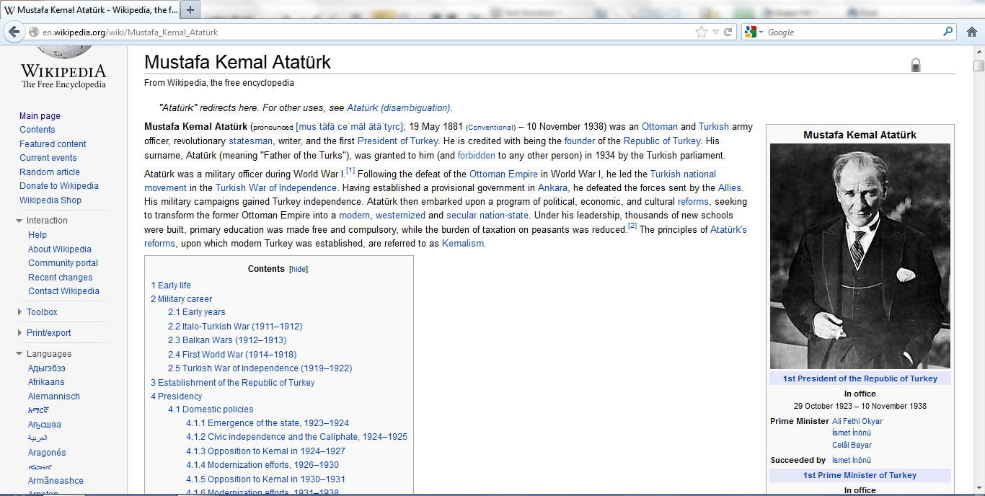
Wikipedia <-> Cold-Start
Infobox

Slide 5
Wikipedia <-> Cold-Start
Summary

Slide 6
Wikipedia <-> Cold-Start
Entity Links

Slide 7
Wikipedia <-> Cold-Start
Cross Language Links

Slide 8
Why is Cold-Start Hard?
Clustering harder than Entity Linking
In Entity Linking you have a KB
Relation extraction
Last several years at TAC shown how hard this is
How do you test it?
How do you scale?

Slide 9
System Diagram
Corpus
Zoning
Entity
Extraction
In-Doc
Coref
Infobox
Extraction
Entity
Linking
Lorify
KB Entries
Information
Fusion
Entity
Clustering

Slide 10
System Diagram
Corpus
Zoning
Entity
Extraction
In-Doc
Coref
Infobox
Extraction
Entity
Linking
Lorify
KB Entries
Information
Fusion
Entity
Clustering

Slide 11
Entity Clustering
NIL Clustering or Cross-Document Coreference
Comparison Space
All pairs or subset
Model similarity
Vector space or ML Classifier
Perform clustering
Hierarchical Agglomerative or Statistical
We chose a statistical clustering algorithm based on MCMC Metropolis-Hastings
(Singh et al. 2011)

Slide 12
MCMC Clustering
Start with size one clusters
Propose moving an entity from one cluster to another cluster
Use similarity function to judge which cluster is better
Don’t always make optimal decision
Temperature parameter controls the level of randomness

Slide 13
Proposal System
Limits which pairs of entities can be clustered together
Require some evidence
Each proposal links two entity mentions in the following ways
String/phonemic similarity
Alias Relation in text
Link to Knowledge Base
Cold-Start statistics
Cold-Start Entity Mentions: 85,289
12,000 total proposal tags
# Pairs (naïve): 3.6 billion
# Pairs (proposal): 20 million
92% recall over training data

Slide 14
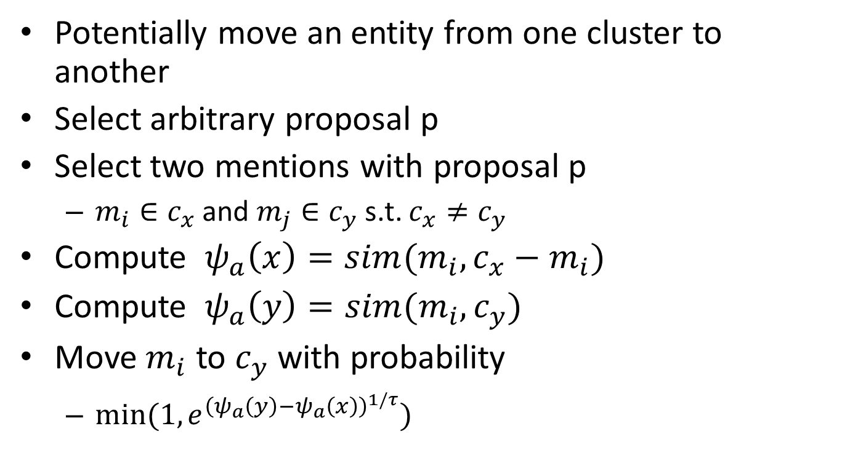
Movement Step
Potentially move an entity from one cluster to another
Select arbitrary proposal p
Select two mentions with proposal p
$m_{i}∈c_{x}$ and $m_{j}∈c_{y}$s.t. $c_{x}≠c_{y}$
Compute $ψ_{a}\left(x\right)=sim(m_{i}, c_{x}−m_{i})$
Compute $ψ_{a}\left(y\right)=sim(m_{i}, c_{y})$
Move $m_{i}$ to $c_{y}$ with probability
$min⁡(1, e^{{\left(ψ_{a}\left(y\right)−ψ_{a}\left(x\right)\right)}^{1/τ}})$
temperature

Slide 15
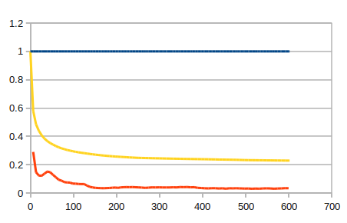
Performance of Base Model
Mentions
Clusters / Mentions
Percentage Moves Accepted
minutes
KBP NIL Clustering 2011
P/R/F: 0.794/0.843/0.818
KBP NIL Clustering 2012
P/R/F: 0.257/0.376/0.305

Slide 16
Singleton Step
Select arbitrary mention $m_{i}∈c_{x}$
Compute $ψ_{a}\left(x\right)=sim (m_{i}, c_{x}−m_{i})$
Move $m_{i}$ to $c_{0}$with probability
$min⁡(1, e^{{(bias−ψ_{a}(x))}^{1/τ} })$
Bias experimentally determined
Controls minimum evidence necessary to build cluster

Slide 17
With Singletons
Mentions
Clusters / Mentions
Percentage Moves Accepted
minutes
KBP NIL Clustering 2011 P/R/F: 0.844/0.803/0.823
KBP NIL Clustering 2012 P/R/F: 0.596/0.627/0.611

Slide 18
Convergence
How do we decide when to stop?
Different than normal Metropolis-Hastings algorithm
The clusters are constantly changing
Annealing schedule
Start with high temperature $τ_{0}$, lower to 0 over time T
At $t_{0}$, temperature is $τ_{0}$
At $t_{i}$, $\frac{T −t_{i}}{T}∗τ_{0}$
Takes a little time to settle after temp reaches 0

Slide 19
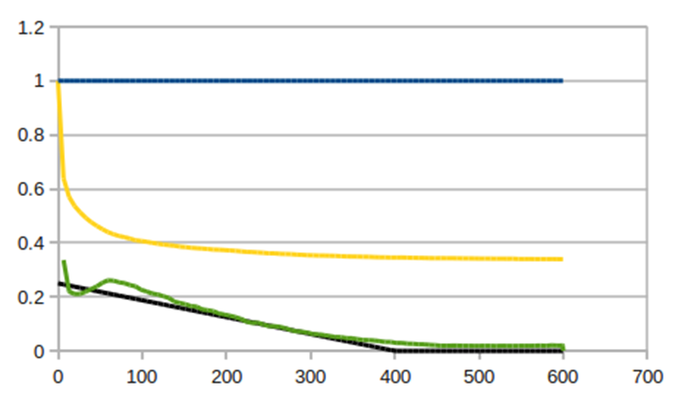
Thermostat
Mentions
Clusters/
Mentions
Temperature
Acceptance Ratio
minutes
KBP NIL Clustering 2011 P/R/F: 0.861/0.824/0.842
KBP NIL Clustering 2012 P/R/F: 0.644/0.669/0.657

Slide 20
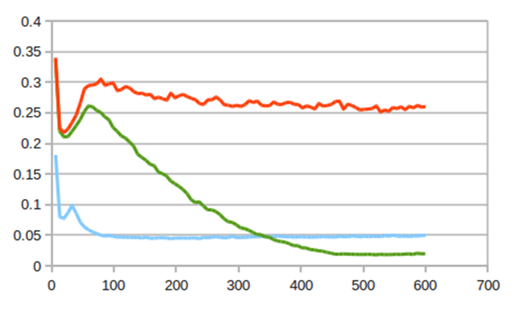
Temperature : Steady vs. Dropping vs. Zero
Constant Temperature
Dropping Temperature
No temperature
minutes
Movement Acceptance Ratios

Slide 21
Clustering Algorithm
Assign each mention to default cluster
while temperature >= 0 do
for N iterations do
Propose movement or singleton, compute similarity, decide to move
end for
Drop temperature
end while

Slide 22
MCMC Clustering
Requires some similarity function
A proposal model
A movement model
Two parameters
Temperature controls time to cluster
Bias determines size of clusters
Scalable to large data sets
To do streaming clustering, add new data and adjust temperature function

Slide 23
Producing Final KB
Once the clustering is completed
Each cluster becomes a KB entry
Fact extraction is run over each mention
Information is shared between mentions
The KB is stored in a Riak database
Riak is distributed key/value store
Riak database exported to a tsv

Slide 24
Results
Combined LDC queries and derived queries at hop level 0.
System | F1 | P | R | Linking | Zoning
lcc2012-1 | 14.4 | 62.7 | 8.2 | No | Yes
lcc2012-2 | 16.5 | 66.4 | 9.4 | Yes | Yes
lcc2012-3 | 17.6 | 62.0 | 10.3 | No | No
lcc2012-4 | 18.0 | 67.7 | 10.4 | Yes | No

Slide 25
Thanks!

