Slide 1
Overview of the TAC2013 Knowledge Base Population Evaluation: English Slot Filling
Mihai Surdeanu
with a lot help from: Hoa Dang, Joe Ellis, Heng Ji, and Ralph Grishman

Slide 2
Introduction
Slot filling (SF): extract values of specified attributes for a given entity from a large collection of natural language texts.
This was the 5th year for the KBP SF evaluation
A few new things this year

Slide 3
New: Annotation Guidelines
per:title
Titles at different organizations are different
Mitt Romney
CEO at Bain Capital
CEO at Bain & Company
CEO at 2002 Winter Olympics
per:employee_of + per:member_of = per:employee_or_member_of
Entities in meta data can be used as query input or output
Consider post authors as filler candidates
different fillers!

Slide 4
New: Provenance and Justification
Exact provenance and justification required
Up to two mentions for slot/filler provenance
Up to two sentences for justification

Slide 5
New: Provenance and Justification
entity: Michelle Obama
slot: per:spouse
query
Michelle Obama started her career as a corporate lawyer specializing in marketing and intellectual property. Michelle met Barack Obama when she was employed as a corporate attorney with the law firm Sidley Austin. She married him in 1992.
Entity provenance: “She”, “Michelle Obama”
Filler provenance: “him”, “Barack Obama”
Justification: “She married him in 1992.”
output

Slide 6
New: Source Corpus
One million documents from Gigaword
One million web documents (similar to 2012)
~100,000 documents from web discussion fora
Released as a single corpus for convenience

Slide 7
Scoring Metric
Each non-NIL response is assessed as: Correct, ineXact, Redundant, or Wrong
Justification contains >2 sentences ➔ W
Provenance and/or justification incomplete ➔ W
Filler string incomplete or include extraneous material ➔ X
Text spans justify the extraction and filler is exact
Filler exists in the KB ➔ R
Filler does not exist in KB ➔ C
Credit given for C and R

Slide 8
Scoring Metric
Precision, recall, and F1 score computed considering C and R fillers as correct
Recall is tricky
Gold keys constructed from
System outputs judged as correct
A manual key prepared by LDC annotators independently
Also serves as a fair performance ceiling

Slide 9
participants

Slide 10
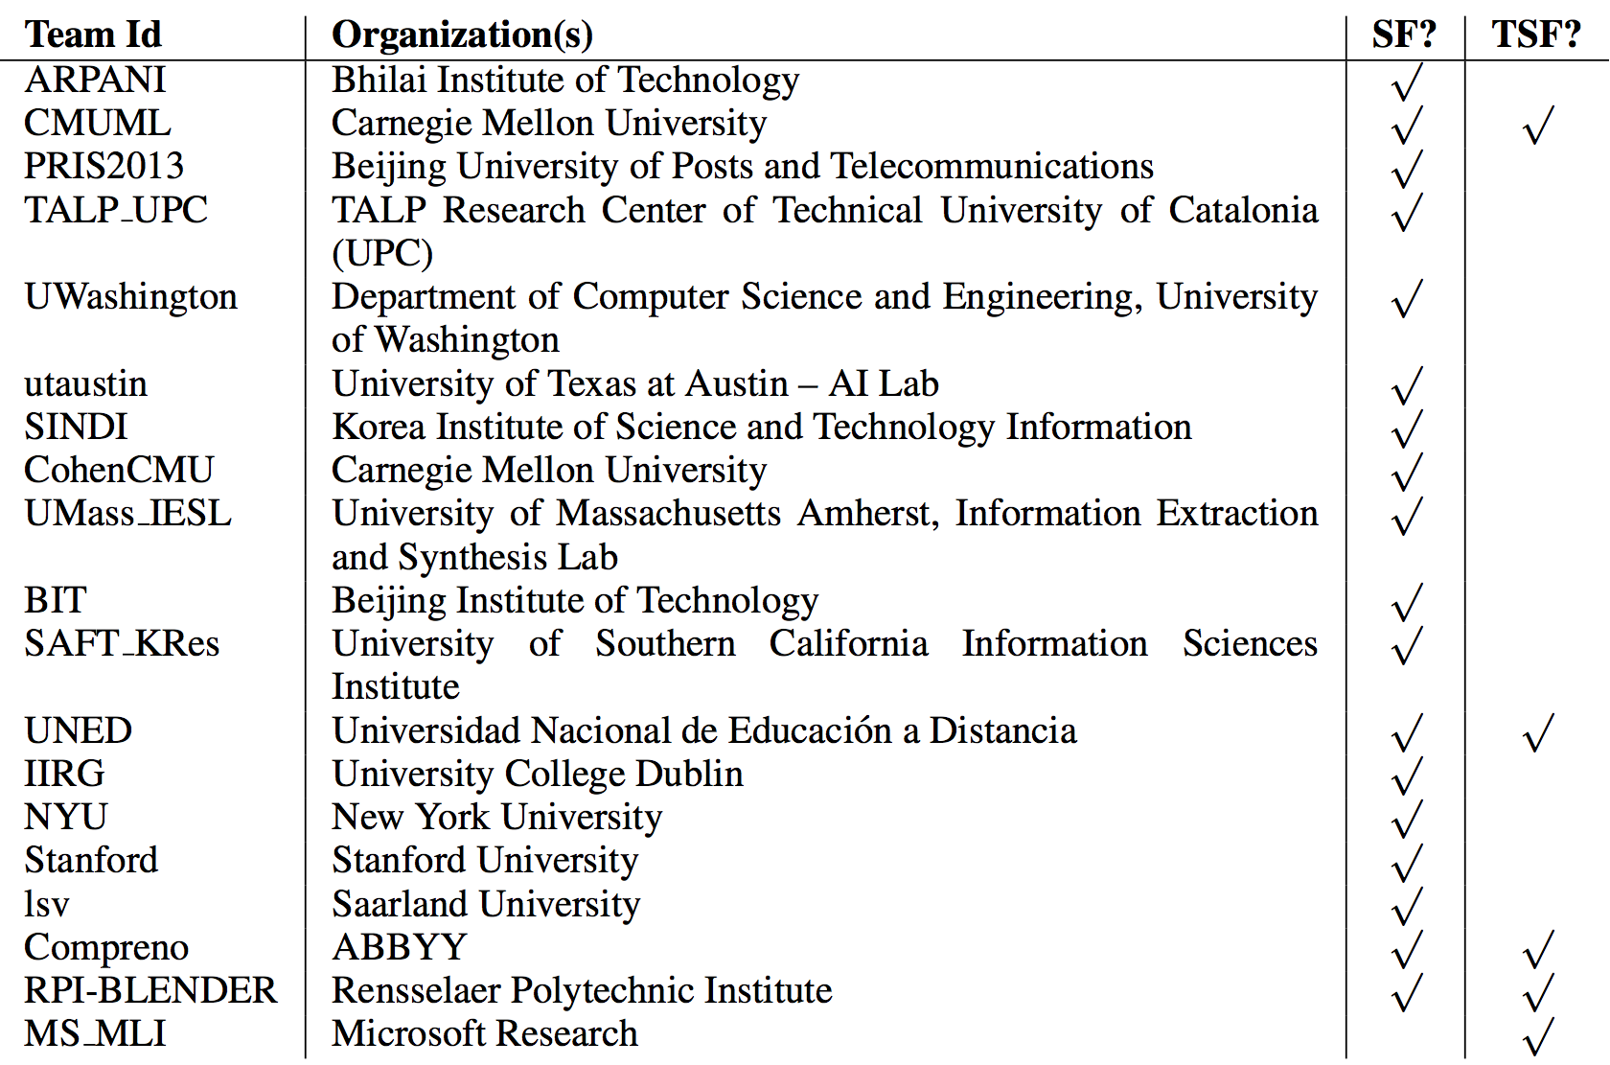
Participants
Notes:
18 total. 9 US. 2 China, 2 Spain. 1 from Germany, India, Russia, Korea, Ireland

Slide 11
Participation Trends
Number of teams who submitted at least one SF run

Slide 12
Participation Trends
Number of SF submissions

Slide 13
results

Slide 14
The Task Was Harder This Year
Harder
Stricter scoring
More complex queries, with a more uniform slot distribution
Easier
Extracting redundant fillers is somewhat easier

Slide 15
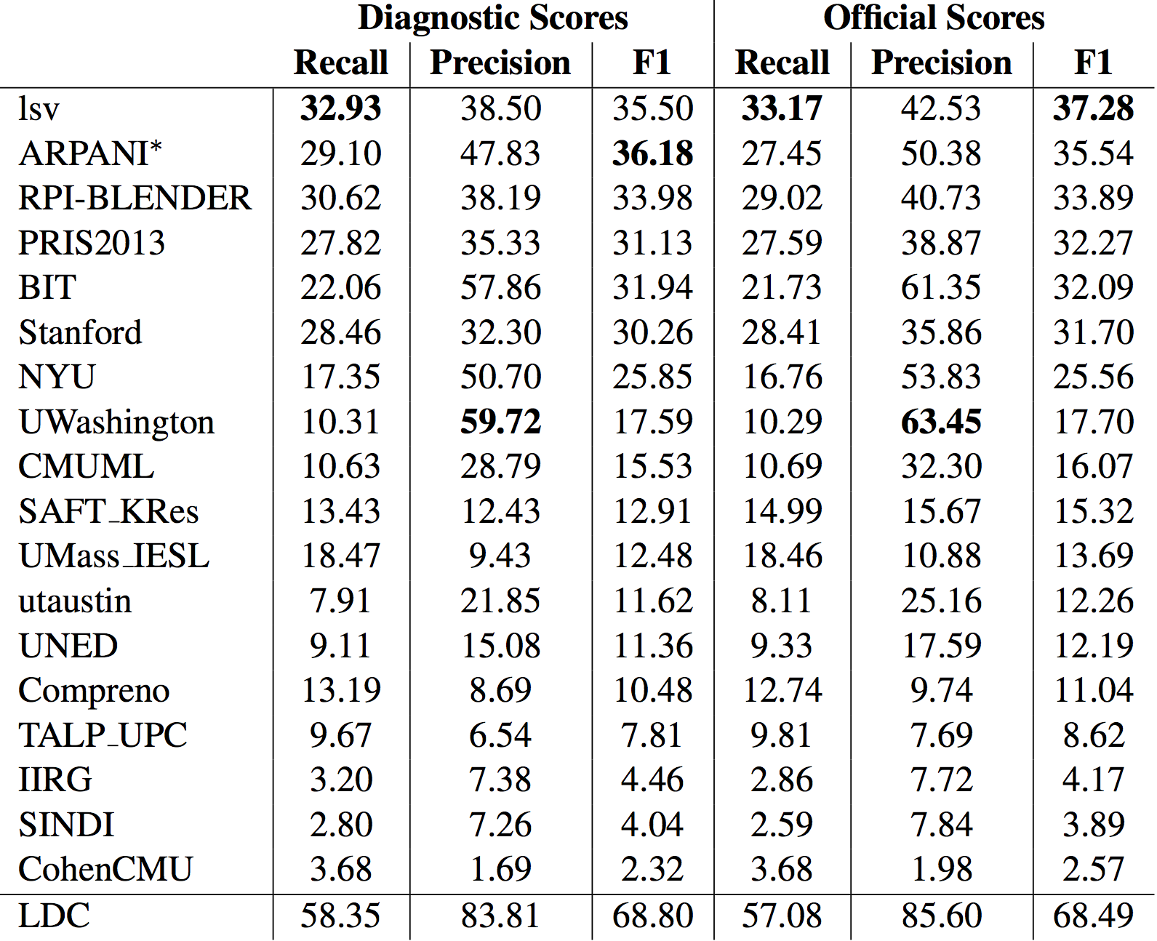
Overall Results

Slide 16
Overall Results
Official scores are generally higher than diagnostic scores
Redundant fillers are easier to extract. That’s why they are already in the KB?

Slide 17
Overall Results
Harder task: this score was 81.4 in 2012.

Slide 18
Overall Results
Increased performance:
6 systems over 30 F1. Last year, there were only 2.

Slide 19
Overall Results
Increased performance:
Median: 15.7 F1.
Last year: 9.9 F1.

Slide 20
Overall Results
Perspective:
We are at 54% of human performance

Slide 21
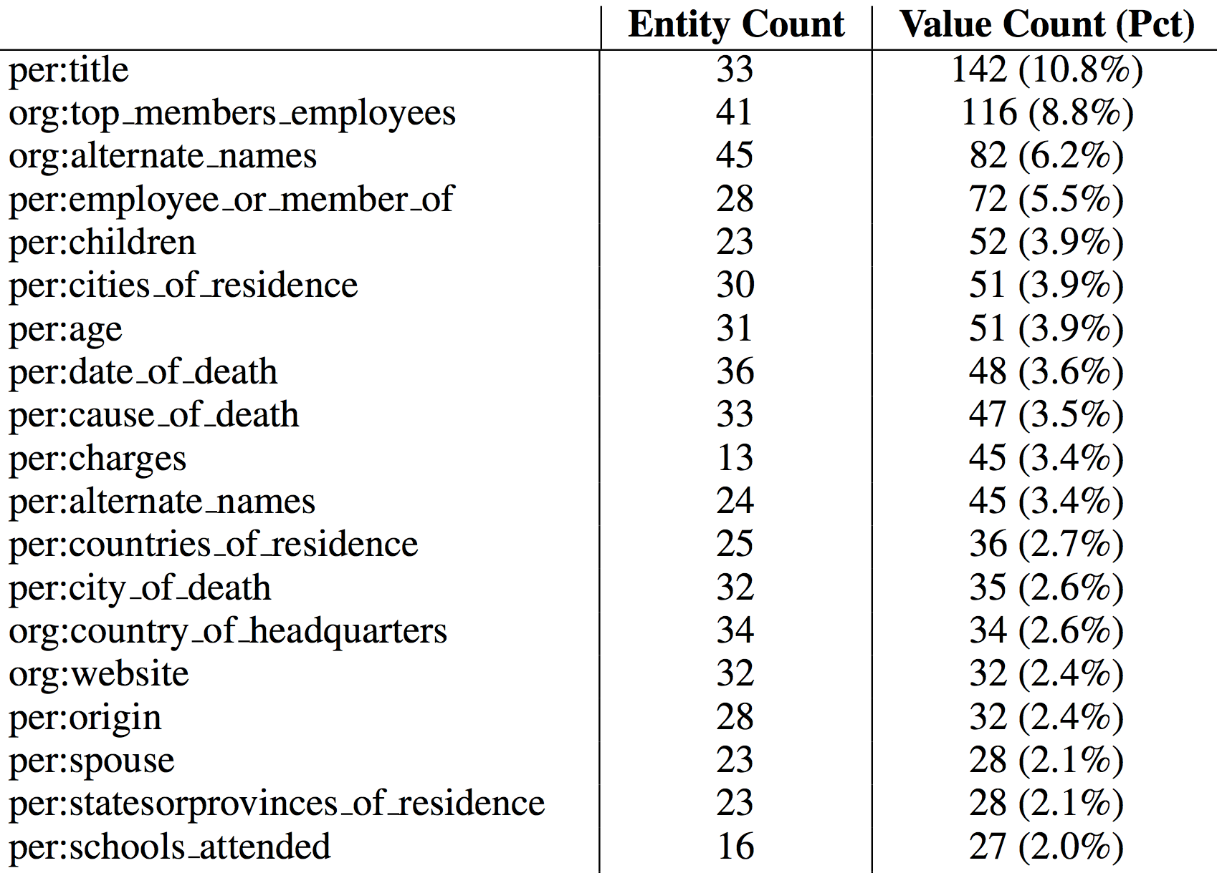
Distribution of Slots in Evaluation Queries
…

Slide 22
Distribution of Slots in Evaluation Queries
Harder data:
13 slots needed to cover 60% of data
Some of these are hard.
In 2011, only 7 slots needed to cover 60% of data.
…

Slide 23
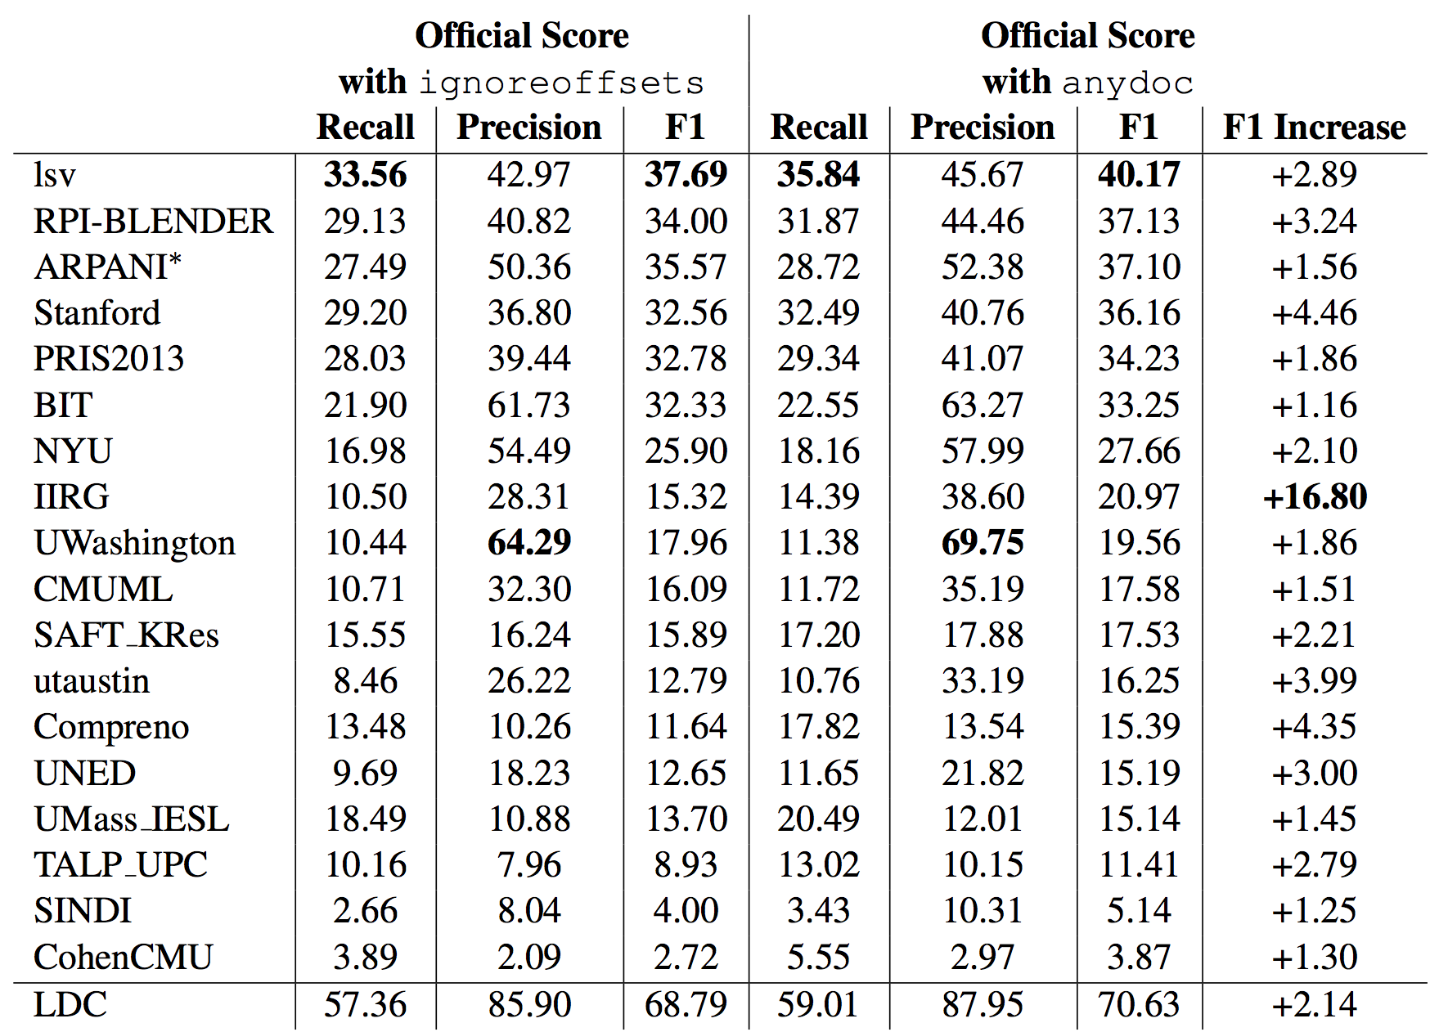
Results with Lenient Scoring

Slide 24
Results with Lenient Scoring
Not directly comparable with the official scores due to collapsing of per:title

Slide 25
Results with Lenient Scoring
System bug?

Slide 26
Results with Lenient Scoring
About the same as the official scores.
If systems identify the correct docs, they can extract correct offsets.

Slide 27
Results with Lenient Scoring
These are much higher for some systems.

Slide 28
Results with Lenient Scoring
Extracted fillers from documents not in the source corpus.

Slide 29
Results with Lenient Scoring
Inferred relations not explicitly stated in text.

Slide 30
Technology
Most successful approaches combine distant supervision (DS) with rules
DS models with built-in noise reduction (Stanford)
Rules
Combiner
(Stanford, NYU, BIT)
DS
Rules
DS
(Saarland)

Slide 31
Technology
KBP system based on OpenIE (Washington)
Extracted tuples (Arg1, Rel, Arg2) from the KBP corpus
Manual written rules to map these tuples to KBP relations
Bootstrapping dependency-based patterns (Beijing University of Posts and Telecommunications)

Slide 32
Technology
Unsupervised clustering of patterns (UPC)
Combining observed and unlabeled data through matrix factorization (UMass)
Inferring new relations from the stated ones using first-order logic rules learned BLP (UT)

Slide 33
Conclusions
Positive trends
Most popular SF evaluation to date
Best performance on average
Things that need more work
Still at ~50% of human performance
Participant retention rate at lower than 50%
Reduce barrier of entry: offer preprocessed data?
Sentences containing <entity, filler> in training
Sentences containing entity in testing
NLP annotations

