Slide 1
Linguistic Resources for the
2013 TAC KBP Temporal SF Evaluation
Joe Ellis (presenter),
Jeremy Getman, Jonathan Wright, Stephanie Strassel
Linguistic Data Consortium
University of Pennsylvania, USA

Slide 2
2013 Source Corpus
Language | Genre | Documents
English | Newswire | 1,000,257
 | Web Text | 999,999
 | Discussion Forums | 99,063

Slide 3
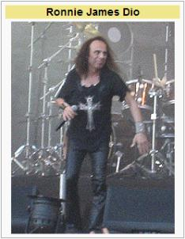
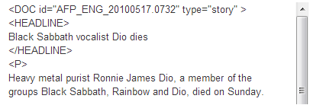
Query Selection
Select queries and reference docs
Temporal Slot Filling queries comprised of
Entity – Slot – Filler
Rich queries (2-3 pieces of temporal info)
Evenly represent seven TSF slots
per:spouse, per:title, per:employee_or_member_of, per:cities_of_residence, per:statesorprovinces_of_residence, per:countries_of_residence, org:top_employee_members
Link namestrings to KB or mark as NIL

Slide 4
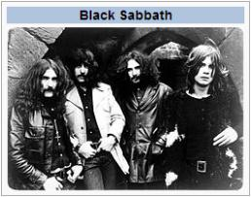
Query Selection
Select queries and reference docs
Temporal Slot Filling queries comprised of
Entity – Slot – Filler
Rich queries (2-3 pieces of temporal info)
Evenly represent seven TSF slots
per:spouse, per:title, per:employee_or_member_of, per:cities_of_residence, per:statesorprovinces_of_residence, per:countries_of_residence, org:top_employee_members
Link namestrings to KB or mark as NIL

Slide 5
Query Selection
Select queries and reference docs
Temporal Slot Filling queries comprised of
Entity – Slot – Filler
Rich queries (2-3 pieces of temporal info)
Evenly represent seven TSF slots
per:spouse, per:title, per:employee_or_member_of, per:cities_of_residence, per:statesorprovinces_of_residence, per:countries_of_residence, org:top_employee_members
Link namestrings to KB or mark as NIL

Slide 6
Annotation
For each query annotator spends up to 2 hours searching for temporal information for targeted relation
Annotators exhaustively add temporal information to system answers marked correct during assessment
Ronnie James Dio
per:employee_or_member_of:
Black Sabbath
BEGIN 1979-XX-XX
END 1982-XX-XX

Slide 7
Annotation
For each query annotator spends up to 2 hours searching for temporal information for targeted relation
Annotators exhaustively add temporal information to system answers marked correct during assessment
Ronnie James Dio
per:employee_or_member_of:
Black Sabbath
BEGIN 1979-XX-XX
END 1982-XX-XX

Slide 8
Assessment
Assess validity of fillers & justification from humans & systems
Filler
Correct – meets the slot requirements and entity supported in document
Wrong – doesn’t meet slot requirements and/or entity not supported in doc
Predicate
Correct, Wrong, Inexact-Short, Inexact-Long
Subject/Object
Correct, Wrong, Inexact
In TSF only the entity must be supported by the source document, not the string
No ‘Inexact’ fillers in TSF

Slide 9
Justification
New in 2013:
Justification is the string(s) of text that show a relation is true
Predicate: Includes all three pieces of information necessary to justify the entity/slot/filler relation
Subject: proves the entity’s involvement in the relation
Object: proves the filler’s involvement in the relation
Each part can be comprised of up to two, discontiguous strings
<Ronnie James Dio – per:countries_of_residence – United States>
Predicate 1: Dio died at his home in Los Angeles
Predicate 2: Los Angeles, the second-most populous city in the US
Ronnie James Dio
- per:employee_or_member_of:

Slide 10
2014 Discoveries
Some restrictions lossy given prevalence of certain features in data
Age used to resolve dates invalid
Ronnie James Dio was born on July 10, 1942 […]
[…] Dio joined Black Sabbath when he was 37
Dates with unspecified years invalid
XXXX-09-11
Some easy-to-add features could benefit data
Offsets for temporal information provenance
justification for temporal information

Slide 11
Delivered 2013 Resources
Corpus Title | Type | LDC Catalog | Language | Size
TAC 2013 KBP English Temporal Slot Filling Training Queries and Annotations | Training | LDC2013E82 | English | 7 Queries
TAC 2013 KBP English Temporal Slot Filling Evaluation Queries and Annotations | Evaluation | LDC2013E86 | English | 273 Queries
TAC 2013 KBP English Temporal Slot Filling Evaluation Assessment Results | Evaluation | LDC2013E99 | English | 4,376 Assessments

