Slide 1
Overview of the TAC2013 Knowledge Base Population Evaluation: Temporal Slot Filling
Mihai Surdeanu
with a lot help from: Hoa Dang, Joe Ellis, Heng Ji, Ralph Grishman, and Taylor Cassidy

Slide 2
Introduction
Temporal Slot filling (TSF): grounds fillers extracted by SF by finding the start and end dates when they were valid.
This was the 2nd year for a KBP TSF evaluation
There was a pilot evaluation in 2011
A few new things this year

Slide 3
~ New: Seven Slots Considered
per:spouse
per:title
per:employee_or_member_of
per:cities_of_residence
per:statesorprovinces_of_residence
per:countries_of_residence
org:top_employees/members

Slide 4
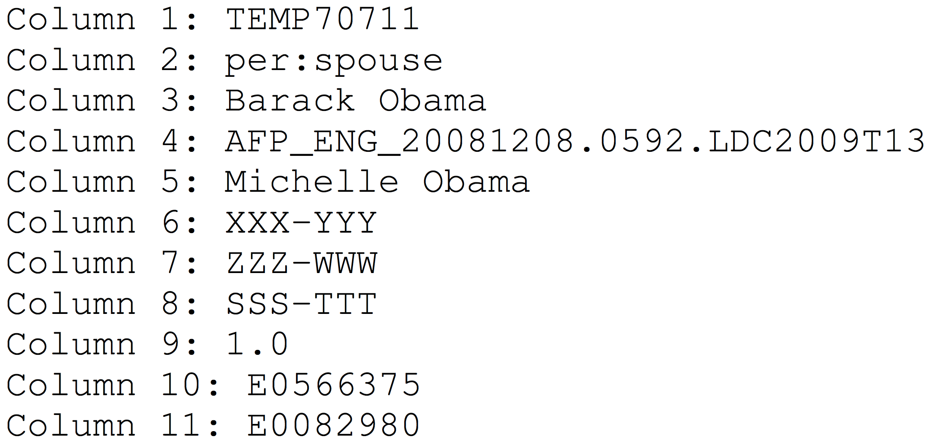
New: Input Queries

Slide 5
New: Input Queries
Both entity and filler given!

Slide 6
New: Input Queries
Provenances and justification given!

Slide 7
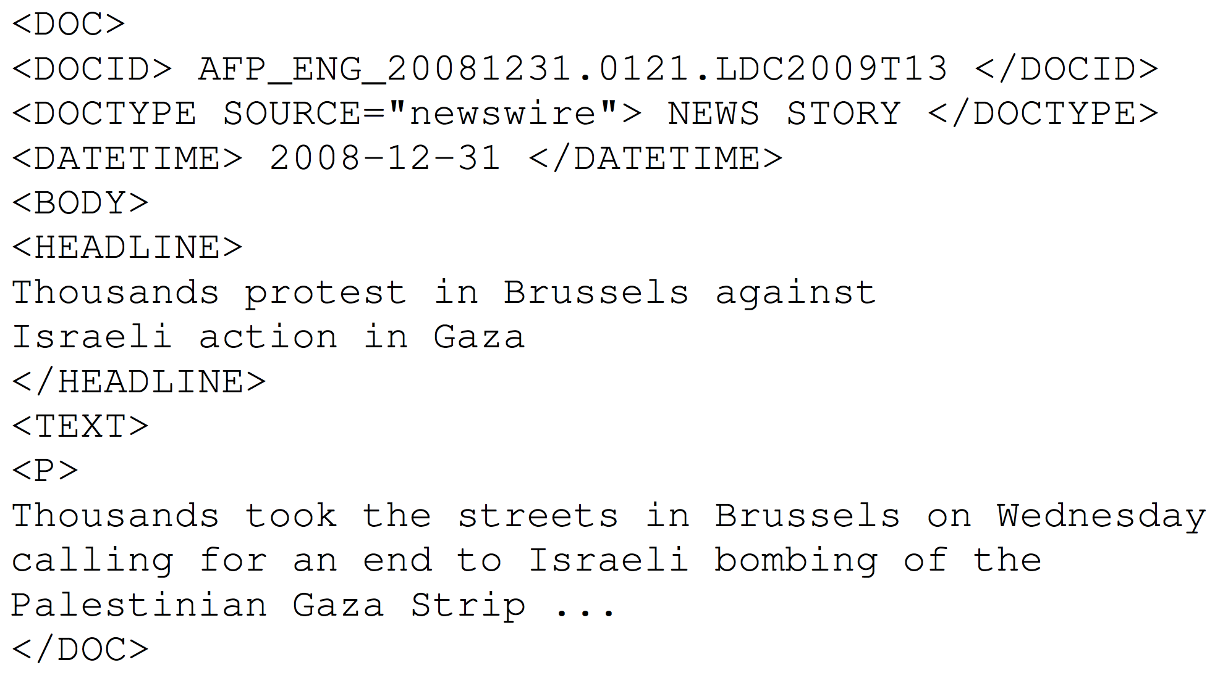
New: Provenance of Dates

Slide 8
New: Provenance of Dates
Provenance of date mentions used for normalization must be reported!

Slide 9
Scoring Metric
Same four-tuple used to represent dates: [T1 T2 T3 T4]
Relation is true for period beginning between T1 and T2
Relation is true for period ending between T3 and T4
Has limitations
Recurring events

Slide 10
Scoring Metric
For each query:
System output S = <t1, t2, t3, t4>
Gold tuple S_{g} = <g1, g2, g3, g4>
Individual query score:
Overall:

Slide 11
participants

Slide 12
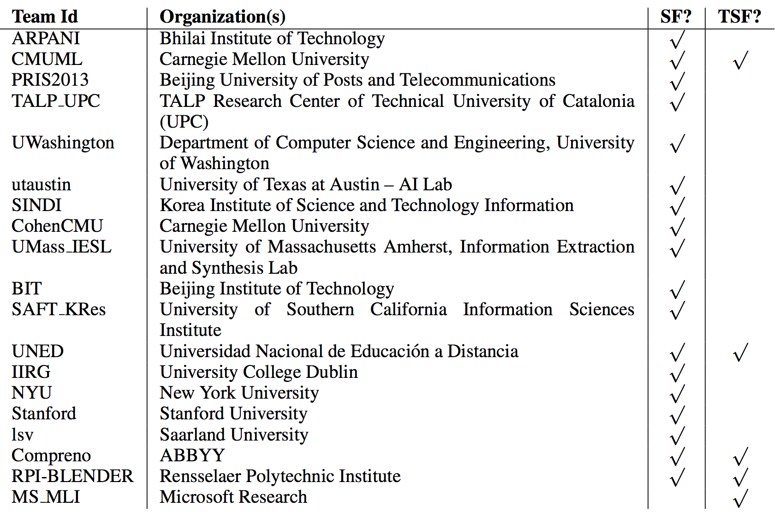
Participants

Slide 13
Participation Summary
 | Teams | Submissions
2011 | 4 | 7
2013 | 5 | 16

Slide 14
results

Slide 15
Data
273 queries
Only 201 were actually scored
5 dropped because neither LDC nor systems found correct fillers
67 dropped because gold annotations had an invalid temporal interval
Valid interval: T1 ≤ T2, T3 ≤ T4, and T1 ≤ T4

Slide 16
Scoring and Baseline
Justification ignored (for now) in scoring
DCT-WITHIN baseline of Ji et al. (2011)
Assumption: the relation is valid at the doc date
Tuple: <-∞, doc date, doc date, +∞>

Slide 17
Results
org:top_members_employees
per:stateorprovinces_of_residence
per:countries_of_residence
per:cities_of_residence
per:employee_or_member_of
per:spouse
per:title

Slide 18
Results
org:top_members_employees
per:stateorprovinces_of_residence
per:countries_of_residence
per:cities_of_residence
per:employee_or_member_of
per:spouse
per:title
2/5 systems outperformed the baseline
3/4 did in 2011

Slide 19
Results
org:top_members_employees
per:stateorprovinces_of_residence
per:countries_of_residence
per:cities_of_residence
per:employee_or_member_of
per:spouse
per:title
Perspective:
Top system is at 48% of human performance

Slide 20
Results
org:top_members_employees
per:stateorprovinces_of_residence
per:countries_of_residence
per:cities_of_residence
per:employee_or_member_of
per:spouse
per:title
Locations of residence tend to perform worse than average

Slide 21
Results
org:top_members_employees
per:stateorprovinces_of_residence
per:countries_of_residence
per:cities_of_residence
per:employee_or_member_of
per:spouse
per:title
Employment relations tend to perform better than average

Slide 22
Technology
Most groups used distant supervision (DS) to assign labels to <entity, filler, date> tuples
Training data:
Freebase (structured) – RPI, UNED
Wikipedia infoboxes (semi-structured) – Microsoft
Labels: Start, End, In, Start-And-End
Ensemble models for DS (RPI)
Explicit features + tree kernels

Slide 23
Technology
Language model to clean up DS noise (Microsoft)
Learns that n-grams such as “FILLER and ENTITY were married” are indicative of per:spouse
These n-grams then used in a boosted decision tree classifier, which identifies noisy tuples

Slide 24
Conclusions
Slight increase in participation
On average, performance worse than in 2011
2/5 systems outperformed the baseline vs. 3/4
New and complex task!
Notable contributions
Noise reduction for TSF
Ensemble models for TSF

