Slide 1
Filtering without Sympathy
Dian Yu and Heng Ji
{yud2,,jih}@rpi.edu

Slide 2
Multi-dimensional Slot Filling Validation Filtering
Source
System
s₁
user
t₃
discussion forum
s₂
t₄
run
s₃
t₅
news
s₄
s₅
t₂
t₁
web document
r₂
r₄
r₃
r₁
r₅
Response
<Claim, Evidence>

Slide 3
Linguistic Constraints to Verify Claims
Covert each claim to knowledge graphs by IE and dependency parsing (Yu et al., 2014)
Node Constraints
  Surface: stop words, lowercased
  Entity type, subtype and mention type
  Entity attributes mined by the NELL system (Carlson et al., 2010)
Path Constraints
  Trigger phrases
  Relations and events:
  Path length:

Slide 4

Linguistic Indicators:
Knowledge Graph Construction
{NUM }
【Per:age】
{PER.Individual, NAM, Billy Mays}
【Query】
50
Mays
amod
nsubj
{Death-Trigger}
aux
died
Tampa
prep_in
located_in
had
sleep
prep_at
nn
home
poss
{FAC.Building-Grounds.NOM}
prep_of
poss
his
June,28
{PER.Individual.PRO, Mays}
Notes:
Mays, 50, died in his sleep at his tampa home the morning of june 28. dependency type

Slide 5
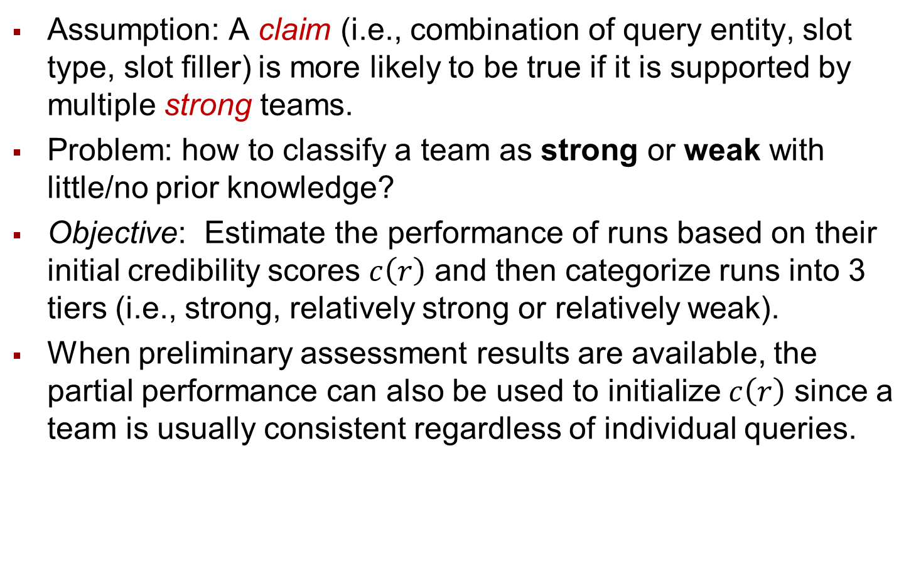
Tier Classification
Assumption: A claim (i.e., combination of query entity, slot type, slot filler) is more likely to be true if it is supported by multiple strong teams.
Problem: how to classify a team as strong or weak with little/no prior knowledge?
Objective: Estimate the performance of runs based on their initial credibility scores $c\left(r\right)$ and then categorize runs into 3 tiers (i.e., strong, relatively strong or relatively weak).
When preliminary assessment results are available, the partial performance can also be used to initialize $c\left(r\right)$ since a team is usually consistent regardless of individual queries.

Slide 6
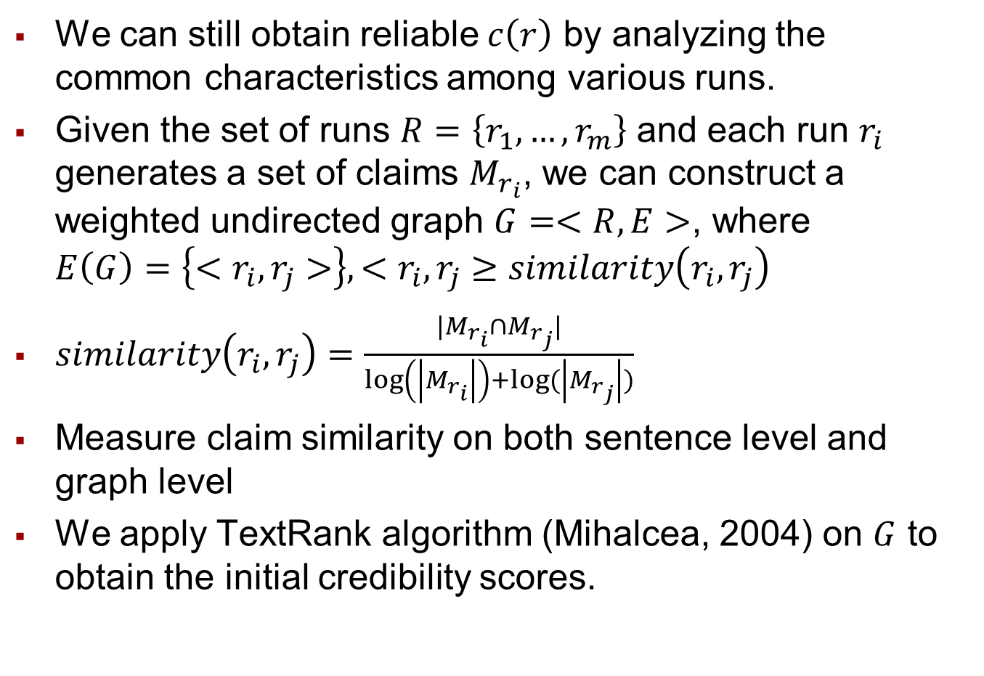
Initialization with No Prior knowledge
We can still obtain reliable $c\left(r\right)$ by analyzing the common characteristics among various runs.
Given the set of runs $R=\left\{r_{1},…,r_{m}\right\}$ and each run $r_{i}$ generates a set of claims $M_{r_{i}}$, we can construct a weighted undirected graph $G=<R,E>$, where $E\left(G\right)=\left\{<r_{i}, r_{j}>\right\}, <r_{i}, r_{j}≥similarity\left(r_{i}, r_{j}\right)$
$similarity\left(r_{i}, r_{j}\right)=\frac{|M_{r_{i}}∩M_{r_{j}}|}{\log\left(\left|M_{r_{i}}\right|\right)+log⁡(\left|M_{r_{j}}\right|)}$
Measure claim similarity on both sentence level and graph level
We apply TextRank algorithm (Mihalcea, 2004) on $G$ to obtain the initial credibility scores.

Slide 7
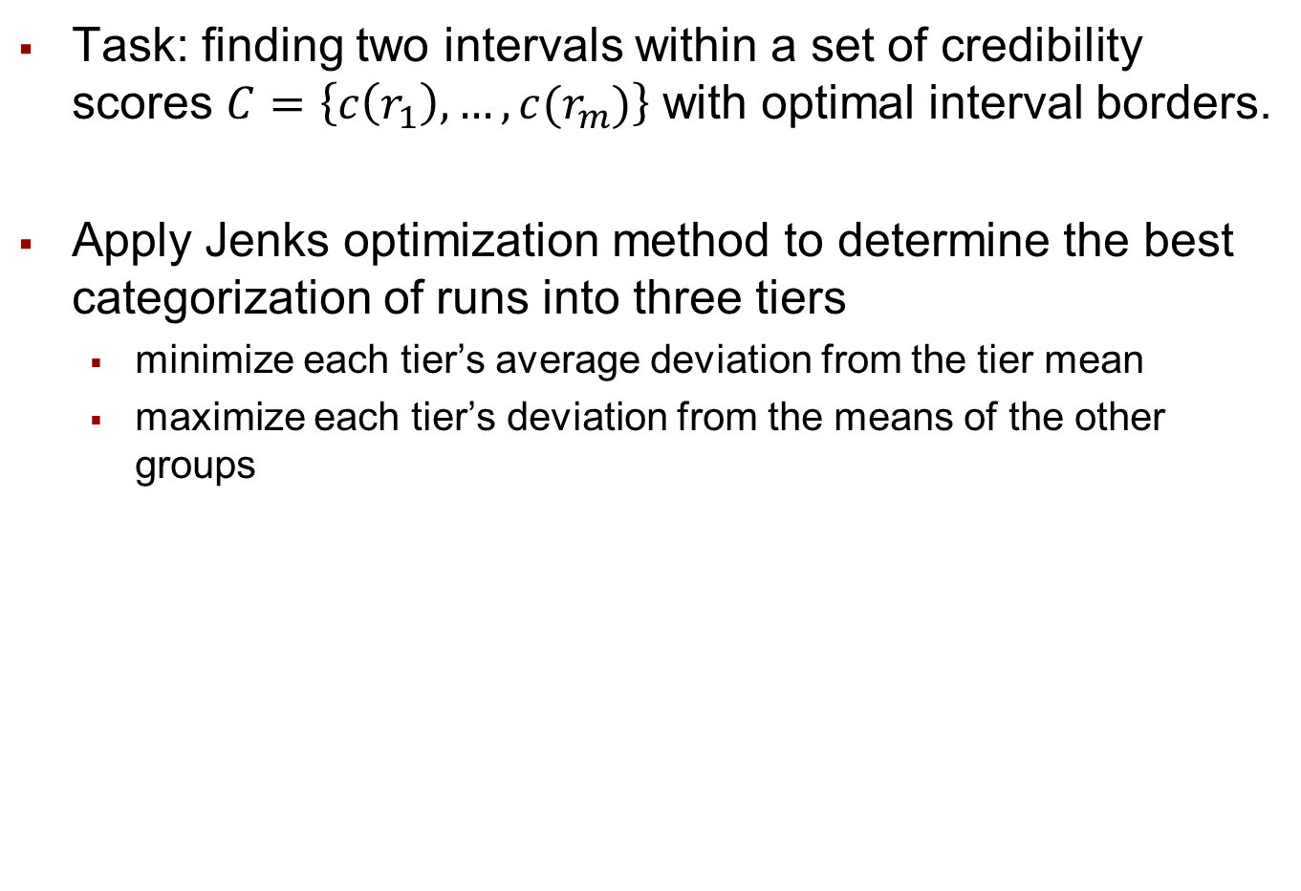
Tier Classification
Task: finding two intervals within a set of credibility scores $C=\left\{c\left(r_{1}\right),…,c(r_{m})\right\}$ with optimal interval borders.
Apply Jenks optimization method to determine the best categorization of runs into three tiers
  minimize each tier’s average deviation from the tier mean
  maximize each tier’s deviation from the means of the other groups

Slide 8
Tier-specific Voting
Keep
Discard because it contributes less than 3% correct claims
Keep once it satisfies slot-specific trigger and type constraints (Yu et al., 2015)
Notes:
We divided responses into 6 fields.
$A_{i_{1}}$: responses submitted by at least two teams in $T_{i}$
$A_{i_{2}}$: responses submitted by only one team in $T_{i}$
We keep all the responses which are
supported by multiple strong or relatively
strong teams ${[A}_{11}, A_{21}, A_{12}∩A_{22}]$
We discard $A_{32}$ which only contributes
less than$3\%$ correct claims.
A response in the remaining fields
will be kept once it satisfies slot-specific
trigger and type constraints (Yu et al., 2015).

Slide 9
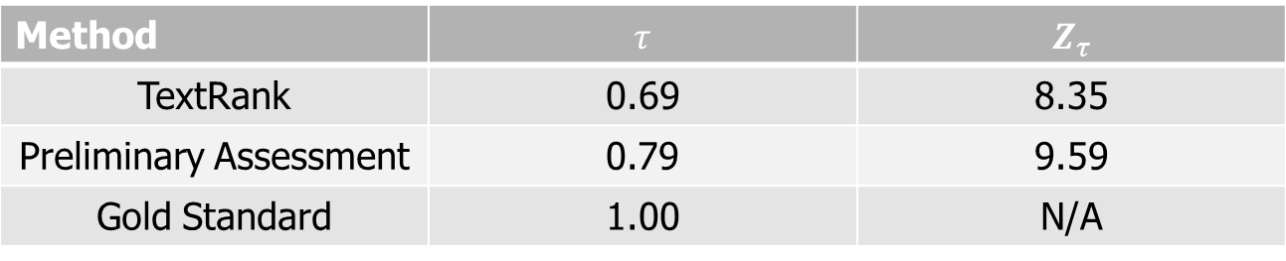
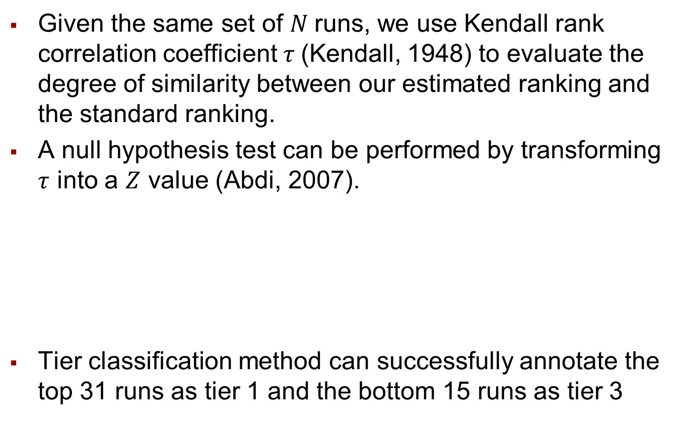
Evaluation
Given the same set of $N$runs, we use Kendall rank correlation coefficient $τ$(Kendall, 1948) to evaluate the degree of similarity between our estimated ranking and the standard ranking.
A null hypothesis test can be performed by transforming $τ$ into a $Z$ value (Abdi, 2007).
Tier classification method can successfully annotate the top 31 runs as tier 1 and the bottom 15 runs as tier 3
Method | $$τ$$ | $$Z_{τ}$$
TextRank | 0.69 | 8.35
Preliminary Assessment | 0.79 | 9.59
Gold Standard | 1.00 | N/A

Slide 10
Evaluation
Our method can improve almost all top CSSF systems considering both hops (CSLDC level).
Boost the best F-score to 36.8%

Slide 11
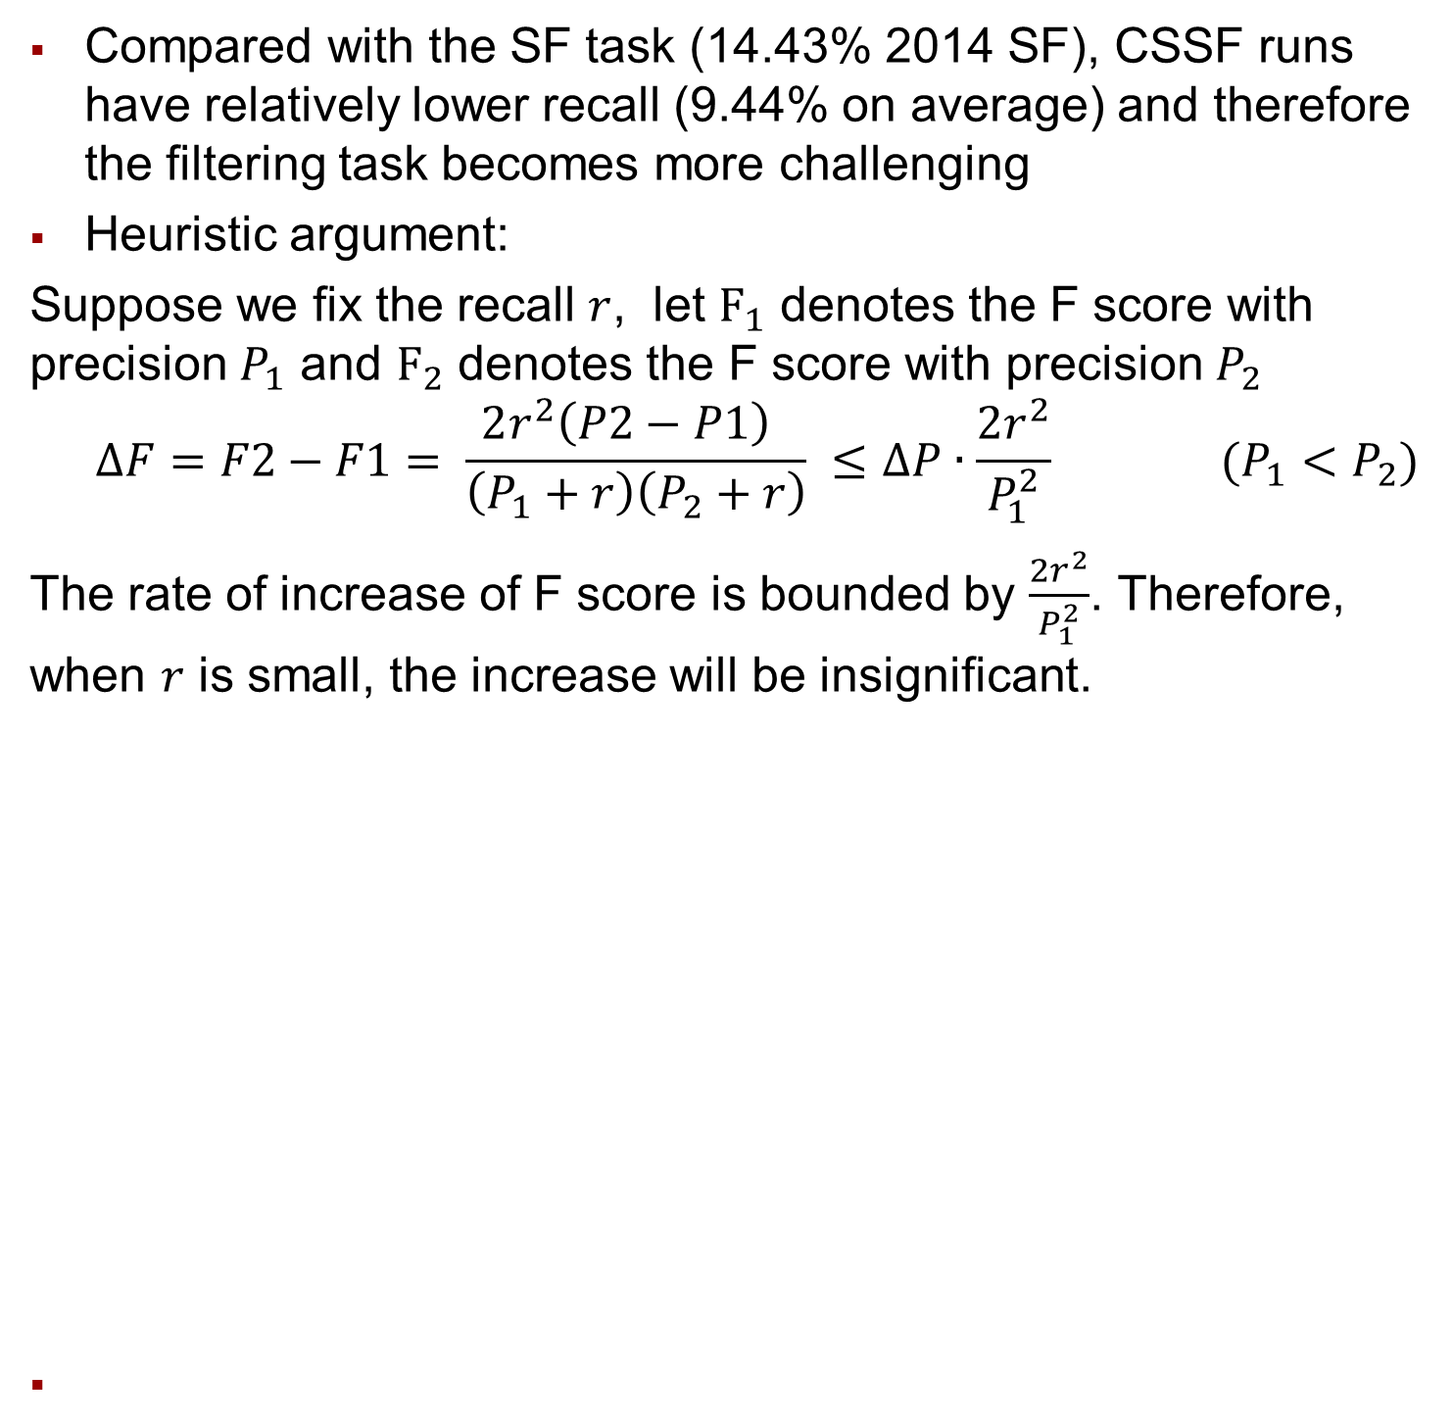
But We Failed to Improve Weak Teams
Compared with the SF task (14.43% 2014 SF), CSSF runs have relatively lower recall (9.44% on average) and therefore the filtering task becomes more challenging
Heuristic argument:
Suppose we fix the recall $r$, let $F_{1}$ denotes the F score with precision $P_{1}$ and $F_{2}$ denotes the F score with precision $P_{2}$
$$∆F=F2−F1= \frac{2r^{2}\left(P2−P1\right) }{\left(P_{1}+r\right)\left(P_{2}+r\right)} ≤∆P∙\frac{2r^{2}}{P_{1}^{2}} (P_{1}<P_{2})$$
The rate of increase of F score is bounded by $\frac{2r^{2}}{P_{1}^{2}}$. Therefore, when $r$ is small, the increase will be insignificant.

Slide 12
Majority Voting also Fails
80% of the true responses are produced only by 1 or 2 of
the 19 CSSF teams (SF13 62%)
Our strategy of discarding all the responses in A32 leads to the failure of filtering for weak runs
Is it possible to develop a universal filter to make everyone happy, before CSSF performance gets more “reasonable”?

Slide 13
CSSF Errors: Name Tagging
Query: Annenberg Foundation
Slot type: org:alternate_names
The Annenberg Foundation based on Walter Anneberg's prominent successes was the creation o patron…
Query: Poland
Slot type: gpe:residents_of_country
k for "boot polish" :P I have no idea why they ask
Query: Poland
Slot type: gpe:residents_of_country
a question for you. Why is Poland mainly a Catholic country instead of a Orthodox country? I mean Germany is right next
Query: Seattle Sounders
Slot type: org:member_of
We always respected them.‘‘ Tonight, the contemporary Rowdies of the new NASL renew a long-dormant grudge with the Seattle Sounders of Major League Soccer

Slide 14
CSSF Errors: Lack of Sufficient Lexical Evidence
Query: Poland
Slot type: gpe:residents_of_country
two gals Kinga and Pasiak.Dem are from poland and guy of name Konrad.Thank
Query: Poland
Slot type: gpe:residents_of_country
this day in 10/13/05 * 1779, Polish nobleman Casimir Pulaski was killed while fighting for American independence during the Revolutionary War Battle of Savannah, Ga. * 1811
Query: Syracuse
Slot type: gpe:births_in_city
Mallory Livingston (red dress), of Syracuse, was one of the speakers that addressed members and supporters of the LGBTQ community during the news conference outside City Hall.
Query: Poland
Slot type: gpe:residents_of_country
Solution in Poland Karl Schleunes' The Twisted Road to Auschwi

Slide 15
CSSF Errors: Filler Constraint
Filler should be a single person.
Query: Poland
Slot type: gpe:residents_of_country
… get - only 5% of Polish Jews survived, and 5% of ethn…
Query: Poland
Slot type: gpe:residents_of_country
PROTESTS While thousands of Polish labor union members
Filler should be an organization.
Query: Timothy F. Geithner
Slot type: per:employee_or_member_of
Timothy F. Geithner will join the private equity firm Warburg Pincus as president
Query!= Filler
Query: Annenberg Foundation
Slot type: org:alternate_names Annenburg Foundation
The Annenburg Foundation is a non-profit charity. Affd a "metaphor". The Annenburg Foundation is a non-profit charity. Aff

Slide 16
CSSF Errors: Within sentence IE
Query: Poland
Slot type: gpe:residents_of_country
Prince-Elector of Saxony and King of Poland, and Maria Josepha of
Query: Traditional Anglican Communion
Slot type: org:country_of_headquarters
The American branch of the largest association of Anglican churches worldwide, the Anglican Communion, is "The Episcopal Church." As noted, it is in jeopardy
Query: Los Angeles
Slot type: gpe:organizations_founded
Spears taken from home in ambulance By KEITH ST. CLAIR, Associated Press Writer 9 minutes ago LOS ANGELES - Britney Spears was taken from
Query: World Bank
Slot type: org:political_religious_affiliation
Representatives of Burundi's main partners, including the United Nations Office in Burundi (BNUB), the World Bank, the European Union (EU), the International Monetary Fund (IMF),
Query: Poland
Slot type: gpe:residents_of_country
Wil Anderson is annoying with his nail polish but Dave Hughes makes that show. He reminds me of Elliott Gob

Slide 17
CSSF/SF Errors: Entity Disambiguation
Query: Traditional Anglican Communion
Slot type: org:country_of_headquarters
Australia d I'll have to have an Aussie Anglican provide the specif
Query: Bain Capital
Slot type: Democrats
Dear idiot, Most of the Bain board are Democrats who support Obama.

