Slide 1
TAC KBP 2019 EDL Track Fine-Grained Name Tagging Data Overview
Jeremy Getman, Jennifer Tracey, Stephanie Strassel, Dave Graff, Alex Shelmire
Linguistic Data Consortium

Slide 2
Data Overview
Catalog ID | Corpus Title | Data
LDC2019E68 | TAC KBP 2019 EDL Track Ultra-Fine-Grained Name Tagging Format Sample | 10 | LTF source docs
 |  | 428 | artificially-generated entity mentions
LDC2019E78 | TAC KBP 2019 EDL Track Fine-Grained Name Tagging Evaluation Annotations | 14,929 | named entity mentions (for 404 docs in LDC2019E79)
LDC2019E79 | TAC KBP 2019 EDL Track Fine-Grained Name Tagging Evaluation Source Corpus | 300,000 | LTF source docs
All data & annotation is monolingual English
LDC2019E79 selected from:
LDC2011T07: English Gigaword Fifth Edition
LDC2017T11: BOLT English Discussion Forums
Selection based around automated tagger output of YAGO types produced over above corpora, provided by University of Illinois Urbana-Champaigne
404 manually annotated docs selected by targeting files containing high counts of the 114 AIDA entity sub-subtypes with a mapping in YAGO
Notes:
Format Sample used YAGO entity types
Eval annotations used AIDA entity sub-subtypes
Full corpus selection followed same approach as the manually annotated subset

Slide 3
Annotation Overview
Exhaustive annotation of all 187 AIDA entity sub-subtypes
vs. 5 types in past EDL annotation
Past EDL Tracks | AIDA Type | AIDA Subtype Count | AIDA Sub-Subtype Count
- | BAL | 3 | 3
- | COM | 5 | 11
- | CRM | 5 | 13
FAC | FAC | 6 | 24
GPE | GPE | 5 | 7
- | LAW | 2 | 2
LOC | LOC | 4 | 11
- | MON | 3 | 3
ORG | ORG | 8 | 28
PER | PER | 8 | 25
- | RES | 3 | 3
- | SID | 6 | 6
- | TTL | 1 | 1
- | VAL | 2 | 2
- | VEH | 6 | 20
- | WEA | 11 | 28

Slide 4
Annotation Overview
Entity sub-subtype definitions follow AIDA guidelines exactly
Named mentions only
proper name, abbreviation, nickname, alias, acronym, or other alternate name
One type per mention
i.e. no double-tagging
No nested mentions
[University of [Minnesota]_{GPE}]_{ORG}
Edge cases and tagging for meaning
[South Korea] beat [Japan] in the World Cup semifinals
ORG.Association.Team (not GPE.Country.Country)
the [greens]ORG are pushing for a more stringent climate policy
most likely being used as shorthand version of “the Green Party” (ORG)
No KB linking, no NIL clustering

Slide 5
Annotation Training & QC
English annotation team comprised of senior annotators
Former TAC KBP EDL annotators
Have worked extensively on named entity annotation
Current AIDA annotators
Thoroughly trained on the AIDA entity ontology
Corpus-wide QC
Review identical annotated text strings assigned different types
And unannotated text strings identical to annotated strings
Correct or confirm outliers
Some are fine as is (e.g. same PER can have multiple sub-subtypes)
===========================================================================================
the | House of Representatives | passed a bill on | org.government.legislativebody
Senate and | House of Representatives | have said they | org.government.legislativebody
the state | House of Representatives | chamber five years | org.government.legislativebody
controlled | House of Representatives | was a victory for | org.government.legislativebody
in the | House of Representatives | in the last eight | org.association.unspecified
===========================================================================================

Slide 6
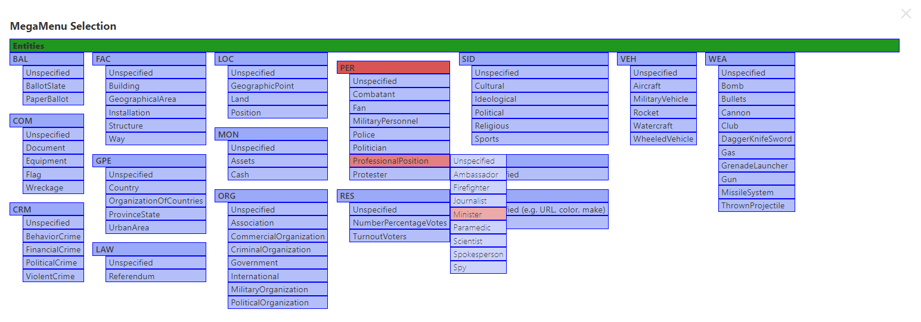
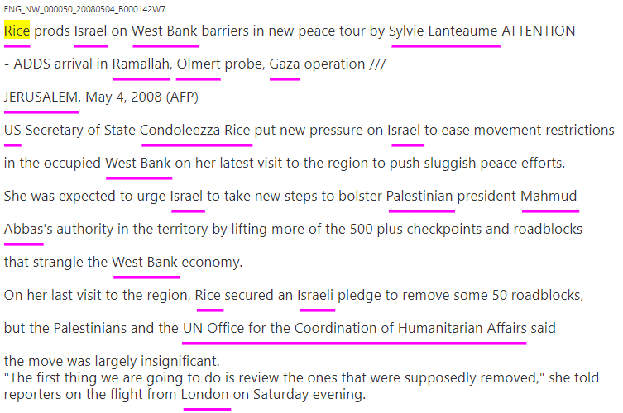
Annotation Walkthrough
mention1
Rice
Mention Type
Mention Subtype
Mention SubSubType
Notes:
Underlined spans are names that have been identified
Need to provide a subsubtype for each
Clicking “select type” button opens up the Entity MegaMenu
Hovering over a subtype opens a sub-subtype menu
For “Rice” we’ll select Per.ProfessionalPosition.Minister

Slide 7
Annotation Walkthrough
mention1
Rice
Mention Type
PER
Mention Subtype
ProfessionalPosition
Mention SubSubType
Minister
Notes:
and voila
…select a sub-subtype for every name in doc

Slide 8
Annotation Results
101 (sub-sub)types were annotated at least once
In 404 documents
So, 86 (sub-sub)types not annotated
No named mentions of any sub-subtype of:
BAL, CRM, MON, RES, TTL, or WEA
top-level type | mention count
com | 5
fac | 317
gpe | 6015
law | 33
loc | 701
org | 3256
per | 4523
sid | 58
val | 2
veh | 19
Notes:
the no sub-subtypes annotated list (BAL, CRM, etc): not surprising, except weapon?
table: breakdown of top-level types of all mentions

Slide 9
Annotation Results
type |  | sub-subtype
com | 5 | 4 | com
 |  | 1 | com.document
fac | 317 | 21 | fac
 |  | 107 | fac.building
 |  | 1 | fac.building.apartmentbuilding
 |  | 10 | fac.building.governmentbuilding
 |  | 5 | fac.building.house
 |  | 3 | fac.building.officebuilding
 |  | 14 | fac.building.school
 |  | 13 | fac.building.storeshop
 |  | 6 | fac.geographicalarea
 |  | 1 | fac.geographicalarea.border
 |  | 20 | fac.installation
 |  | 28 | fac.installation.airport
 |  | 18 | fac.installation.militaryinstallation
 |  | 3 | fac.installation.trainstation
 |  | 33 | fac.structure
 |  | 4 | fac.structure.bridge
 |  | 6 | fac.structure.plaza
 |  | 1 | fac.way
 |  | 2 | fac.way.highway
 |  | 21 | fac.way.street
Notes:
For reference, a breakdown of counts of mentions by type and sub-subtype
“sub-subtype” includes mentions that were only given type, e.g. PER, or subtype, e.g. PER.Politician

Slide 10
Annotation Results
type |  | sub-subtype
gpe | 6015 | 87 | gpe
 |  | 3609 | gpe.country.country
 |  | 301 | gpe.organizationofcountries.organizationofcountries
 |  | 402 | gpe.provincestate.provincestate
 |  | 60 | gpe.urbanarea
 |  | 1513 | gpe.urbanarea.city
 |  | 43 | gpe.urbanarea.village
law | 33 | 33 | law
loc | 701 | 53 | loc
 |  | 6 | loc.geographicpoint
 |  | 2 | loc.geographicpoint.address
 |  | 209 | loc.land
 |  | 152 | loc.land.continent
 |  | 24 | loc.position
 |  | 1 | loc.position.field
 |  | 49 | loc.position.neighborhood
 |  | 205 | loc.position.region
Notes:
For reference, a breakdown of counts of mentions by type and sub-subtype
“sub-subtype” includes mentions that were only given type, e.g. PER, or subtype, e.g. PER.Politician

Slide 11
Annotation Results
type |  | sub-subtype
org | 3256 | 181 | org
 |  | 163 | org.association
 |  | 21 | org.association.club
 |  | 790 | org.association.team
 |  | 113 | org.commercialorganization
 |  | 99 | org.commercialorganization.broadcastingcompany
 |  | 341 | org.commercialorganization.corporation
 |  | 72 | org.commercialorganization.manufacturer
 |  | 136 | org.commercialorganization.newsagency
 |  | 13 | org.criminalorganization.criminalorganization
 |  | 140 | org.government
 |  | 168 | org.government.agency
 |  | 18 | org.government.council
 |  | 5 | org.government.firedepartment
 |  | 51 | org.government.lawenforcementagency
 |  | 121 | org.government.legislativebody
 |  | 2 | org.government.prosecutoroffice
 |  | 8 | org.government.railway
 |  | 173 | org.international
 |  | 25 | org.international.commission
 |  | 9 | org.international.monitoringgroup
 |  | 14 | org.militaryorganization
 |  | 73 | org.militaryorganization.governmentarmedforces
 |  | 32 | org.militaryorganization.intelligence
 |  | 163 | org.militaryorganization.nongovernmentmilitia
 |  | 12 | org.politicalorganization
 |  | 29 | org.politicalorganization.court
 |  | 284 | org.politicalorganization.party
Notes:
For reference, a breakdown of counts of mentions by type and sub-subtype
“sub-subtype” includes mentions that were only given type, e.g. PER, or subtype, e.g. PER.Politician

Slide 12
Annotation Results
type |  | sub-subtype
per | 4523 | 563 | per
 |  | 14 | per.combatant
 |  | 2 | per.fan
 |  | 31 | per.militarypersonnel
 |  | 98 | per.militarypersonnel.militaryofficer
 |  | 10 | per.police
 |  | 24 | per.police.chiefofpolice
 |  | 616 | per.politician
 |  | 29 | per.politician.governor
 |  | 823 | per.politician.headofgovernment
 |  | 15 | per.politician.mayor
 |  | 1785 | per.professionalposition
 |  | 27 | per.professionalposition.ambassador
 |  | 3 | per.professionalposition.firefighter
 |  | 138 | per.professionalposition.journalist
 |  | 135 | per.professionalposition.minister
 |  | 3 | per.professionalposition.paramedic
 |  | 45 | per.professionalposition.scientist
 |  | 134 | per.professionalposition.spokesperson
 |  | 3 | per.professionalposition.spy
 |  | 23 | per.protester
 |  | 2 | per.protester.protestleader
Notes:
For reference, a breakdown of counts of mentions by type and sub-subtype
“sub-subtype” includes mentions that were only given type, e.g. PER, or subtype, e.g. PER.Politician

Slide 13
Annotation Results
type |  | sub-subtype
sid | 58 | 14 | sid.cultural.cultural
 |  | 11 | sid.ideological.ideological
 |  | 2 | sid.political.opposition
 |  | 31 | sid.religious.religious
val | 2 | 2 | val
veh | 19 | 3 | veh.aircraft.airplane
 |  | 1 | veh.aircraft.helicopter
 |  | 1 | veh.militaryvehicle
 |  | 3 | veh.militaryvehicle.militaryboat
 |  | 6 | veh.rocket.rocket
 |  | 1 | veh.watercraft
 |  | 4 | veh.watercraft.boat
Notes:
For reference, a breakdown of counts of mentions by type and sub-subtype
“sub-subtype” includes mentions that were only given type, e.g. PER, or subtype, e.g. PER.Politician

