Slide 1
HypoGator: Hypotheses Generation and Ranking over Event-Driven Multimedia Knowledge Graph
Yang Bai, Miguel Rodriguez, Yifan Wang, Ali Sadeghian and Daisy Zhe Wang
UF-GAIA TA3 • 2019

Slide 2
Introduction
Task Definition
Old Pipeline Architecture
Challenges
New Pipeline Architecture
Progress
Query Decomposition
Hypotheses Composition
Hypothesis Enrichment
New Visualization Tool
Overview

Slide 3
Task definition
Given :
A knowledge graph representation of a set of web documents
A statement of information need (query)
Generate a set of hypotheses such that each hypothesis is consistent, coherent and is associated with confidence and coherence scores that are used for ranking.

Slide 4
HypoGator System Architecture(M9)
Query-Processor
Information need
String/offset Similarity Entry Point Extraction
Candidate Hypothesis Gen.
Inconsistency feature
Coherence feature
Local Graph Expansion
A* Algorithm
Hierarchical Logical Inconsistency Detection
Query Relevance
Edge Intensity
Entity Correlation
TA2 KB
Hypothesis Clustering
Confidence Computation
AIDA Hypothesis
String/offset Similarity
Score calculation
Ensemble

Slide 5
A* Algorithm
The core hypothesis generation algorithm(A*) used in the HypoGator is based on local graph expansion.
It generates connected hypothesis graph by visiting paths starting from an entry point.
A simple information need can be answered with a path, all of the explicit elements may be visited by walking paths starting from the entry point(s).

Slide 6
Challenges
Complex Queries

Slide 7
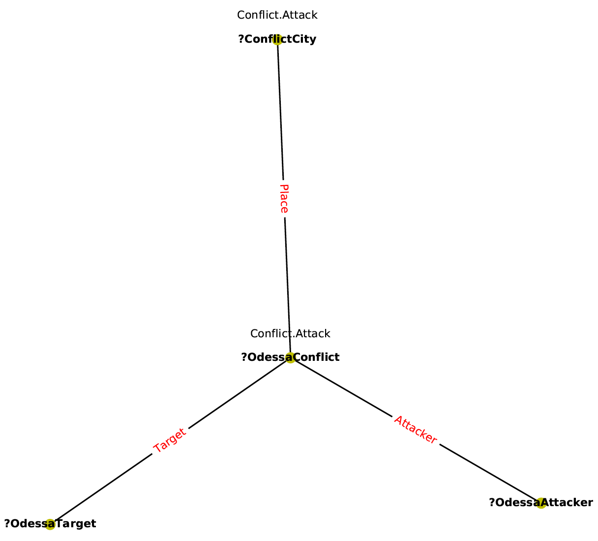
Simple Query
Odessa City
Query Graph: A statement of information need is a subgraph pattern with event/relation types and entities as nodes, event/relation argument roles as edges and a set of grounded entities known as entry points.
Simple Query: if each entry point is used as the argument of only one event/relation.
Entry Point
Who is the attacker of the violence in Odessa and who/what is the target?

Slide 8
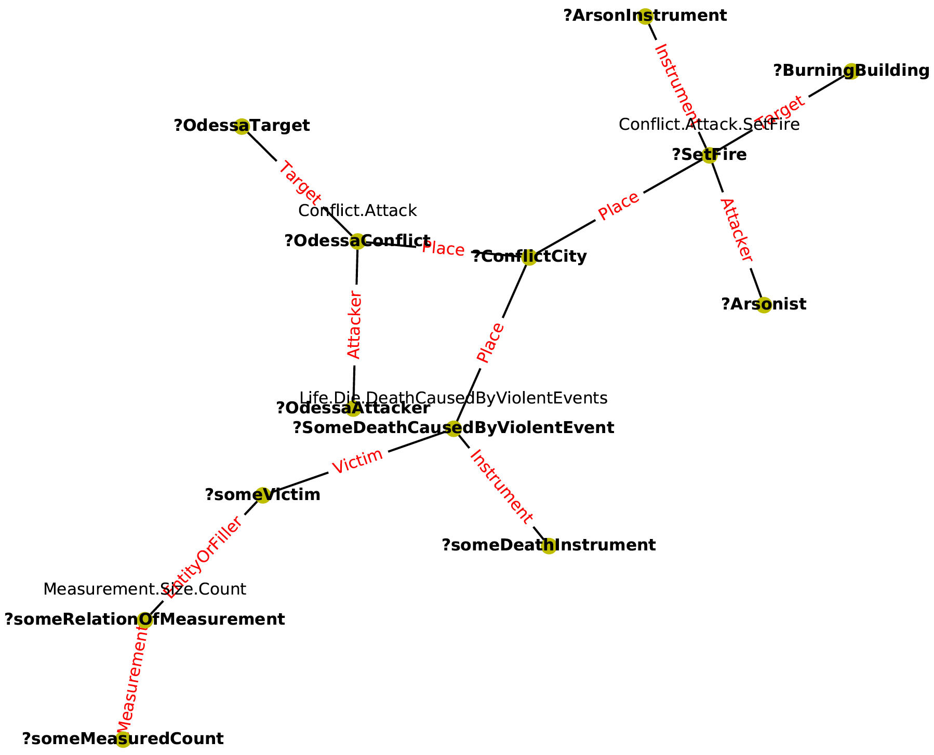
Complex Query
Complex Query: if an information need has entry points that are shared by multiple events/relations developing into a star-like structure.
Entry Point

Slide 9
Challenges
Complex Queries
Structure: Simple → Complex
Size: much larger.
The vanilla A* algorithm is not capable of answering star-schema queries.
Large query harms search efficiency and recall of the hypothesis.
Lack of Coherent Context
Only core elements are found.
Simply increase the size of the hypothesis by including more hops of neighbors is expensive and inaccurate.

Slide 10
HypoGator System Architecture(M18)
Query-Processor
Entry Point Extraction
Query decomposition
Information need
Old pipeline
Candidate Hypothesis Generator
Coherence feature extraction
Ranking and Selection
Local Graph Expansion
A* Algorithm
Query Relevance
Edge Intensity
Entity Correlation
Candidate Hypothesis Scoring
Document-based sampling
Deduplication
TA2 KB
Hypothesis Enrichment
Hypothesis Clustering
Hypothesis Composition
AIDA Hypothesis
Subgraph expansion
with contextual relations
Subgraph Similarity
Graph Embedding
Join-Score-Rank

Slide 11
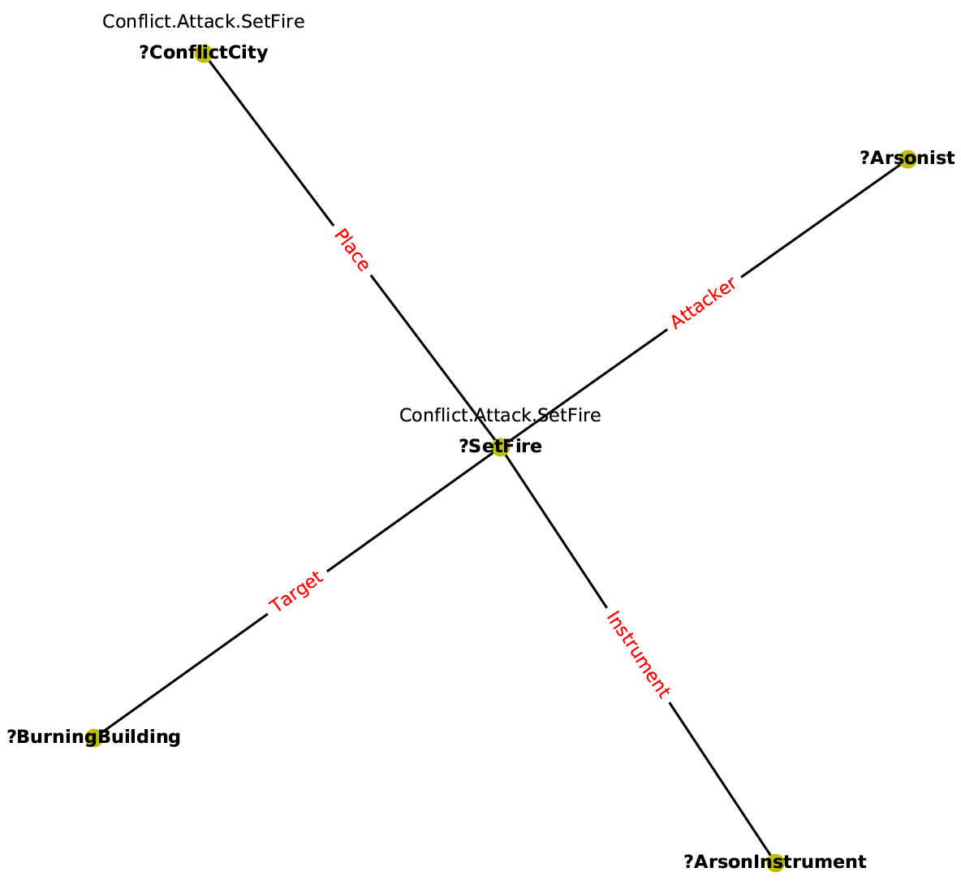
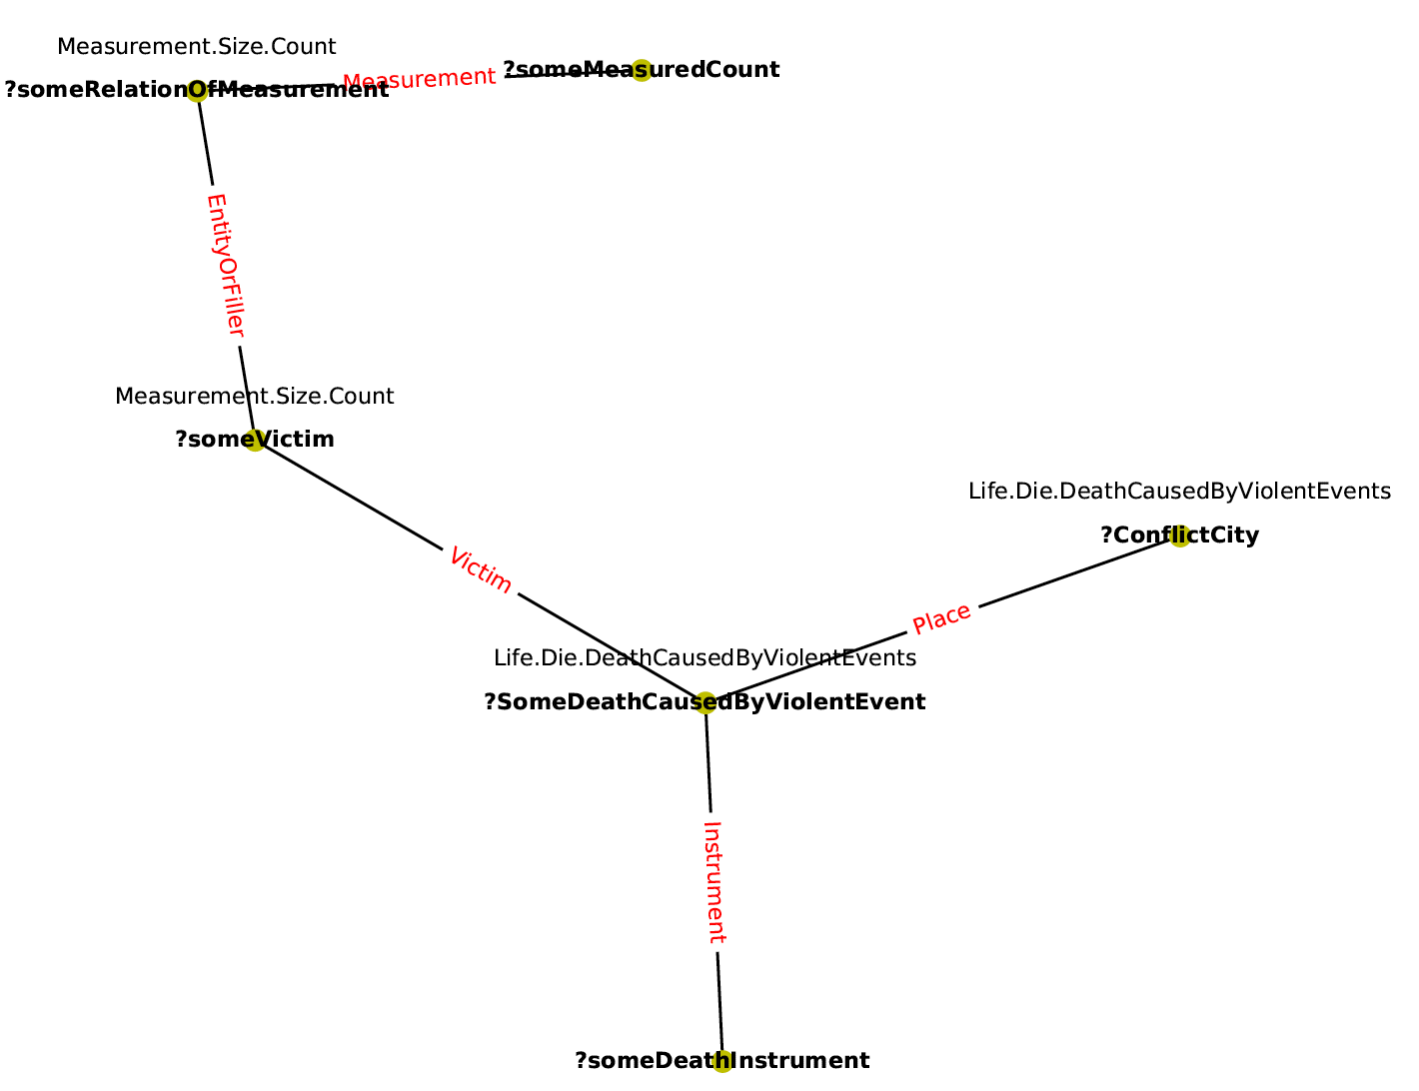
Example: Query Decomposition
2. Who started the fire in the Trade Union Building in Odessa and what is the instrument?
Entry Point
1. Who is the attacker of the violence in Odessa and who/what is the target?
3. How many victims were killed in the violence happened in Odessa?

Slide 12
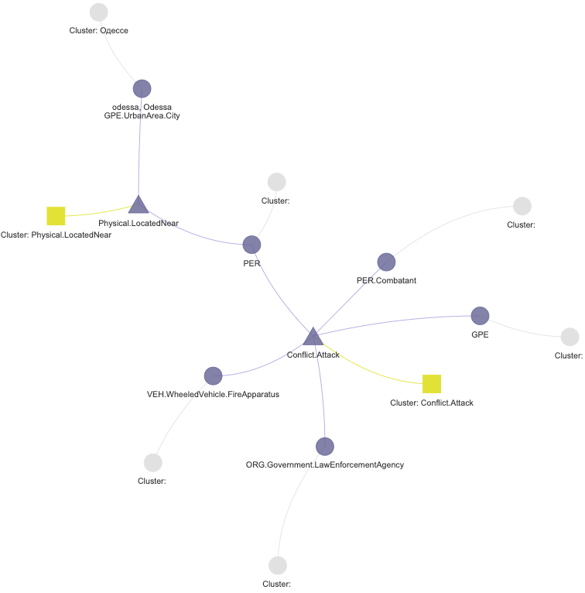
Example: Atomic Hypothesis
Vanilla A*
Ranking and Clustering
20
…
Atomic-Query-1:
Who is the attacker of the violence in Odessa and who/what is the target?
1
2
Atomic-Hypothesis-1: LawEnforcementAgency(police) attacked Combatant(separatists) using FireApparatus at Odessa.

Slide 13
Hypotheses Composition
Query
subqueries
Rank & Clustering
Atomic-hypothesis
Candidates
Score joined hypotheses and take top k
Cross join atomic-hypotheses between each atomic-queries.
Hypotheses Clustering

Slide 14
Example: Hypothesis Composition
Building
Odessa

Slide 15
Hypothesis Enrichment
Hypothesis generated by A* algorithm highly matches the core query elements(specific edges and entry points) but lacks of context to the answer.
Simply increase the size of the hypothesis by including more hops of neighbors is expensive and inaccurate.
Strategy:
We generate hypotheses with relative short paths first.
Then we extend the graph only from the nodes that we are interested.
And only include in the relevant neighbors that we defined at the beginning.

Slide 16
Example: Hypotheses Context Enrichment
Core Hypo:
Victim
Context:
Killer
PlaceOfEmployment
Employee
Context

Slide 17
Demo: Interactive Hypothesis Visualization with Narratives

Slide 18
Thank You!
Questions?

