Slide 1
SM-KBP Data Overview
Jennifer Tracey, Jeremy Getman,
Stephanie Strassel, Ann Bies, Kira Griffitt,
Justin Mott, Alex Shelmire, Dave Graff, Chris Caruso, Jon Wright, Brian Gainor
Linguistic Data Consortium

Slide 2
Introduction
Linguistic Data Consortium provides data resources for SM-KBP/AIDA, including labeled corpora and assessment
Ukraine-Russia Relations Scenario
  3 “practice” and 3 test topics
    Same topics as 2018 evaluation
  Multimedia data in 3 languages: English, Ukrainian, Russian
    ~10K docs distributed for practice topics and non-eval “background” data
    ~2K documents in this year’s evaluation set (subset of 10K from 2018)
  Subset of scenario-relevant documents annotated for each topic
    233 annotated documents for practice topics
    224 annotated documents for evaluation topics
    20 “tracer” documents (subset of eval) annotated exhaustively for salient mentions of knowledge elements
Notes:
Define SALIENT

Slide 3
Source Data Overview
Multiple methods of identifying suitable data sources
  Manual data scouting for topic-relevant URLs
  Automatic keyword- and site-based collection for background
For each root URL, extract and process content (text, image, video, etc.) into individual files
  ltf.xml = text
  psm.xml = structural markup
  *.ldcc = wrapped media files
Parent_children.tab file provided information about how media and text elements form a full root document
  LDC annotation always performed on full root document
Notes:
Note: psm.xml contains variable information about structure depending on what our off-the-shelf process was able to obtain

Slide 4
Data Pipeline Overview
Updated topic model to guide annotation
Build source data corpus
Annotate salient knowledge elements (KEs) base mentions
Annotate additional mentions of salient KEs
Link KEs to KB, perform cross-document coreference for NILs
Assess system output for each task
Title, description, summary of expected info conflict
Natural language queries
Natural language prevailing theories with matrix of expected KEs
Select subset of 2018 data
Update documentation for uniformity
Notes:
Prevailing theories are part of topic development, but are developed later in the process, in parallel with annotation

Slide 5
Topic Development: Queries
Queries express information needs related to informational conflict for the topic
Queries are used to inform questions of knowledge element salience
Reformulated 2018 queries for 2019
  Reduce number of “why” queries
  Break other complex queries into multiple atomic queries
    Answers typically comprise one relation or event argument role/slot
  Where possible, add new queries to capture additional aspects of informational conflict
Queries shared with NIST to inform Statements of Information Need

Slide 6
Topic Development:
Prevailing Theories
Prevailing theories describe expectations about what will very likely appear in corpus
  Informed by MITRE’s Scenario Document
  Informed by 2018 seedling annotation/KEs
  NOT informed by exhaustive annotation
Prevailing Theories include a natural language description and a structured list of KEs required to fully support this theory
Shared with NIST to inform TA1 and TA2 queries and TA3 Statements of Information Need

Slide 7
Prevailing Theory Strategy
Use information drawn from MITRE’s Scenario Document, including URLs
Be responsive to (more than) one query for the topic
Represent a coherent sub-part of the larger topic narrative
  KEs in each theory have some understandable connection to each other
Cover a range of the theories present for each topic, but not complete coverage
Include only information/conflict covered by annotation categories
Well represented in the KB to the extent possible
Range of theory “sizes” for each topic, to the extent possible
  Some with only a short list of KEs, some with a very long list of KEs required

Slide 8
R103 PTs
R103: Who Started the Shooting at Maidan? (February 2014)
  R103_PT001: Members of Ukraine's new coalition government, which includes the Ukrainian-nationalist Svoboda party, sponsored snipers who fired on protesters and police alike, including some members of the Berkut riot police, in February 2014 in protests taking place in Kiev's Independence Square (aka Maidan), killing 21 people.
  R103_PT002: Provocateurs hired by Russia carried out the shootings that took place during the protests in February 2014 in Kiev's Independence Square (aka Maidan).
  R103_PT003: The CIA, a US foreign intelligence service, sponsored snipers who fired on police (including some members of the Berkut riot police) and protesters alike in February 2014 in protests taking place in Kiev's Independence Square (aka Maidan).
  R103_PT004: On February 20, 2014, a member of the Maidan protest movement, identified only as "Sergei," fired at police (including some members of the Berkut riot police) and protesters alike from a position in the Kiev Conservatory building in Kiev's Independence Square (aka Maidan), using a Saiga hunting rifle that he had stored in the post office overnight.
  R103_PT005: Snipers affiliated with Ukraine's Berkut riot police, under the direction of Aleksandr Yakimenko (who was at the time head of Ukraine's SBU intelligence service) and in collaboration with Russia's intelligence service the FSB, killed at least 53 anti-government activists protesting in Kiev's Independence Square (aka Maidan) on February 20 2014, using AK-47s and sniper rifles.
conflict attack firearmattack
Notes:
Each prevailing theory starts as a prose description of one “account” of topic-relevant events, based on MITRE scenario doc, expected informational conflict, and reading of source data. Once prose version is finalized, KE matrix is constructed using the expected information – a translation of the prose theory into the set of taggable events and relations that comprise it (not important to be able to read the table of KEs on this slide, each blue/white grouping represents an event or relation and its args, included expected type information, KB links, temporal info, etc.)
Walkthrough – how does the prose theory result in the KE matrix?
--identify events and relations of taggable types in the prose description (for example the underlined portions of the theory discuss the shooting of protesters in Maidan, so this will be our first KE for the matrix.
--this is an event of the conflict.attack.firearmattack type, so it has arg slots for attacker, target, instrument, and place, all of which are mentioned in the theory and can be filled in
--once the args are filled in, we can assign types to those as well
--once args and event are in place, determine whether args appear in the KB and note their KB IDs or assign a NIL value

Slide 9
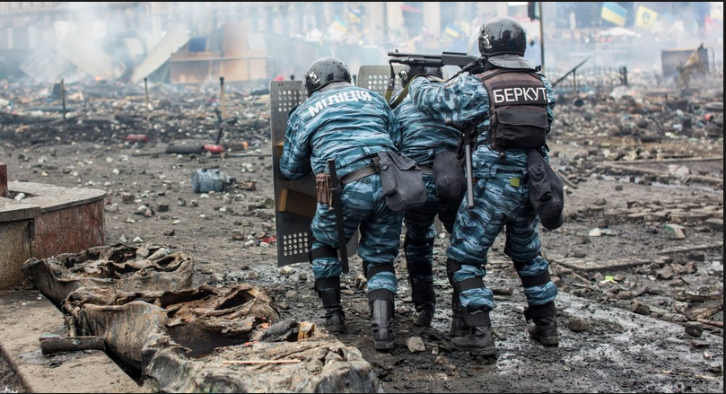
Illustration of Annotation Pipeline
According to Ukraine's security chiefs today members of the riot police shot 17 protesters in Kiev, gunned down while agitating for the ouster of then-President Viktor Yanukovych. Ukraine's new authorities have pointed the finger at members of the country's disbanded "Berkut" riot police.
Base mentions
Conflict.Attack.FirearmAttack Event
Agent: members of the riot police
…
Quality control review
Informative mentions
Agent: members of the country’s disbanded “Berkut” riot police
…
Quality control review
Granular media provenance
Quality control review
KB linking & NIL clustering
Agent: members of the riot police
KB ID 8822058
Agent: members of the country’s disbanded “Berkut” riot police

Slide 10
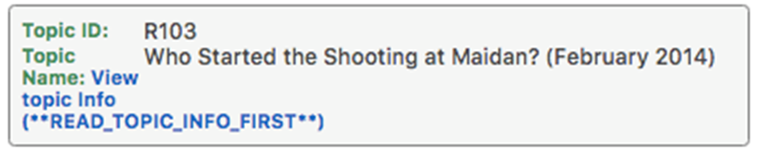
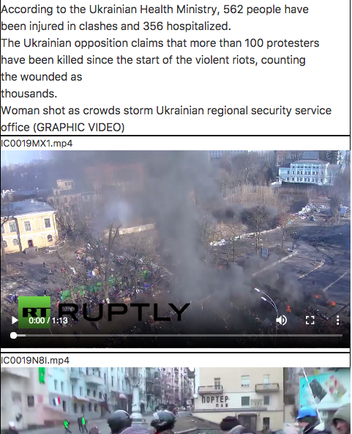
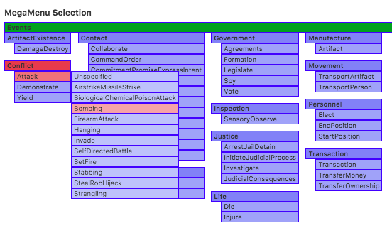
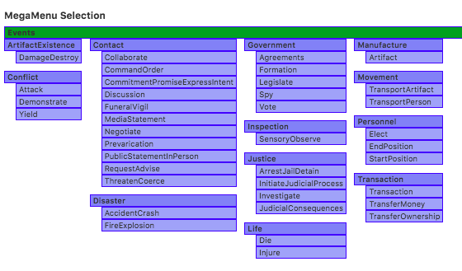
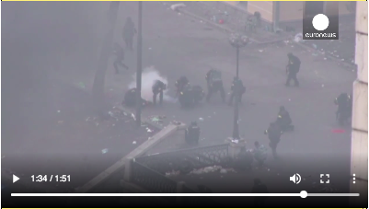
Stage 1: Label Base Mention KEs
Event mention
Trigger:
Attributes:
NOT HEDGED
Type.Subtype.Sub-Subtype:
Conflict.Attack.Bombing
Start date: End date:
2014-02-20 unknown
Notes:
-Annotation of salient mentions, one source doc at a time
-Salient means providing information about a part of one of the topic’s queries
-Doesn’t need to directly answer a query, just speak to some part of it
-Annotate each event or relation that provides information to any part of a query
-One event/relation mention per doc element
-In Seedling video was annotated as single doc element
-For re-annotation we annotate picture track and audio track
-Mark trigger (event/relation provenance)
-For video, select start and end times (didn’t do this in Seedling) - clicking trigger brings up that portion
-Mark attributes, where relevant - NOT, HEDGED (or both)
-Select type/subtype/sub-subtype
-Megamenu helps annotators easily tackle the much larger new ontology
-Mark temporal information of event/relation, if present

Slide 11
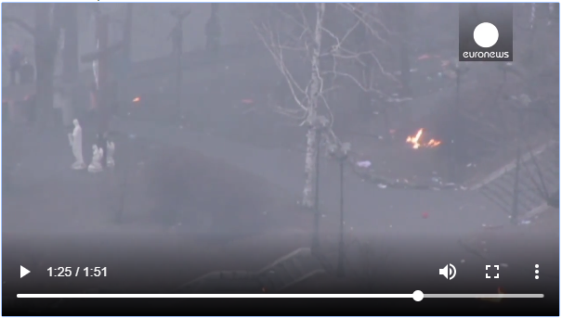
Stage 2: Review Stage 1,
Add Informative Mentions
Event mention
Trigger:
Attributes:
NOT HEDGED
Type.Subtype.Sub-Subtype:
Conflict.Attack.Bombing
Start date: End date:
2014-02-20 unknown
Event mention
Trigger:
Attributes:
NOT HEDGED
Type.Subtype.Sub-Subtype:
Conflict.Attack.SetFire
Start date: End date:
2014-02-20 unknown
Notes:
-Senior annotators perform QC of Stage 1 annotations and annotate additional mentions
-Review Stage 1 events and relations, one at a time
-Tweak minor issues; for example:
-adjust start/end of video event mention
-Change sub-subtype from Conflict.Attack.Bombing to Conflict.Attack.SetFire
-Add/change attributes
-Add missing arguments (maybe stage1 annotator forgot place, e.g.)
-Delete if not salient or incorrect
-Re-read document, adding any missed salient events/relations

Slide 12
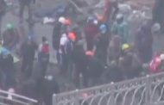

Review/Informative Mentions
Event mention
Conflict.Attack.SetFire
Target
PER.Protester.Unspecified
Attacker
PER.Police.Unspecified
Notes:
-Once quality control is complete, annotators add informative mentions
-Events, relations, and arguments
-No additional or informative mentions annotated in Seedling
-additional video and image mentions
-Names
-Descriptive nominal phrases
-Alternate event/relation triggers
-Clear, “canonical” image mentions
-Additional video mentions

Slide 13
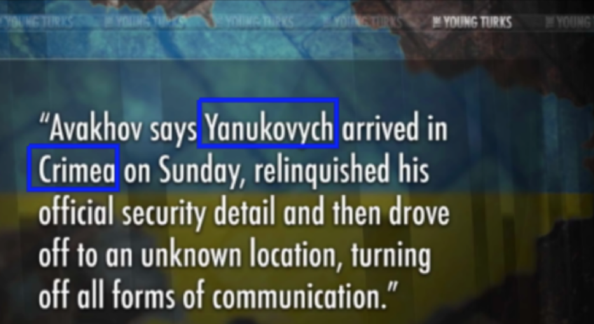
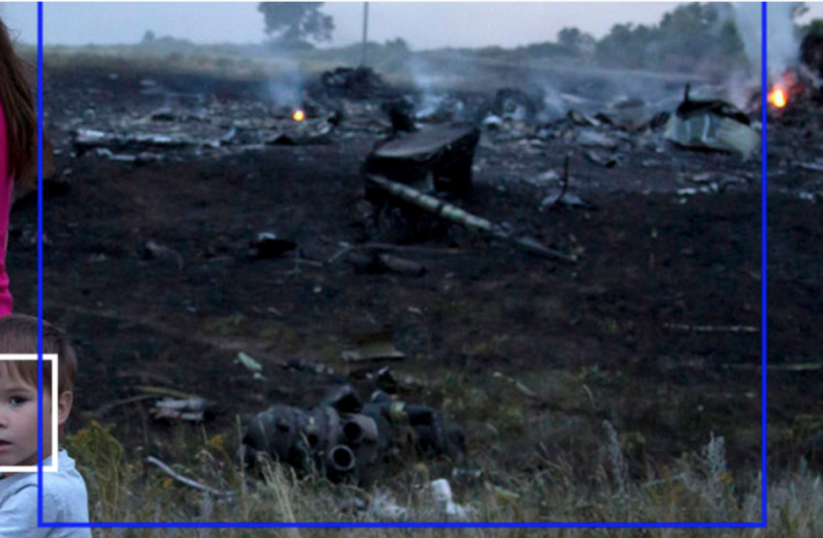
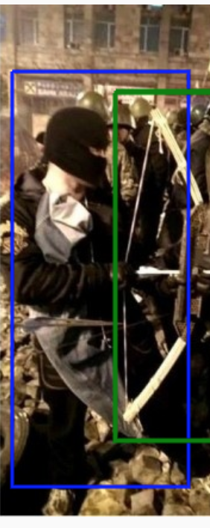
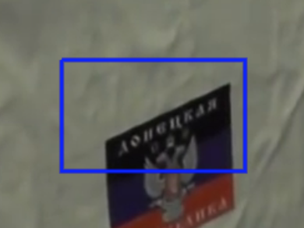
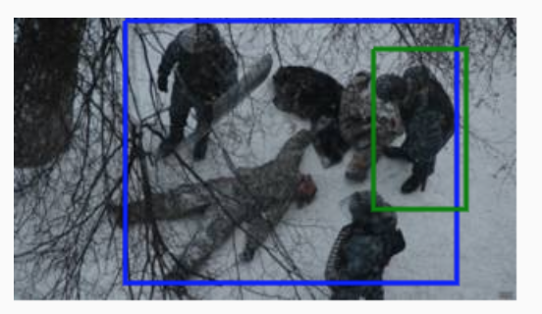
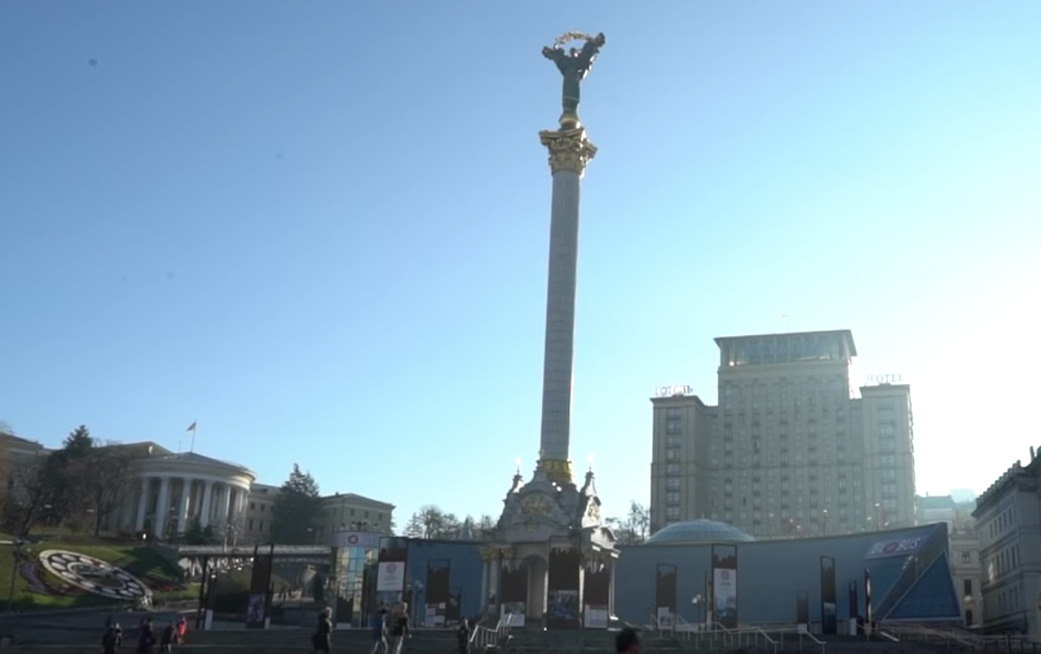
Media Provenance Annotation Guidelines
Include all of the entity. Exclude areas that occlude the entity. Exclude blank space.
Identify words if an object cannot clearly denote entity.
Crimea
Donetsk
Crash aftermath
Capture unique landmarks, insignia, etc.
Soldiers club protester.
Maidan Square
Archer

Slide 14
Stage 4: Linking KEs to
Knowledge Base
KB linking approach
  Shared KB across all topics, covering entities only
  Events and Relations also have cross-document coreference assigned using NIL ids
  Linking annotation follows LORELEI approach with some AIDA-specific adaptations
    Multiple links created when there is ambiguity
  Cross-doc, cross-modal, cross-lingual NIL clustering after all linking complete

Slide 15
NIL Clustering Approach
Cross-doc, cross-modal, cross-lingual NIL clustering after all linking complete
Separate coref tasks for entities and events
Image/video mentions have English written labels (manually produced during base and informative mention tasks)
  Media is also present for review
NILs first compiled into one table for each language
3 senior annotators (English, Russian, Ukrainian) perform initial within-language, cross-doc passes
Within-language clusters are then compiled in a single table
Same annotators work side-by-side to collapse equivalent clusters across languages
Notes:
Note: relations coref’s based on kb ids of args, plus relation type and roles

Slide 16
QC Measures
Stage 2 mentions review
Corpus-wide review of identical text strings with different annotations
  “39 unarmed protestors” 3 times as per.protestor.unspecified
  1 time as per.police.unspecified
39 unarmed protesters | EM=per:protester:unspecified:nom(3) EM=per:police:unspecified:nom(1)
===========================================================================
ee stand accused of massacring | 39 unarmed protesters | . On Sept . | per:protester:unspecified:nom
ee stand accused of massacring | 39 unarmed protesters | . On Sept . | per:protester:unspecified:nom
ee stand accused of massacring | 39 unarmed protesters | . On Sept . | per:protester:unspecified:nom
===========================================================================
ee stand accused of massacring | 39 unarmed protesters | . On Sept . | per:police:unspecified:nom
===========================================================================
Linking reviewed during NIL coref stage
Notes:
-Automated corpus-wide QC
-Not necessarily indicative of mistakes, but identifies things to compare across documents
-Checks for instances of identical text strings that were annotated in different ways
-Provides overview of differences in typing, extents
-Reports on cases where identical strings were annotated in some cases and not others
-n.b. Salient Mention annotation is non-exhaustive

Slide 17
Assessment Overview
Assessment tasks
  Class
  Zero-hop
  Graph
    Graph correctness feeds into TA3 assessment
  TA3 hypotheses
    Relevance
    Coherence
    Coverage
NIST pools responses, sends to LDC
LDC assesses in order prioritized by NIST’s pooling
Notes:
Coherence assessed immediately after relevance, in same assessment kit, by same annotator. Coverage is a separate task.

Slide 18
Assessment – Class & Zero-Hop
Class responses: Is entity/filler X of type Y?
  For Phase 1, added clustering/KB linking to assessment of class-based responses
Zero-hop responses: Is entity/filler X coreferent with KB node Z?
  Assessment of zero-hop responses unchanged from Pilot Eval
Text mentions (of type PER, ORG, GPE, LOC, FAC, WEA, VEH)
What is the mention level?
Select NAM, NOM, or PRO
Is this system mention the same entity as the reference entity?
Non-text mentions
Move on to the next response
Is the entity mention of the type indicated?
Yes
Response marked Correct
No
Response marked Wrong
Notes:
Class & Zero-hop – largely the same tasks as the Pilot Eval (plus KB linking/NIL clustering for class)

Slide 19
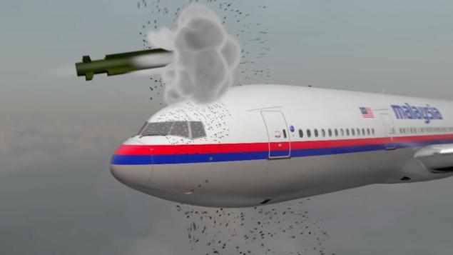


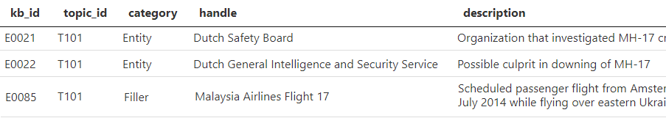
Assessment – Class & Zero-Hop
Malaysia Airlines Flight 17
Type: VEH
correct wrong
The Dutch Safety Board has issued the results of its investigation of the cause of the crash of Malaysia Airlines Flight 17 on
July 12, 2014. It concluded that a ...
Dutch Safety Board
Type: PER
correct wrong
Dutch Safety Board
KB node: E0021
correct wrong
Malaysia Airlines Flight 17
KB node: E0085
correct wrong
Dutch Safety Board
Type: ORG
correct wrong
Dutch Safety Board
KB node: E0022
correct wrong
Notes:
Straightforward example

Slide 20
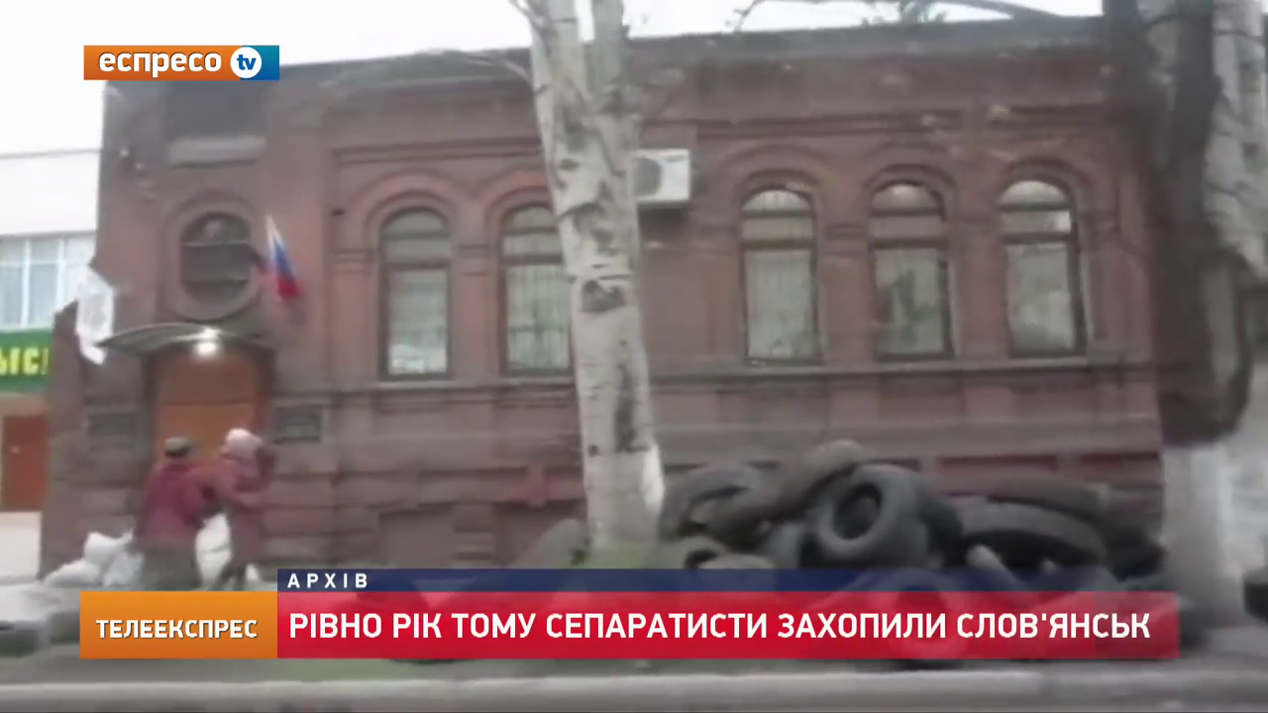
Assessment – Class & Zero-Hop
Lenient assessment
  Does this contain a mention of the correct type / KB node?
Text examples marked correct
  Class: Does this contain a PER?
    Putin stood next to the embassy
  Zero-hop: Does this contain a mention of 693468 [Sloviansk]?
    the situation in Sloviansk and outside the city
    Marked as a NAM (despite also containing a NOM reference)
For images and keyframes, bounding boxes ignored
marked correct
Notes:
Lenient assessment: not “IS this a mention of…?” but rather “DOES THIS CONTAIN a mention of…?”
additional note about images/video: question is also does this CONTAIN a mention of type/KB node? so can contain other entities, too, and still be correct

Slide 21
Assessment – Graph
New task for Phase 1 eval
  Planned for pilot, didn’t happen
  More time-consuming than estimated
    Multimedia
    Event KB linking
Correctness (graph) assessment for TA3
  Same task as TA1/TA2 graph assessment
  TA3 graph prioritized vs. TA1/TA2 graph
Notes:
Regarding time estimate: similar to Cold Start/KBP in years past, but… multimedia + event linking both added significant additional time to the task

Slide 22
Assessment – Graph
Judge validity of system-returned relation and/or event arguments
Does the predicate justification prove all of the following?
  relation/event type
  argument role
  object entity
Is object mention coreferent with entity in predicate justification?
Does this PJ contain an entity whose role is [ROLE TYPE] in an event/relation of [EVENT/RELATION TYPE]?
No
Mark PJ wrong
Is this system mention the same entity as the entity whose role is [ROLE TYPE] in the predicate justification?
Mark Object correct
Display object entity mention. Mention is also now highlighted in source doc.
Yes
Move on to the next response
Yes
No
Mark Object wrong

Slide 23
Assessment – Graph
Correct roles + objects
Predicate justification(s)
Relation arguments:
OrganizationAffiliation.EmploymentMembership
EmployeeMember: Spanish dispatcher
OrganizationAffiliation.EmploymentMembership
PlaceOfEmploymentMembership: Ukrainian air traffic control
A "Spanish dispatcher" supposedly working for Ukrainian air traffic control, suggested that two Ukrainian fighter jets shot down MH17.
Event arguments:
Conflict.Attack Attacker: two Ukrainian fighter jets
Conflict.Attack Target: MH17
Conflict.Attack Target:
Notes:
Straightforward examples (all are correct with respect to example predicate justification)

Slide 24
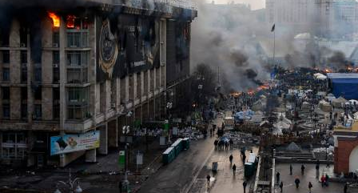
Assessment – Graph
KB Linking & NIL Clustering
Entities: link correct object entities to KB and cluster NILs
  Some PER and WEA groups proved difficult
    Linked/clustered during annotation, marked NIL in assessment
  Coref/linking of Place difficult in images
    Could be correctly linked to
    Trade Unions House or
    Kulikovo field
Events: global clustering of correct responses’ events
Relations: additional “relation assessment” task
  Can’t manually cluster/KB-link half a relation
  Do these two relation arguments form a correct/justified relation?

Slide 25
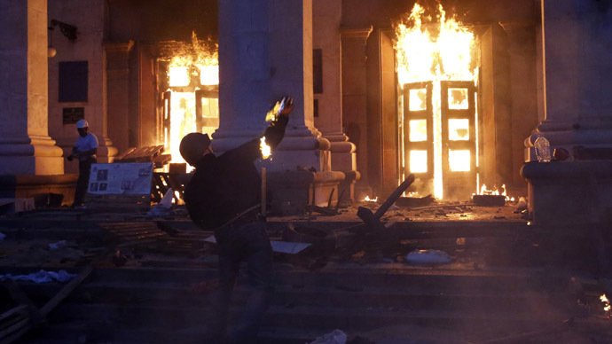
Assessment – Graph
Lenient assessment
Assessors are only shown event/relation type + role
  Entity type isn’t known
  Object justification just has to contain a mention coreferent with the role in the predicate justification
    Other entities may be present
e.g. Conflict.Attack.SetFire_Target
    Predicate justification:
      throws a petrol bomb at the trade union building in Odessa
    Object justification:
Notes:
Object justification doesn’t have to be a “perfect” entity mention; just has to contain a reference to a correct/coreferent entity
Example predicate justification doesn’t technically contain a SetFire, but can see from context that “throws a petrol bomb” refers to someone setting the Trade Unions House on fire
Object justification contains a view of the Trade Unions House, which is coreferent with the Target in the predicate justification

Slide 26
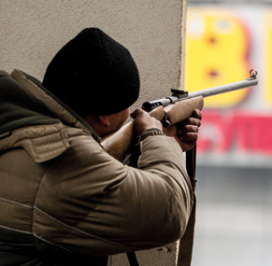
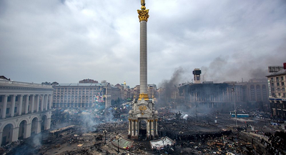
Assessment
TA3 Example Hypothesis
Event Type and Argument Role | Argument Entity Type | Object | Doc Justification
Conflict.Attack.FirearmAttack-Attacker | PER.Combatant.Sniper | snipers | snipers on the roof of the underground mall
Conflict.Attack.FirearmAttack-Target | PER.Protester.Unspecified | Demonstrators | Snipers attacked Maidan protesters
Conflict.Attack.FirearmAttack-Place | FAC.Structure.Plaza | Maidan Nezalezhnosti
Conflict.Demonstrate. MarchProtestPoliticalGathering-Demonstrator | PER.Protester.Unspecified | Local residents | local residents
Conflict.Demonstrate. MarchProtestPoliticalGathering-Place | FAC.Structure.Plaza | Maidan Nezalezhnosti | Maidan square
Event Type and Argument Role | Argument Entity Type | Handle | Doc Justification
Conflict.Attack.FirearmAttack-Attacker | PER.Combatant.Sniper | snipers
Conflict.Attack.FirearmAttack-Target | PER.Protester.Unspecified | Demonstrators | Maidan protesters
Conflict.Attack.FirearmAttack-Place | FAC.Structure.Plaza | Maidan Nezalezhnosti
Conflict.Demonstrate. MarchProtestPoliticalGathering-Demonstrator | PER.Protester.Unspecified | Local residents | local residents
Conflict.Demonstrate. MarchProtestPoliticalGathering-Place | FAC.Structure.Plaza | Maidan Nezalezhnosti | Maidan square
Event Type and Argument Role | Argument Entity Type | Handle | Doc Justification
Conflict.Attack.FirearmAttack-Attacker | PER.Combatant.Sniper | snipers | snipers
Conflict.Attack.FirearmAttack-Target | PER.Protester.Unspecified | Demonstrators | Maidan protesters
Conflict.Attack.FirearmAttack-Place | FAC.Structure.Plaza | Maidan Nezalezhnosti
Conflict.Demonstrate. MarchProtestPoliticalGathering-Demonstrator | PER.Protester.Unspecified | Local residents | local residents
Conflict.Demonstrate. MarchProtestPoliticalGathering-Place | FAC.Structure.Plaza | Maidan Nezalezhnosti | Maidan square
Notes:
Actual hypotheses contain a lot more information, but these are the primary pieces needed by assessors
Handles were expected to be helpful, but not shown here, as they were largely unusable and ignored by assessors
Assessors shown one hypothesis at a time (= 1 kit)
All event/relation KEs comprising a single hypothesis + all arguments of each KE
Event/relation argument clustering shown here with color
Each hypothesis is presented as a table, where each row is an event/relation arg
Can view arguments’ justifications within doc context
Assessors view justifications when handles aren’t informative enough

Slide 27
Assessment
TA3 Relevance
Event Type and Argument Role | Argument Entity Type | Object | Doc Justification
Conflict.Attack.FirearmAttack-Attacker | PER.Combatant.Sniper | snipers
Conflict.Attack.FirearmAttack-Target | PER.Protester.Unspecified | Demonstrators | Snipers attacked Maidan protesters
Conflict.Attack.FirearmAttack-Place | FAC.Structure.Plaza | Maidan Nezalezhnosti
Is this event/relation relevant to the topic?
Assessor has three options in judging the above
  Fully relevant
  Partially relevant
  Not relevant
Notes:
-Assessors judge relevance of each event/relation KE to the topic and/or its queries
-Although queries are displayed, assessors are instructed to consider relevance to the SIN/topic as a whole, not only to the topic queries.

Slide 28

Assessment
TA3 Relevance
Event Type and Argument Role | Argument Entity Type | Object | Doc Justification
Conflict.Demonstrate. MarchProtestPoliticalGathering-Demonstrator | PER.Protester.Unspecified | Local residents | local residents gathered to protest…
Conflict.Demonstrate. MarchProtestPoliticalGathering-Place | FAC.Structure.Plaza | Times Square
Is this event/relation relevant to the topic?
Assessor has three options in judging the above
  Fully relevant
  Partially relevant
  Not relevant
Notes:
(Partially relevant used for cases where one or more arguments of an event/relation are relevant, one or more others are not)

Slide 29
Assessment
TA3 Coherence
Event Type and Argument Role | Argument Entity Type | Object | Doc Justification
Conflict.Attack.FirearmAttack-Attacker | PER.Combatant.Sniper | Sergei | Sergei attacked…
Conflict.Attack.FirearmAttack-Target | PER.Protester.Unspecified | Demonstrators | Maidan protesters
Conflict.Attack.FirearmAttack-Place | FAC.Structure.Plaza | Maidan Nezalezhnosti
Conflict.Attack.SetFire-Attacker | PER.Combatant.Unspecified | Sergei | Sergei attacked…
Conflict.Attack.SetFire-Place | FAC.Building.Unspecified | Trade Unions House | Trade Unions House
For each hypothesis, can all its arguments (across all its KEs) exist/coexist within a single hypothesis?
Notes:
-Assessors judge semantic coherence of event/relation arguments within the KEs comprising a hypothesis
-Virtual checklist, in which all incoherent arguments are marked as such
-Assessors review one hypothesis at a time (same display as relevance task; can view mentions)
-For each hypothesis…? No – Sergei can’t be in two places at once
-Contradictory, illogical arguments are marked incoherent
-If an argument can’t be disambiguated, is nonsensical, or is somehow illogical for the event/relation or hypothesis as a whole, it is marked incoherent

Slide 30
Assessment
TA3 Coherence
Event Type and Argument Role | Argument Entity Type | Object | Doc Justification
Conflict.Attack.FirearmAttack-Attacker | PER.Combatant.Sniper | Sergei | Sergei attacked…
Conflict.Attack.FirearmAttack-Target | PER.Protester.Unspecified | Demonstrators | Maidan protesters
Conflict.Attack.FirearmAttack-Place | FAC.Structure.Plaza | Maidan Nezalezhnosti
Conflict.Attack.SetFire-Attacker | PER.Combatant.Unspecified | Sergei | Sergei attacked…
Conflict.Attack.SetFire-Place | FAC.Building.Unspecified | Trade Unions House | Trade Unions House
For each hypothesis, can all of its events and relations exist/coexist within a single hypothesis?
Notes:
-Assessors judge the semantic coherence of the events/relations comprising a hypothesis
-For each hypothesis, can all of its events and relations exist/coexist within a single hypothesis? This example – yes, both events can have occurred (even if Sergei possibly isn’t the attacker in both)
-Any events or relations within a hypothesis that do not “hang together” (e.g. are contradictory, an illogical/impossible combination, …) are marked incoherent
KEs were seldom marked incoherent at the event/relation level
Example could be Russia both agreeing to a ceasefire AND not agreeing to that same ceasefire – that disagreement is only encoded in the event sub-subtype

Slide 31
Assessment
TA3 Coverage
Event Type and Argument Role | Argument Entity Type | Object | Doc Justification
Conflict.Attack.FirearmAttack-Attacker | PER.Combatant.Sniper | Sergei | Sergei attacked…
Conflict.Attack.FirearmAttack-Target | PER.Protester.Unspecified | Demonstrators | …Maidan protesters
Conflict.Attack.FirearmAttack-Place | FAC.Structure.Plaza | Maidan Nezalezhnosti
On February 20, 2014, a member of the Maidan protest movement, identified only as "Sergei," fired at police and protesters alike from a position in the Kiev Conservatory building in Kiev's Independence Square (aka Maidan), using a Saiga hunting rifle that he had stored in the post office overnight.
Is this system hypothesis argument equivalent to an argument of a prevailing theory?
Notes:
-Assessors judge overlap/match between system KEs and component KEs of prevailing theories
Prevailing theories displayed here in prose form, but in the actual task, these are presented to assessors as tables, similar to hypotheses
-Similar to a linking task
-If a match exists, assessor links the hypothesis argument to the prevailing theory argument.
-Assessor steps through all arguments of the system hypothesis, comparing against arguments of the prevailing theory, and creating links where they exist.

Slide 32
Assessment
TA3 Coverage
Event Type and Argument Role | Argument Entity Type | Object | Doc Justification
Conflict.Attack.FirearmAttack-Attacker | PER.Combatant.Sniper | Sergei | Sergei attacked…
Conflict.Attack.FirearmAttack-Target | PER.Protester.Unspecified | Demonstrators | …Maidan protesters
Conflict.Attack.FirearmAttack-Place | FAC.Structure.Plaza | Maidan Nezalezhnosti
On February 20, 2014, a member of the Maidan protest movement, identified only as "Sergei," fired at police and protesters alike from a position in the Kiev Conservatory building in Kiev's Independence Square (aka Maidan), using a Saiga hunting rifle that he had stored in the post office overnight.
The CIA, a US foreign intelligence service, sponsored snipers who fired on police (including some members of the Berkut riot police) and protesters alike in February 2014 in protests taking place in Kiev's Independence Square (aka Maidan).
Is this hypothesis a reasonable match to one of LDC’s prevailing theories?
  Fully covered
  Partially covered
Notes:
Assessors judge overlap/match between system hypotheses and prevailing theories at the hypothesis level
If a match exists, assessor indicates which prevailing theory is the best match.
Assessor indicates the level of coverage of the matching prevailing theory.
System hypotheses without a matching prevailing theory are marked as such.
LDC assessors provided this at the level of the hypothesis, not at the level of the prevailing theory
Some prevailing theories have multiple matching hypotheses

Slide 33
TA3 Assessment
Effects of Leniency
Lenient graph assessment affects hypothesis assessment
  Hypotheses populated with leniently assessed graph responses
Lenient graph example from earlier
  Conflict.Attack.SetFire_Target
    Predicate justification:
      throws a petrol bomb at the trade union building in Odessa
    Object justification:
    Object marked correct for Target role (coreferent with “trade union building”)

Slide 34
TA3 Assessment
Effects of Leniency
Event Type and Argument Role | Argument Entity Type | Object | Doc Justification
Conflict.Attack.SetFire_Attacker | PER.Combatant.Sniper | Sergei | Sergei set fire to the trade union house
Conflict.Attack.SetFire_Target | PER.Protester.Unspecified |  | throws a petrol bomb at the trade union building in Odessa
Conflict.Attack.SetFire_Place | FAC.Structure.Plaza | Odessa | throws a petrol bomb at the trade union building in Odessa
Entity type (not known during graph assessment)
  Image is a correct Target for “trade union building”
    Not for a PER.Protester
  Similarly, Odessa is a correct Place for that same justification
    But entity type is FAC.Structure.Plaza
Notes:
Hypothesis populated with lenient graph example

Slide 35
TA3 Assessment
Effects of Leniency
Event Type and Argument Role | Argument Entity Type | Object | Doc Justification
Conflict.Attack.SetFire_Attacker | PER.Combatant.Sniper | Sergei | Sergei set fire to the trade union house
Conflict.Attack.SetFire_Target | PER.Protester.Unspecified |  | throws a petrol bomb at the trade union building in Odessa
Conflict.Attack.SetFire_Place | FAC.Structure.Plaza | Odessa | throws a petrol bomb at the trade union building in Odessa
Relevance
  Generally, not a problem
  Don’t need to disambiguate entities for relevance, typically
Notes:
For relevance, this is generally fine.
Multiple entities in the image, but all are relevant, so don’t have to disambiguate
So the entity type/justification mismatch isn’t really a factor

Slide 36
TA3 Assessment
Effects of Leniency
Event Type and Argument Role | Argument Entity Type | Object | Doc Justification
Conflict.Attack.SetFire_Attacker | PER.Combatant.Sniper | Sergei | Sergei set fire to the trade union house
Conflict.Attack.SetFire_Target | PER.Protester.Unspecified |  | throws a petrol bomb at the trade union building in Odessa
Conflict.Attack.SetFire_Place | FAC.Structure.Plaza | Odessa | throws a petrol bomb at the trade union building in Odessa
Coherence
  Target is the building, but is the argument actually the PER?
  Judge coherence against other PERs involved, or against other Targets?
  Hard to determine coherence when entities can’t be disambiguated
Notes:
Ultimately, hypothesis assessment had to be done ignoring the entity types much of the time, since that’s how graph correctness was assessed

Slide 37
TA3 Assessment
Effects of Leniency
Event Type and Argument Role | Argument Entity Type | Object | Doc Justification
Conflict.Attack.SetFire_Attacker | PER.Combatant.Sniper | Sergei | Sergei set fire to the trade union house
Conflict.Attack.SetFire_Target | PER.Protester.Unspecified |  | throws a petrol bomb at the trade union building in Odessa
Conflict.Attack.SetFire_Place | FAC.Structure.Plaza | Odessa | throws a petrol bomb at the trade union building in Odessa
Coverage
  Which entity is intended?
    Link or don’t link to prevailing theory arguments? If so, which?
    Or link to multiple?
Notes:
Similar to the issues with coherence, but even harder to judge. For the first example, assessors would again ignore entity type, and link based on the correct object entity (the PER isn’t a Target, so that decides it)
But for the second one, it’s more difficult, since both Odessa and Trade Unions House are correct Places, and are both in the prevailing theories. Ultimately, since “Odessa” was marked correct, they linked based on Odessa

Slide 38
TA3 Assessment Challenges
General issues
  Coherence, relevance, and coverage tasks designed without access to actual system output
    Tasks didn’t always align well to real hypotheses, as with the lenient examples
  Many hypotheses nearly identical; workload highly repetitive
Relevance
  Almost everything marked relevant
Coherence
  For hypotheses w/ large number of edges
    Cognitive burden is large
    Difficult to determine what all requires comparison
  Many edges difficult to disambiguate (lenient examples)

Slide 39
TA3 Assessment Difficulties
Coverage
  More time-consuming than expected
    4 weeks (vs. ~1 week for both relevance + coherence)
  Hypotheses comprised of mixes of theories/topics
    “Best matches” largely non-existent or only partial
    Assessors leniently linked arguments across topics when no links were found within indicated topic

Slide 40
TA3 Assessment Difficulties
“Swiss cheese” hypotheses
  Resulting from wrong graph responses
  Many hypotheses are comprised of disconnected “orphaned” arguments
  Affected all three tasks, but especially Coverage
  Difficult to determine meaningful links to prevailing theories
  Impossible to link half-relations

Slide 41
TA3 Assessment Difficulties
“Swiss cheese” hypotheses
Event Type and Argument Role | Argument Entity Type | Object | Doc Justification
Conflict.Attack.FirearmAttack_Attacker | PER.Combatant.Sniper | Sergei | Sergei shot at the Maidan protesters
Conflict.Attack.FirearmAttack_Target | PER.Protester.Unspecified | demonstrators | Sergei shot at the Maidan protesters
Conflict.Attack.FirearmAttack_Place | FAC.Structure.Plaza | Maidan Nezalezhnosti | protests on Maidan
GeneralAffiliation.Sponsorship. Unspecified_ActorOrEvent | PER.Combatant.Sniper | Sergei | Russian-backed sniper
GeneralAffiliation.Sponsorship. Unspecified_Sponsor | GPE.Country.Country | Russia | Russian-backed sniper
Notes:
example hypothesis is well-formed, with complete events/relations. easy to see what the arguments are, can link to a prevailing theory, etc

Slide 42
TA3 Assessment Difficulties
“Swiss cheese” hypotheses
What do these refer to? How should they be linked in the Coverage task?
Doc-level justifications only exist to disambiguate arguments
  (Can’t pull in information from docs that isn’t actually present in the hypothesis)
Event Type and Argument Role | Argument Entity Type | Object | Doc Justification
Conflict.Attack.FirearmAttack_Place | FAC.Structure.Plaza | Maidan Nezalezhnosti | protests on Maidan
GeneralAffiliation.Sponsorship. Unspecified_Sponsor | GPE.Country.Country | Russia | Russian-backed sniper
Notes:
Similar hypothesis, but where some arguments were marked wrong in graph assessment
No real way to know what these things are
Could theoretically use doc justifications to help, but anything not in the hypothesis isn’t fair game
This example is very representative of many of the hypotheses assessors were faced with. Many hypotheses had only two or three arguments, and some just had one. (Some were completely empty!)

Slide 43
Assessment Results
Everything got assessed!
Original plan was 6 batches of responses assessed over 2.5 months
Ultimately, LDC assessed 15 batches over 3.5 months
Task | Batches planned | Batches assessed | Responses | Dates | Calendar time
Class | 2 | 2 | 8859 | 7/15-8/20 | 5 weeks
Zero-hop | 1 | 3 | 5978 | 7/22-8/23 +9/30-10/7 | 6 weeks
Graph | 2 | 8 | 16854 | 7/29-9/6 +10/4-10/14 | 7.5 weeks
Relevance + Coherence | 1 | 1 | 9949 | 9/9-9/19 | 1.5 weeks
Coverage |  |  |  | 9/9-10/7 | 4 weeks
Relation assessment | 0 | 1 | 845 | 10/21-10/31 | 1.5 weeks
all tasks | 6 | 15 | - | 7/15-10/31 | 3.5 months

Slide 44
Up Next: Scenario 2 -
Crisis in Venezuela
Practice Topics
Limited, targeted ontology expansions, to capture necessary information conflict in the new scenario, e.g.
  Drones
  Medical issues
  Cause of death
  Court issues
Partition | Topic | ID
Practice | 2014 Disease Outbreak in Venezuela | T201
Practice | 2017 Venezuelan Constituent Assembly Election | T202
Practice | Drone Explosions in Caracas | T203

Slide 45
Requested Changes to Annotation
Requested Change | Requested By | Status
Events as arguments of other events | OWG | Likely added for some event types
Generalized Prevent/Allow events/relations that take events as arguments | OWG | Under discussion
Generic Crime events to serve as crime args of Justice events when crime event is not a taggable type | OWG | Under discussion
Generic Topic filler to serve as topic arg of Contact events when topic arg is not a taggable event or entity/filler | OWG | Under discussion
Remove TTL filler type(s) | OWG | Allow passing of TTL strings
Remove role-like entity types | OWG | No annotation change; handle via mapping
Relations as arguments of sentiment relations | NIST | Under discussion
Belief relations on events/relations and/or their args | NIST | Under discussion
Multiple labels on entities allowing more than one fine-grained type per mention | NIST | Under discussion
Exhaustive annotation of entities/relations/events, regardless of salience to support gold standard TA1/TA2 evaluation | NIST | Under discussion
Notes:
- Some of the “Under discussion” status cells should probably be more likely or less likely, but I’m not sure which.
- NB: There are slides below with examples for most of these requests. However,
1. There are no slides for the two requests that already have solutions (could add slides for these if needed)
-- Remove TTL filler type(s)
-- Remove role-like entity types
2. There is a slide but no example for the Belief relations request, because it is unclear what the details of that request are.

Slide 46
Conclusions and Next Steps
Re-annotated Scenario 1 corpus for 3 practice, 3 eval topics
  Much richer annotation ontology, more mentions per KE, other feature additions to respond to performer requests and evaluation requirements
  Over 635,000 individual annotation decisions
Developed prevailing theories as a strategy to address the need for topic-wide hypotheses in evaluation
Assessed around 42,485 responses, comprising15 batches across 6 assessment tasks
  Delivered on time, supported multiple add-on sets
Ongoing discussions with OWG (Susan Brown) and T&E team to determine necessary annotation changes in support of Scenario 2 and Month 36 Evaluation

