Slide 1
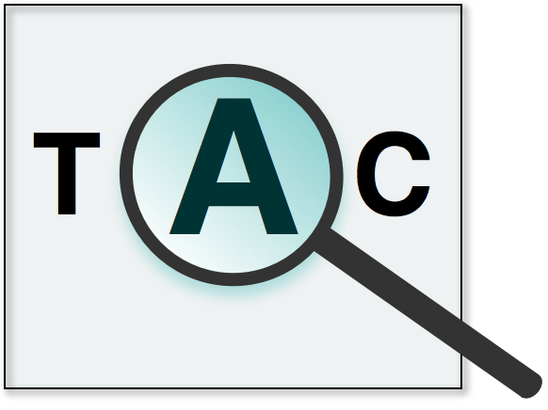
Text Analysis Conference TAC 2019
Sponsored by:
Hoa Trang Dang
U.S. National Institute of Standards and Technology

Slide 2
Outline
Intro to Text Analysis Conference (TAC)
TAC 2019 tracks
Drug-Drug Interaction Extraction from Drug Labels (DDI)
Streaming Multimedia Knowledge Base Population (SM-KBP)
Entity Discovery and Linking (EDL): Fine-grained entity typing

Slide 3
TAC Goals
To promote research in NLP based on large common test collections
To improve evaluation methodologies and measures for NLP
To build test collections that evolve to meet the evaluation needs of state-of-the-art NLP systems
To increase communication among industry, academia, and government by creating an open forum for the exchange of research ideas
To speed transfer of technology from research labs into commercial products
This is not a competition – we learn and advance together.
Notes:
Scores don’t tell the whole story.
Encourage wide range of techniques, different ways of phrasing a problem

Slide 4
Features of TAC
Component evaluations situated within context of end-user tasks (e.g., summarization, knowledge base population)
opportunity to test components in end-user tasks
Test common techniques across tracks
“Small” number of tracks
critical mass of participants per track
sufficient resources per track (data, annotation/assessing, technical support)
Leverage shared resources across tracks (organizational infrastructure, data, annotation/assessing, tools)
Notes:
These features of TAC are best illustrated in our evaluations for Knowledge Base Population

Slide 5
Working Workshop
Geared towards track participants
Share lessons learned
Investigate intriguing/unexpected evaluation results
Improve evaluation specifications and infrastructure
Extensive time for discussion/planning
What support is needed to improve system performance?

Slide 6
Working Workshop

Slide 7
TAC 2019 Track Participants – THANK YOU
DDI Track Coordinators
NIH/NLM (Travis Goodwin and Dina Demner-Fushman)
EDL Track Coordinators
Heng Ji (UIUC) and Avi Sil (IBM)
SM-KBP Organizers
NIST (Hoa Dang, Shahzad Rajput, George Awad, Asad Butt, Oleg Aulov)
LDC (Stephanie Strassel, Jennifer Tracey, Jeremy Getman, ….)
Next Century (Craig Watson, Eddie Curley, Patrick Sharkey,…)
MITRE (Jason Duncan)
DARPA (Boyan Onyshkevych, Joseph Olive, Caitlin Christianson)
22 teams participating

Slide 8
Drug-Drug Interaction Extraction from Drug Labels
Task 1: Extract Mentions of Interacting Drugs/Substances and specific interactions at sentence level. This is similar to many NLP named entity recognition (NER) evaluations.
Task 2: Identify interactions at sentence level, including: the interacting drugs, the specific interaction types (pharmacokinetic, pharmacodynamic or unspecified), and the outcomes of pharmacokinetic and pharmacodynamic interactions. This is similar to many NLP relation identification evaluations.
Task 3: Normalization task. Normalize the interacting substance, drug classes, consequences of the interaction (if it is a medical condition), and pharmacokinetic effects.
Task 4: Generate a global list of distinct interactions for the label in normalized form.

Slide 9
Streaming Multimedia KBP
DARPA AIDA (Active Interpretation of Disparate Alternatives) program evaluation
Goal is to develop a multi-hypothesis semantic engine that generates explicit alternative interpretations of events, situations, and trends from a variety of unstructured sources, for use in noisy, conflicting, and potentially deceptive information environments.
Task 1: TA1 extracts knowledge elements from a stream of heterogeneous documents containing multilingual multimedia sources
Task 2: TA2 aggregates the knowledge elements (from TA1) from multiple documents without access to the raw documents themselves (maintaining multiple interpretations and confidence values for KEs extracted or inferred from the documents)
Task 3: TA3 develops semantically coherent hypotheses, each of which represents an interpretation of the document stream.

Slide 10
EDL: Fine-grained Entity Extraction
100+ SM-KBP entity types
Intersects with SM-KBP task
Exhaustive annotation of all name mentions of all entities (not just a few mentions of each entity)
Annotate only English text, not multi-lingual multimedia documents
No linking or coreference (yet)
Low resources: limited number of annotations for each entity type
+
Human in the loop: feedback based on user model of how an analyst might interact with system to provide feedback to improve system

Slide 11
TAC 2020
Drug-Drug Interaction from Drug Labels (DDI)
Entity Discovery and Linking (EDL)
Streaming Multimedia KBP (SM-KBP)

