Slide 1
PRIS at Slot Filling in KBP 2012: An Enhanced Adaboost Pattern-Matching System
Yan Li
Beijing University of Posts and Telecommunications
buptliyan@gmail.com
Notes:
Hello everyone, my name is Yan, I’m from the lab of PRIS in BUPT.
What I’d like to mainly describe today is an enhanced pattern bootstrapping system designed for this year’s slot filling task.

Slide 2
Outline
Introduction
Preprocessing
Entity Expansion
Pattern bootstrapping
Post-processing
Evaluation results
Conclusion
Notes:
1.I will first give a brief introduction of our work.
2.The pattern bootstrapping, which is the key module of our framework, follows some steps of preprocessing and entity name expansion.
3.And the post-processing is also very important to ensure the quality of slot fillers.
4.The evaluation results will show the effectiveness of our system.
5.Finally, I will give a conclusion.

Slide 3
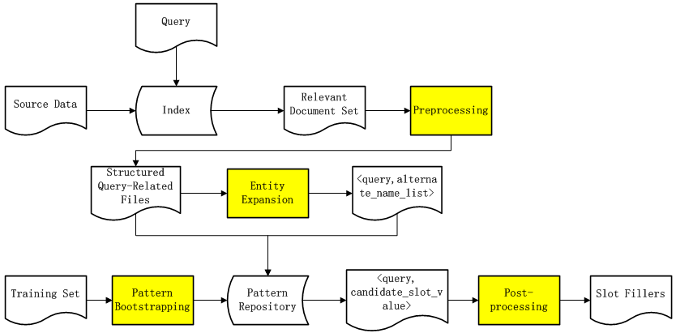
Introduction: the framework
Notes:
This is a simple framework illustrating our full workflow.
The pattern bootstrapping module, which is the most important one, is trained in advance and generates a set of patterns for each slot.
The initial query is searched in our index of source data. The top 50 relevant docs are returned to conduct the preprocessing and expansion, which is also needed before training the bootstrapping system.
Then we match the query-relevant documents with patterns generated by the bootstrapping module for each slot.
We finally post-process the extracted candidates to ensure more reasonable fillers.

Slide 4
Preprocessing
NLP (the Standford CoreNLP toolkit)
POS tagger
NER
Date and time expression recognition
Dependency parser
Coreference resolution
Notes:
Preprocessing is necessary for both training the bootstrapping system and extracting the fillers for queries.
The Stanford CoreNLP toolkit is used to do the NLP including: slide列的五点.
All the slots are categorized into 12 domain types showing as follows.

Slide 5
Preprocessing (cont’)
Example:
Takeshi Watanabe, the first president of the ADB, died in his native Japan.
The categorizations of slots

Slide 6
PER |  | ORG
Domain | Slots | Domain | Slots
PER | alternate_names; spouses; children; parents; siblings; other_family | PER | alternate_names; members; shareholders; founded_by; top_members/emplyees
ORG | member_of; employee_of | ORG | parents; members; member_of; shareholders; subsidiaries
LOC | country/state/city_of_birth/death/residence
DATE | date_of_birth/death | LOC | member_of; country/state/city_of_headquarters;
NUM | age
ORI | origin
REL | religion | DATE | founded; dissolved
SCHOOL | schools_attended | NUM | number_of_employees/members
CAUSE | cause_of_death
TITLE | titles | URL | website
CHARGE | charges | REL | political/religious_affiliation

Slide 8
Entity Expansion
The coreferences and alternate names of an entity exist in relevant documents.
In the purpose of improving recall.
Scheme 1 (PER & ORG): coreference resolution
The relation chain run by the Stanford CoreNLP.
Example:
Notes:
Why it is necessary to expand queries? Because … slide中的第一条.
we should identify as much mentions of the target entity as possible in its relevant documents, which is very important to improve recall.
In particular, three ways are used to do the expansion.
The first thing needed to do is the coreference resolution for both PER and ORG queries. We find the coreference in documents of a query through its relation chains conducted by the CoreNLP and replace them with the query.
Here is an illustration. The three mentions: group, lashkar-e-taiba and army of the righterous would appear in the chain, and the last two are considered as alternate names.

Slide 9
Entity Expansion (cont’)
Scheme 2 (PER & ORG): identifying alternate names
Rule-based information extraction
Interpretative entities in parenthesis
Example:
Starr International Co., known as SICO, ……
Scheme 3 (ORG)
Removing the corporate suffixes in queries
Finding the acronyms or full expressions
Example:
Norwegian University of Science and Technology (NTNU)
Notes:
We applied rule-based information extraction to identify the alternate names of queries in relevant documents. In addition, interpretative entities appearing in parenthesis of sentences are also regarded as alternates.
The following is a simple rule pattern with trigger phrase “known as”.
For the ORG queries, we need to further find their acronyms or full expressions after removing the corporate suffixes.
For example, we try our best to find the acronym “NTNU” for the organization “Norwegian University of Science and Technology”, or vice visa.

Slide 11
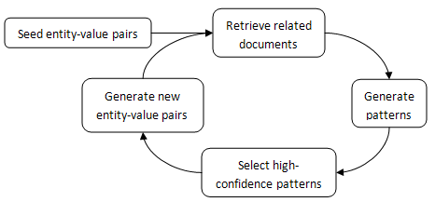
Pattern Bootstrapping: Workflow
Ralph Grishman and Bonan Min, “New York University KBP 2010 Slot‐Filling System”, 2010.
Notes:
Before I describe the procedure of our bootstrapping system, I must first express our acknowledgement to the researchers in NYU. They have already developed a pattern bootstrapping system for doing slot filling task in KBP 2010. And we actually referenced their work report.
The seed entity-value pairs for a specific slot are input to retrieve some related documents. The new patterns are then generated automatically based on some predefined rules. After evaluating these patterns, the high-confidence ones are used to find new entity-value pairs. This workflow can be iterated many times as needed.

Slide 12
Pattern Bootstrapping: Seed Pairs
The KBP English Monolingual Slot Filling Evaluation Data in the past three years
92 PER entities
106 ORG entities
1,627 entity-value pairs

Slide 13
Pattern Bootstrapping: Pattern Generation
Word sequence pattern
the middle context between an entity-value pair
Example:
PER:countries_of_residence <PER> native <LOC>
Dependency path pattern
the shortest dependency path which connects an entity-value pair
Example:
PER:title <PER> appos <TITLE>
PER:member_of <PER> appos president prep_of<ORG>
PER:country_of_death <PER> nsubj-1 died prep_in<LOC>
Notes:
As the NYU group mentioned in their paper, there are two types of sentence-level patterns: word sequence patterns and dependency path patterns.
A word sequence pattern is the middle context between an entity-value pair.
And with dependency structures generated by the parser, a dependency pattern refers to the shortest path which connects an entity-value pair.
The examples are derived from the above sentence.

Slide 14
Pattern Bootstrapping: Pattern Evaluation
In the purpose of improving precision
Pattern frequency
Trigger phrase
High-confidence patterns
New entity-value pairs
Iteration
Notes:
We need to filter out the low-quality generated patterns to avoid too much noise and improve precision.
We evaluate the quality of patterns according to their frequencies and the trigger phrases.
In particular, we keep the high-frequency patterns containing important trigger phrases. For example, “president, died and native” in previous examples are all trigger words.
The remaining patterns are used to extract new entity-value pairs and we just do the iteration twice.

Slide 16
Post-processing
In the purpose of improving precision
DATE
The SUTime module of the CoreNLP
TIMEX2 normalization
PER: spouses, children and parents
Last name complement
Example: John Doe’s first wife, Ruth
“Ruth Doe” is better than “Ruth”.
Notes:
We match the query-relevant documents with patterns generated by the bootstrapping module for each slot. And the extracted candidate fillers need to be normalized to improve precision.
For the slots of DATE type, We use SUTime module of the Stanford CoreNLP to identify temporal expressions in the text and normalize them to the required TIMEX2 format.
For the PER slots of spouses, children and parents, we searched last names from the context and make the fillers more detailed and less ambiguous. For example, if there is a context like “John Doe’s first wife, Ruth”, then “Ruth Doe” is regarded as a better filler than “Ruth” for PER: spouse of the target entity “John Doe”.

Slide 17
Post-processing (cont’)
Identifying countries, states/provinces and cities for LOC slots
A Wikipedia list containing all countries and states or provinces.
Adding modifiers into fillers of per: title
adjectival modifier: financial Minister
noun compound modifier: police chief
prepositional modifier: chief of military operations
Notes:
To identify LOCATION slot fillers into countries, states/provinces and cities, we apply a list from Wikipedia, which contained all countries and states or provinces. Fillers not in the gazetteer are classified as city-level.
For fillers of the PER: title, we add three types of modifiers including adjectival modifiers, noun compound modifiers and prepositional modifiers.

Slide 18
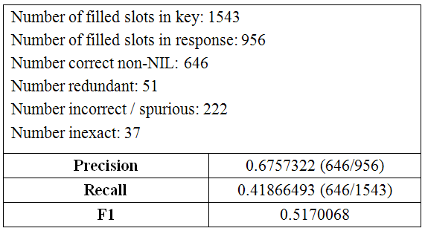
Evaluation Results
PRIS
Summary Statistics
 | LDC | Top-1 | Top-2 | Median
Precision | 0.9278607 | 0.6757322 | 0.48955223 | 0.11392405
Recall | 0.7252106 | 0.41866493 | 0.21257292 | 0.0874919
F1 | 0.8141142 | 0.5170068 | 0.2964302 | 0.0989736
Notes:
This table shows our best evaluation results with the precision about 0.68, recall 0.42 and F1 0.52.
The evaluation summary statistics are also listed below where the Top-1 team is exactly the PRIS. It is really a surprise.
But there is still a long way to reach the manual run provided by LDC.

Slide 19
Slot | non-NIL correct | redundant | inexact | wrong | missing
Alternate names | 6 | 0 | 0 | 0 | 23
Date of birth | 16 | 4 | 0 | 1 | 1
Date of death | 17 | 1 | 0 | 4 | 2
age | 22 | 0 | 0 | 2 | 2
Country of birth | 1 | 0 | 0 | 0 | 1
State or province of birth | 8 | 0 | 2 | 3 | 2
City of birth | 13 | 1 | 0 | 5 | 2
Country of death | 1 | 0 | 0 | 2 | 0
State or province of death | 13 | 0 | 2 | 1 | 2
City of death | 17 | 0 | 0 | 4 | 1
Country of residence | 10 | 2 | 2 | 7 | 3
State or province of residence | 22 | 1 | 4 | 5 | 13
City of residence | 35 | 1 | 0 | 14 | 8
origin | 16 | 2 | 0 | 17 | 0
Cause of death | 18 | 0 | 0 | 1 | 13
Schools attended | 19 | 7 | 0 | 1 | 14
titles | 85 | 13 | 8 | 24 | 4
Member of | 26 | 2 | 4 | 17 | 10
Employee of | 7 | 0 | 2 | 5 | 20
religion | 4 | 0 | 0 | 1 | 3
spouses | 16 | 5 | 1 | 3 | 10
Children | 73 | 0 | 3 | 10 | 6
Parents | 21 | 4 | 0 | 1 | 4
Siblings | 20 | 0 | 1 | 8 | 3
Other family | 2 | 0 | 0 | 0 | 7
Charges | 5 | 0 | 0 | 4 | 2
Notes:
Here is the performance analysis for each slot of Person.
The value in the table indicate the number of fillers.
Blue rows represent the slots enjoying high performance of both precision and recall.
Red rows indicate the slots with a high precision.
And the green rows stand for the high-recall slots.

Slide 20
Slot | non-NIL correct | redundant | inexact | wrong | missing
Alternate names | 46 | 4 | 5 | 25 | 5
Political/religious affiliations | 7 | 1 | 0 | 6 | 3
Top members/employees | 59 | 1 | 2 | 20 | 8
Number of employees/members | 3 | 0 | 0 | 0 | 8
Members | 0 | 0 | 0 | 0 | 4
Member of | 0 | 0 | 0 | 0 | 7
Subsidiaries | 7 | 0 | 0 | 3 | 10
Parents | 4 | 1 | 0 | 4 | 4
Founded by | 5 | 0 | 0 | 3 | 5
Founded | 5 | 0 | 0 | 1 | 3
Dissolved | 1 | 0 | 0 | 0 | 2
Country of headquarters | 3 | 0 | 0 | 1 | 20
State or province of headquarters | 1 | 1 | 0 | 7 | 11
City of headquarters | 2 | 0 | 0 | 3 | 10
Shareholders | 3 | 0 | 1 | 8 | 0
Website | 7 | 0 | 0 | 1 | 8
Notes:
And here is the cases of the ORG slots.
It can be seen that the general performance for ORG slots is lower than the one of PER slots.

Slide 21
Conclusion
In the slot filling task of KBP 2012, we designed an enhanced pattern-matching system which consists of preprocessing, entity expansion, pattern bootstrapping and post-processing.
The precision and recall are relatively good for some specific slots.
It is urgent to improve the remaining slots.
Notes:
Now let me make a brief conclusion.
As we see in the above tables, 第二条.
第三条。

Slide 22
Tips
Adequate preparation
A harmonious team
Active and disciplined environment
Be passionate, patient and hardworking
……
Notes:
In the end, I list some tips for our success.
Adequate preparation: We actually prepared for the KBP 2012 in early April.
And a harmonious team makes it possible to practice the theory of “one plus one is greater than two”.
Our laboratory builds a very active and disciplined environment to do the research.
The last is the most important. Please keep yourself passionate, patient and hardworking when you are doing things.

Slide 23
Thank you!

