Slide 1
Linguistic Resources for the
2012 TAC KBP Cold Start Evaluation
Joe Ellis (presenter),
Brendan Callahan, Jonathan Wright, Stephanie Strassel
Linguistic Data Consortium
University of Pennsylvania, USA

Slide 2
Outline
Linguistic Resources for 2012 Cold Start
English source data
Annotated evaluation data
Annotation Tasks and Methodologies
Corpus Scouting
NER Output Curation
Query Development
Assessment

Slide 3
Cold Start Corpus and Eval Data

Slide 4
Corpus Scouting and Selection
Annotators searched the web looking for suitable source document sites
At least 10K documents
Included numerous PERs, ORGs, & GPEs linked via KBP slots
http://www.sas.upenn.edu/
Selected site harvested and processed in a joint effort between LDC and KBP coordinators

Slide 5
Cold Start Annotation
NER Output Curation
Query Development
Searched and annotated chains of entities connected by KBP slots
“Jane Doe is the president of the School of Arts and Sciences at the University of Pennsylvania”
“The University of Pennsylvania, located in Philadelphia”
“Jane Doe”
per:employee_of
“School of Arts and Sciences”
org:parents
“University of Pennsylvania”
org:city_of_headquarters
“Philadelphia”

Slide 6
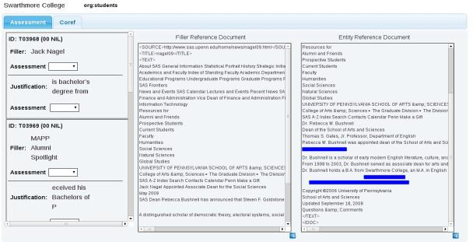
Cold Start Assessment
Assess validity of slot-filling answers from humans and systems
Create equivalence classes from fillers assessed as correct
Quality control pass as with annotation

Slide 7
Conclusions
2012 Achievements
Successfully developed and executed new tasks and tools in support of the Cold Start evaluation
2013 Goals
Further refinement of processes
Expedite corpus selection process

