Slide 1
Linguistic Resources for the
2013 TAC KBP Slot Filling Evaluations
Joe Ellis (presenter),
Jeremy Getman, Jonathan Wright, Stephanie Strassel
Linguistic Data Consortium
University of Pennsylvania, USA

Slide 2
2013 Source Corpus
Language | Genre | Documents
English | Newswire | 1,000,257
 | Web Text | 999,999
 | Discussion Forums | 99,063

Slide 3
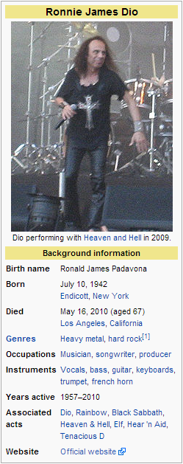
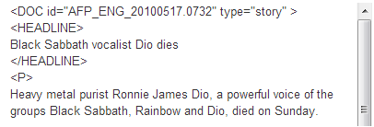
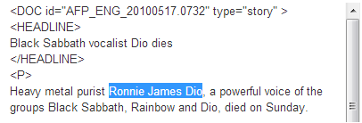
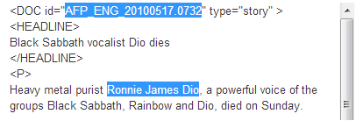
Query Selection
Select entities and reference docs
Entities selected via slots
Non-confusable, productive namestrings
Rich entities
at least 2-3 fillers in the source corpora
Query set with ~even spread of slot types
Name, value, string
Link namestrings to KB or mark as NIL

Slide 4
Query Selection
What’s new in 2013?
Redundancy with KB OK for list-value slots

Slide 5
Annotation
For each query annotator spends up to 2 hours searching corpus to identify fillers for targeted slot
per:alternate_names
per:city_of_birth
per:stateorprovince_of_birth
per:cities_of_residence
per:statesorprovinces_of_
residence

Slide 6
Annotation
For each query annotator spends up to 2 hours searching corpus to identify fillers for targeted slot
What’s new?
per:title – positions at different ORGs are distinct fillers
per:employee_of and per:member_of merged into a single slot
per:employee_or_member_of
Ronnie James Dio
- per:title:
singer
singer
- per:employee_or_member_of:

Slide 7
Assessment
Assess validity of fillers & justification from humans & systems
Filler
Correct – meets the slot requirements and supported ~in justification
Wrong – doesn’t meet slot requirements and/or not supported ~in justification
Inexact – otherwise correct, but is incomplete, includes extraneous text, or is not the most informative string in the document
Predicate
Correct, Wrong, Inexact-Short, Inexact-Long
Subject/Object
Correct, Wrong, Inexact
Ignore

Slide 8
Justification
New in 2013:
Justification is the string(s) of text that show a relation is true
Predicate: Includes all three pieces of information necessary to justify the entity/slot/filler relation
Subject: proves the entity’s involvement in the relation
Object: proves the filler’s involvement in the relation
Each part can be comprised of up to two, discontiguous strings
<Harkat-ul-Mujahideen - org:country_of_headquarters - Pakistan>
Predicate 1: the Islamabad headquarters of Harkat-ul-Mujahideen
Predicate 2: Islamabad, the capital city of Pakistan
Ronnie James Dio
- per:date_of_death:
Sunday
[2010-05-16]

Slide 9
2013 Discoveries
New justification scheme used in unexpected, creative ways
Additional predicate strings used to disambiguate entities
<Vitaly Ginzburg - per:cause_of_death - cardiac arrest>
Predicate 1: Ginzburg died late Sunday of cardiac arrest.
Predicate 2: Vitaly Ginzburg, a Nobel Prize-winning Russian physicist and one of the fathers of the Soviet hydrogen bomb

Slide 10
68%? What happened?
Usual challenges of SF annotation tasks
Familiarity with SF descriptions
Irregular occurrence
2013 Challenges
Early finish in 2012, late start in 2013
Packed schedule
What was affected?
Query development and annotation as training
Quality control on assessment

Slide 11
2014 Goals
Improve score!
Decompress timeline for greater annotator training and quality control
Dual assessment?

Slide 12
Delivered 2013 Resources
Corpus Title | Type | LDC Catalog | Language | Size
TAC 2013 English Regular Slot Filling per:title Training Data | Training | LDC2013E60 | English | 1949 Assessments
TAC 2013 English Regular Slot Filling Evaluation Queries and Annotations | Evaluation | LDC2013E77 | English | 100 Queries
TAC 2013 English Regular Slot Filling Evaluation Assessment Results V1.1 | Evaluation | LDC2013E91 | English | 27,655 Assessments

