Slide 1
Drug-Drug Interaction Extraction from Structured Drug Labels
Travis R. Goodwin¹, Dina Demner-Fushman¹, Kin Wah Fung¹, and Phong Do²
¹ Lister Hill National Center for Biomedical Communications,
U.S. National Library of Medicine
² Office of Health Informatics, U.S. Food and Drug Administration

Slide 2
Motivation
Practical – needed to support FDA operations
Interesting – challenging NLP problems
Impactful – successful approaches will help avoid DDIs

Slide 3
Mechanisms of Drug-Drug Interaction
A drug interaction results when the effects of a drug are altered in some way by the presence of another drug, by food, or by environmental exposure.
The risk of developing an adverse drug reaction (ADR) secondary to a drug–drug interaction increases significantly with the number of medications a patient is receiving.
Mechanisms of drug interactions:
  A pharmacodynamic interaction results when a drug interferes with a second drug at its target site, or changes in some way its anticipated pharmacologic response.
    Results in additivity, synergy, or antagonism of the intended effect.
    E.g., the synergism that results from combining two or more anti-infectives in the treatment of a resistant pathogen.
  A pharmacokinetic interactions occur when one drug alters the absorption, distribution, metabolism, or elimination of another drug, thereby changing its concentration in plasma and, consequently, at the targeted site of action.
    Clinically significant drug interactions are most often due to alterations in pharmacokinetics, secondary to modulation of drug metabolism.
  http://www.sciencedirect.com/topics/pharmacology-toxicology-and-pharmaceutical-science/drug-interaction

Slide 4


Goal: generate structured (index) document for distinct DDIs in SPL
Precipitants
VHA National Drug File Medication Reference Terminology (MED-RT)
Structured Product Labels
(SPLs)
Specific effects
Pharmacokinetic effects

Slide 5
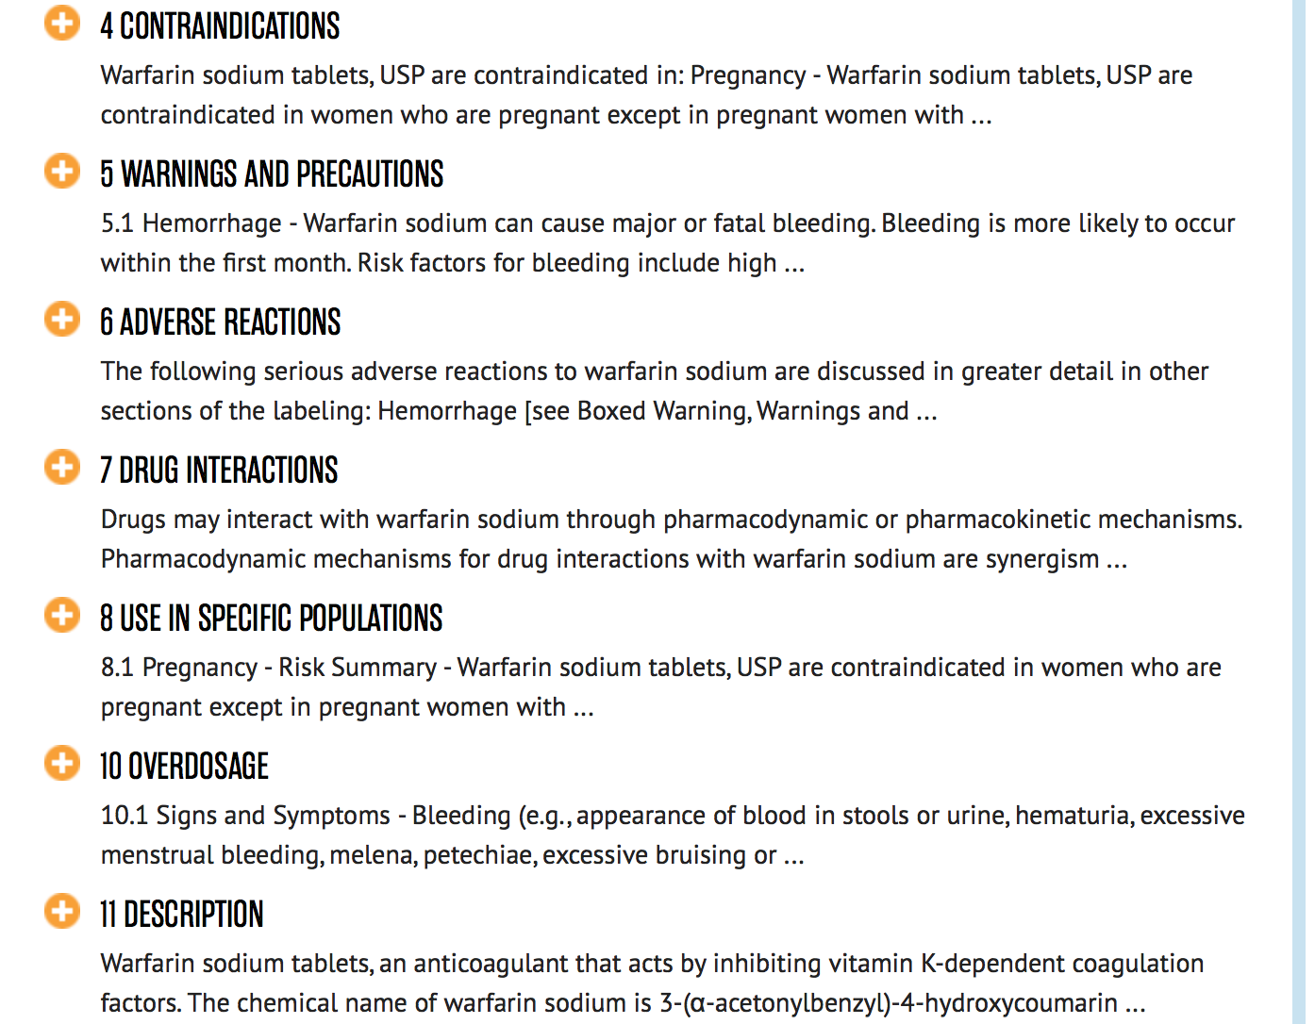
Relevant SPL sections
Boxed Warning
Contraindications
Dosage and Administration
Drug Interactions
Laboratory Test Interactions
Drug Interactions
Precautions
Warnings and Precautions
Warnings
Clinical Pharmacology

Slide 6
Related work
  An attempt to combine all publically available PDDIs sources.
  The merged dataset consists of fourteen different sources of PDDIs information.
    Ayvaz S, Horn J, Hassanzadeh O, Zhu Q, Stan J, Tatonetti NP, Vilar S, Brochhausen M, Samwald M, Rastegar-Mojarad M, Dumontier M. Toward a complete dataset of drug–drug interaction information from publicly available sources. Journal of biomedical informatics. 2015 Jun 30;55:206-17.

Slide 7
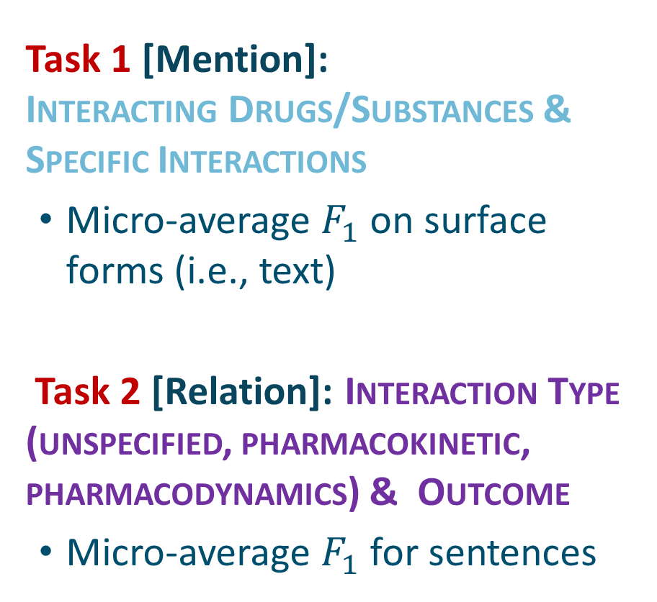
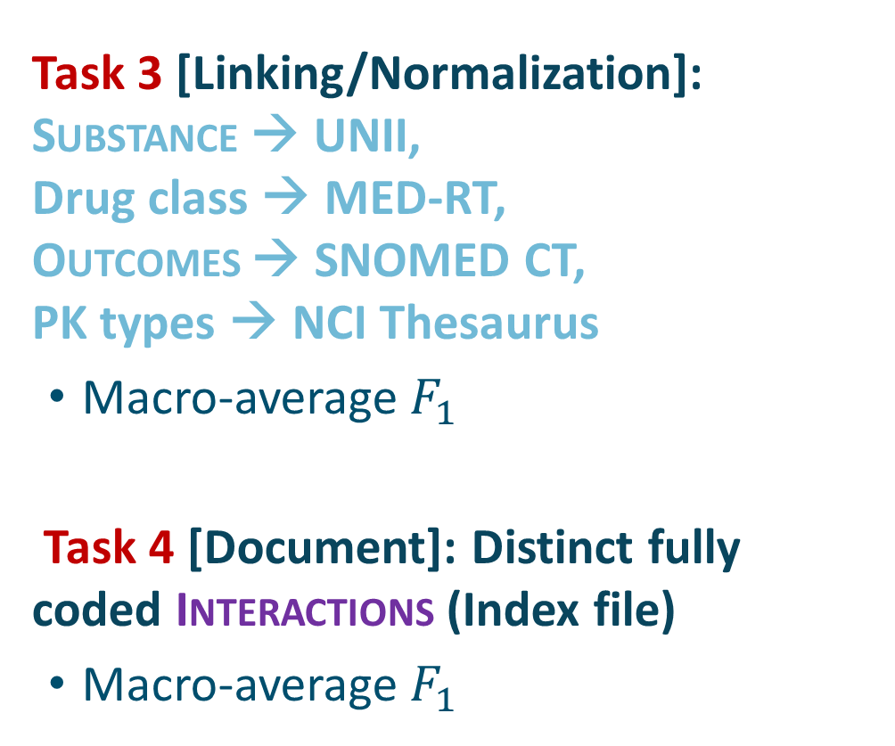
Tasks
Task 1 [Mention]:
Interacting Drugs/Substances & Specific Interactions
  Micro-average $F_{1}$ on surface forms (i.e., text)
Task 2 [Relation]: Interaction Type (unspecified, pharmacokinetic, pharmacodynamics) & Outcome
  Micro-average $F_{1}$ for sentences
Task 3 [Linking/Normalization]: Substance → UNII,
Drug class → MED-RT,
Outcomes → SNOMED CT,
PK types → NCI Thesaurus
  Macro-average $F_{1}$
Task 4 [Document]: Distinct fully coded Interactions (Index file)
  Macro-average $F_{1}$

Slide 8

Data
Entities
  Precipitants: Drug, Drug class, Substance
  Interaction Triggers
    (annotated but not evaluated)
  Interaction Effects
Interactions
  Caution (Unspecified)
  Increase / Decrease (Pharmacokinetic)
  Specific (Pharmacodynamic)
“Index file”
406 drug labels
  325 training (180 + 22 + 57 + 66)
  81 testing
DailyMed XML → Basic XML
  Only maintain sections

Slide 9
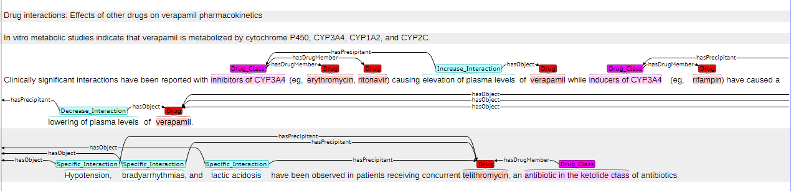
NLM-180 Training set

Slide 10
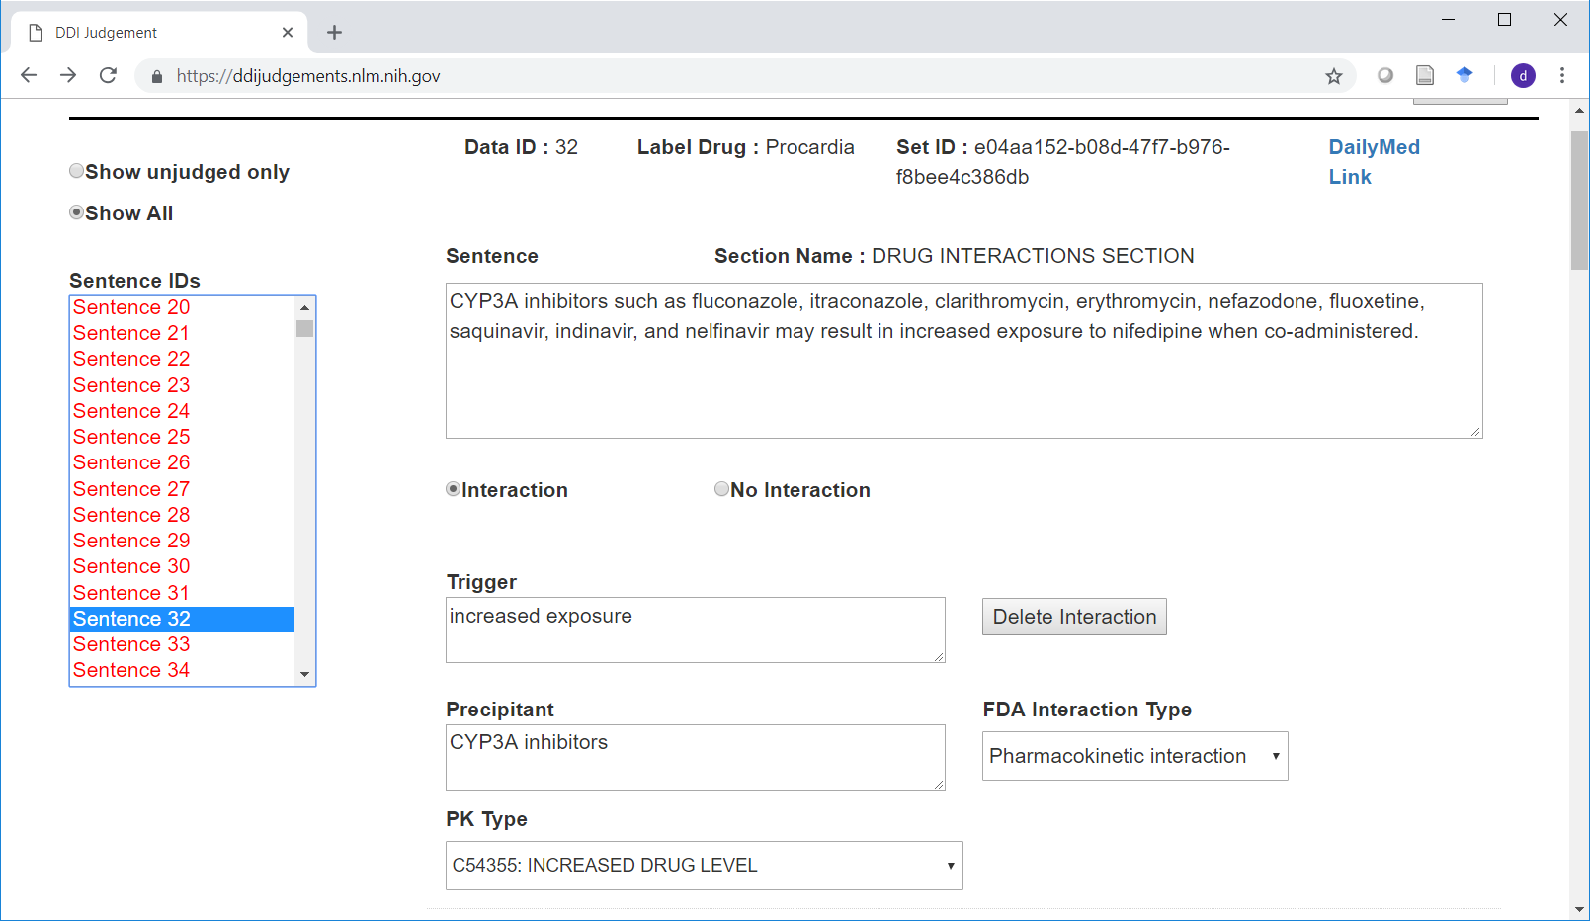
FDA-22 training and test sets annotation tool

Slide 11
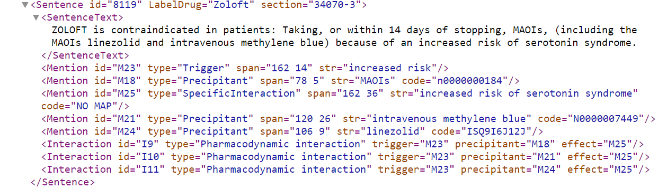
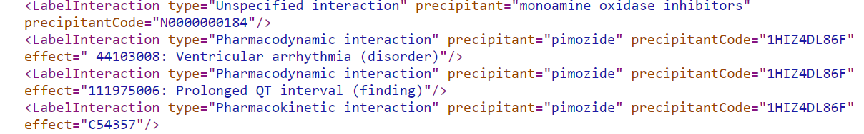
Annotations

Slide 12
Participants
System | Affiliation | T1 | T2 | T3 | T4
IBMResearch | IBM Research | ✓ | ✓
INK_BC | Shandong University of Finance and Economics (Chinese: 山东财经大学) | ✓ | ✓
UTDHLTRI | The Human Language Technology Research Institute (HLTRI) at the University of Texas at Dallas (UTD) | ✓ | ✓ | ✓ | ✓
SRCB | Ricoh Software Research Center (Beijing) (Chinese: 理光软件研究所(北京)有限公司). | ✓ | ✓ | ✓

Slide 13
Approaches
bi-directional LSTM-CRF
CRF & RNN
CNN-based encoder + RNN-based decoder + dictionary- and rule-based methods
BiLSTM-CRF + Piecewise Attention-LSTM + learning to rank (RankSVM)
SVM
BiLSTM
CNN

Slide 14
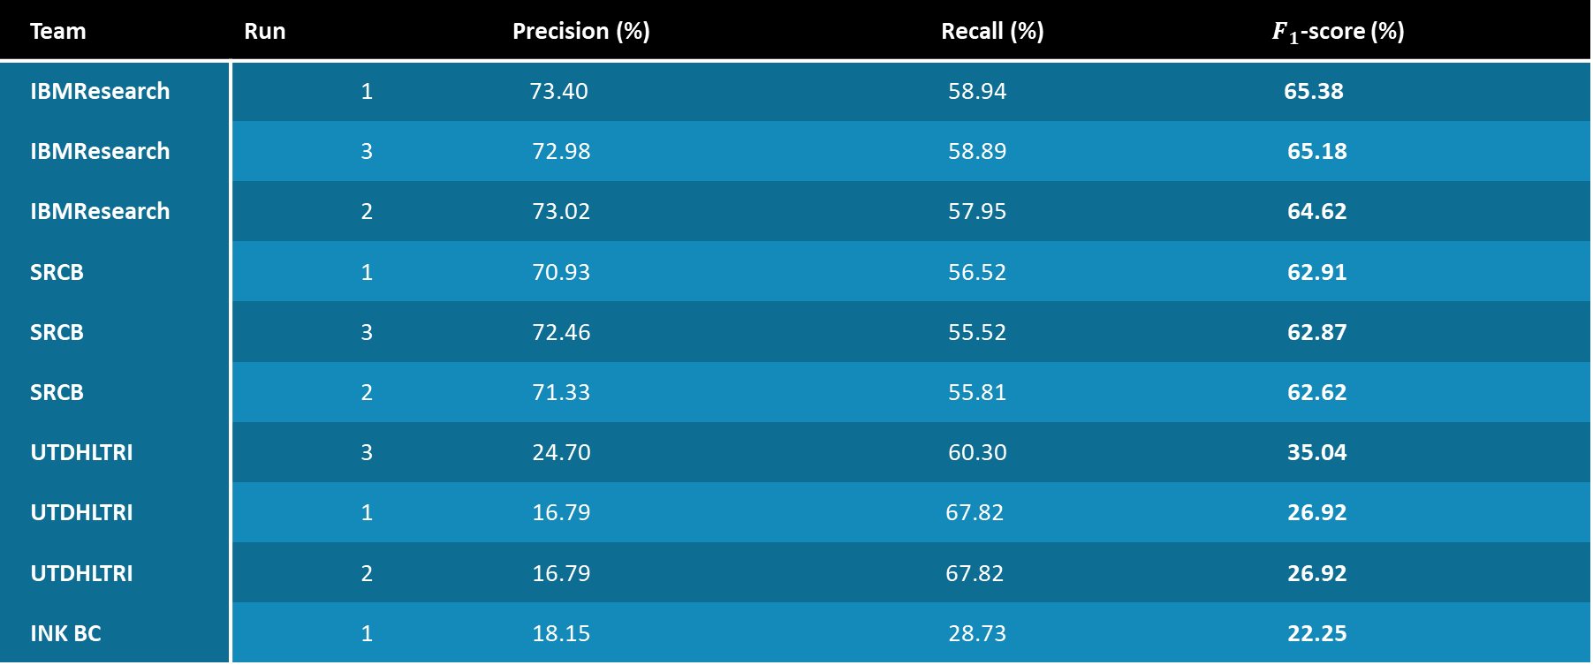
Results Task 1 (Mention)
Team | Run | Precision (%) | Recall (%) | $F_{1}$-score (%)
IBMResearch | 1 | 73.40 | 58.94 | 65.38
IBMResearch | 3 | 72.98 | 58.89 | 65.18
IBMResearch | 2 | 73.02 | 57.95 | 64.62
SRCB | 1 | 70.93 | 56.52 | 62.91
SRCB | 3 | 72.46 | 55.52 | 62.87
SRCB | 2 | 71.33 | 55.81 | 62.62
UTDHLTRI | 3 | 24.70 | 60.30 | 35.04
UTDHLTRI | 1 | 16.79 | 67.82 | 26.92
UTDHLTRI | 2 | 16.79 | 67.82 | 26.92
INK BC | 1 | 18.15 | 28.73 | 22.25

Slide 15
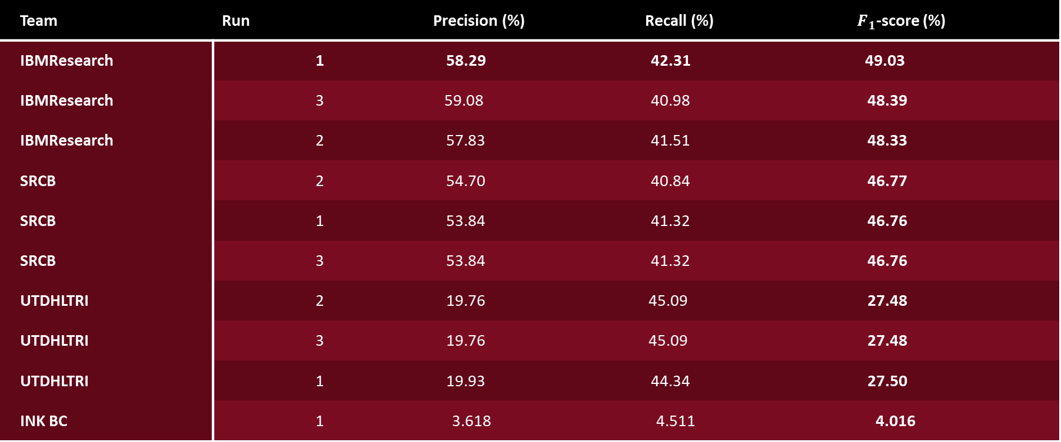
Results Task 2 (Relation)
Team | Run | Precision (%) | Recall (%) | $F_{1}$-score (%)
IBMResearch | 1 | 58.29 | 42.31 | 49.03
IBMResearch | 3 | 59.08 | 40.98 | 48.39
IBMResearch | 2 | 57.83 | 41.51 | 48.33
SRCB | 2 | 54.70 | 40.84 | 46.77
SRCB | 1 | 53.84 | 41.32 | 46.76
SRCB | 3 | 53.84 | 41.32 | 46.76
UTDHLTRI | 2 | 19.76 | 45.09 | 27.48
UTDHLTRI | 3 | 19.76 | 45.09 | 27.48
UTDHLTRI | 1 | 19.93 | 44.34 | 27.50
INK BC | 1 | 3.618 | 4.511 | 4.016

Slide 16
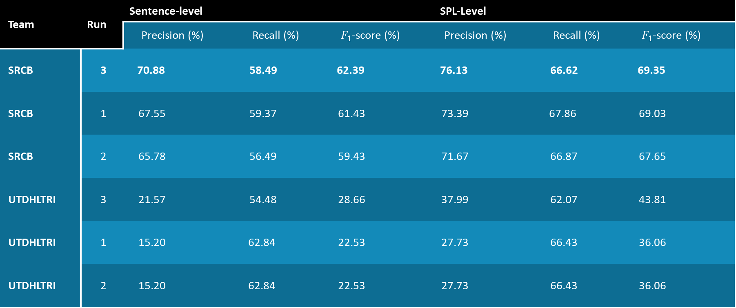
Results Task 3 (Normalization)
Team | Run | Sentence-level |  |  | SPL-Level
 |  | Precision (%) | Recall (%) | $F_{1}$-score (%) | Precision (%) | Recall (%) | $F_{1}$-score (%)
SRCB | 3 | 70.88 | 58.49 | 62.39 | 76.13 | 66.62 | 69.35
SRCB | 1 | 67.55 | 59.37 | 61.43 | 73.39 | 67.86 | 69.03
SRCB | 2 | 65.78 | 56.49 | 59.43 | 71.67 | 66.87 | 67.65
UTDHLTRI | 3 | 21.57 | 54.48 | 28.66 | 37.99 | 62.07 | 43.81
UTDHLTRI | 1 | 15.20 | 62.84 | 22.53 | 27.73 | 66.43 | 36.06
UTDHLTRI | 2 | 15.20 | 62.84 | 22.53 | 27.73 | 66.43 | 36.06

Slide 17
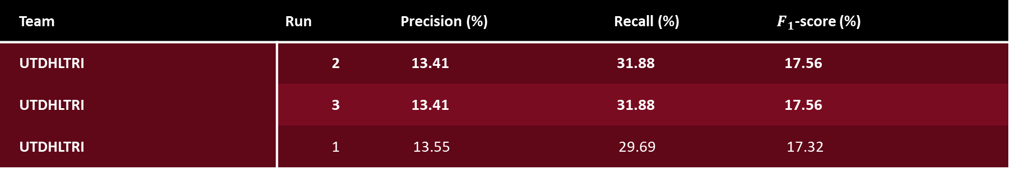
Results Task 4 (Output for FDA)
Team | Run | Precision (%) | Recall (%) | $F_{1}$-score (%)
UTDHLTRI | 2 | 13.41 | 31.88 | 17.56
UTDHLTRI | 3 | 13.41 | 31.88 | 17.56
UTDHLTRI | 1 | 13.55 | 29.69 | 17.32

Slide 18
Conclusion
Goal: evaluate and draw attention to the important problem of identifying DDIs in drug labels
DDIs are described differently in different sections
International participation
The tasks are challenging, but improved from previous year!
Task 1: 12.36% (relative; 7.19% absolute) increase
Task 2: 8.80% (relative; 3.97% absolute) increase
Task 3: 236.47% (relative; 48.74% absolute) increase
Task 4: 30% (relative; 4.09% absolute) increase
* Relative increases are computed as the percent change from the top 2018 score to the top 2019 score using the top score on the first test set from 2018 as the reference.

Slide 19
Acknowledgments
Funding:
  FDA/NLM Interagency Agreements
  NLM Grant: "Addressing gaps in clinically useful evidence on drug-drug interactions" (R01LM011838)
  NLM Intramural Research Program
Annotators:
  Mark Sharp, Phong Do, Farinaz Beniesfahany, Wujin Kim, Mohammed Abuassi, Melissa Teng, Markos Gebru, Jessica Kim, Julia Xu, Kin Wah Fung, Britney Ann Stottlemyer and Amy Grizzle
Development:
  Soumya Gayen
NIST

