Slide 1
Natural Language Processing Meets Information Retrieval:
The Past, Present, and Future
ChengXiang (“Cheng”) Zhai
Department of Computer Science
(Carl R. Woese Institute for Genomic Biology
School of Information Sciences
Department of Statistics)
University of Illinois at Urbana-Champaign
czhai@illinois.edu
http://czhai.cs.illinois.edu/
Keynote, Text Analysis Conference Workshop, Feb. 22, 2021

Slide 2
NLP as Foundation of IR
Retrieval Decision-Making
Text Representation
Query Representation
Natural Language Processing
Query
Retrieval Results
Text
collection

Slide 3
IR researchers have been concerned about NLP since day one…

Slide 4

Luhn’s idea (1958): automatic indexing based on statistical analysis of text
“It is here proposed that the frequency of word occurrence in an article furnishes a useful measurement of word significance. It is further proposed that the relative position within a sentence of words having given values of significance furnish a useful measurement for determining the significance of sentences. The significance factor of a sentence will therefore be based on a combination of these two measurements. ” (Luhn 58)
Hans Peter Luhn
(IBM)
LUHN, H.P., 'A statistical approach to mechanised encoding and searching of library information', IBM Journal of Research and Development, 1, 309-317 (1957).
LUHN, H.P., 'The automatic creation of literature abstracts', IBM Journal of Research and Development, 2, 159-165 (1958).

Slide 5
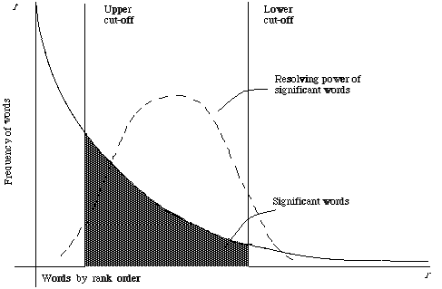
The notion of “resolving power of a word”
P(W=1): prob. of seeing word w in a document
“Resolving Power” ≈ Entropy H(W)
Feature selection for a categorization task C,
Mutual Information: I (W; C) <= H(W)
P(W=1) ≈ 0
P(W=1) ≈ 1.0
LUHN, H.P., 'The automatic creation of literature abstracts', IBM Journal of Research and Development, 2, 159-165 (1958).

Slide 6
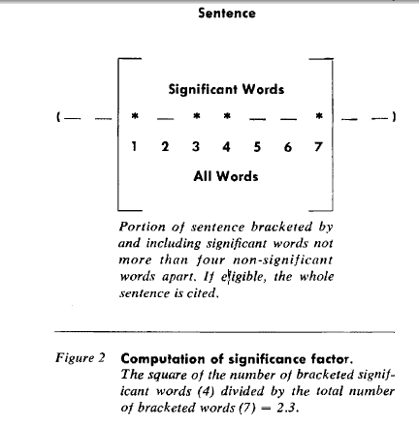
Automatic abstracting algorithm [Luhn 58]
The idea can be adapted for query-specific summarization
“In many instances condensations of documents are made emphasizing the relationship of the information in the document to a special interest or field of investigation. In such cases sentences could be weighted by assigning a premium value to a predetermined class of words.”
“In certain cases an abstract might be amplified by
following it with an enumeration of specifics, such as
names of persons, places, organizations, products, materials,
processes, et cetera. Such specific words could be
selected by the machine either because they are capitalized
or by means of lookup in a stored special dictionary.”
LUHN, H.P., 'The automatic creation of literature abstracts', IBM Journal of Research and Development, 2, 159-165 (1958).

Slide 7
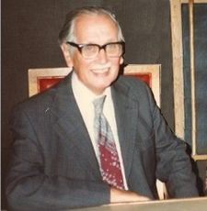
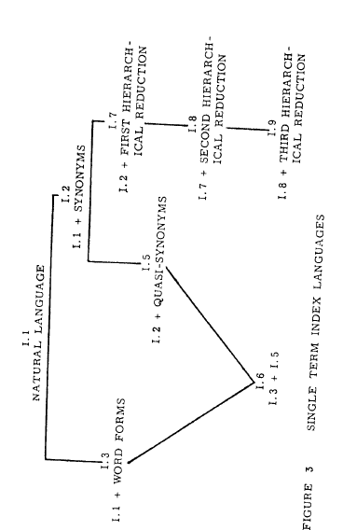
Cleverdon’s Cranfield Project (1957-1966)
Established rigorous evaluation methodology
Introduced precision & recall
Compared different linguistic units for indexing
Cyril Cleverdon
(Cranfield Inst. of Tech, UK)
Cleverdon, C., 1967, June. The Cranfield tests on index language devices. In Aslib proceedings. MCB UP Ltd.

Slide 8
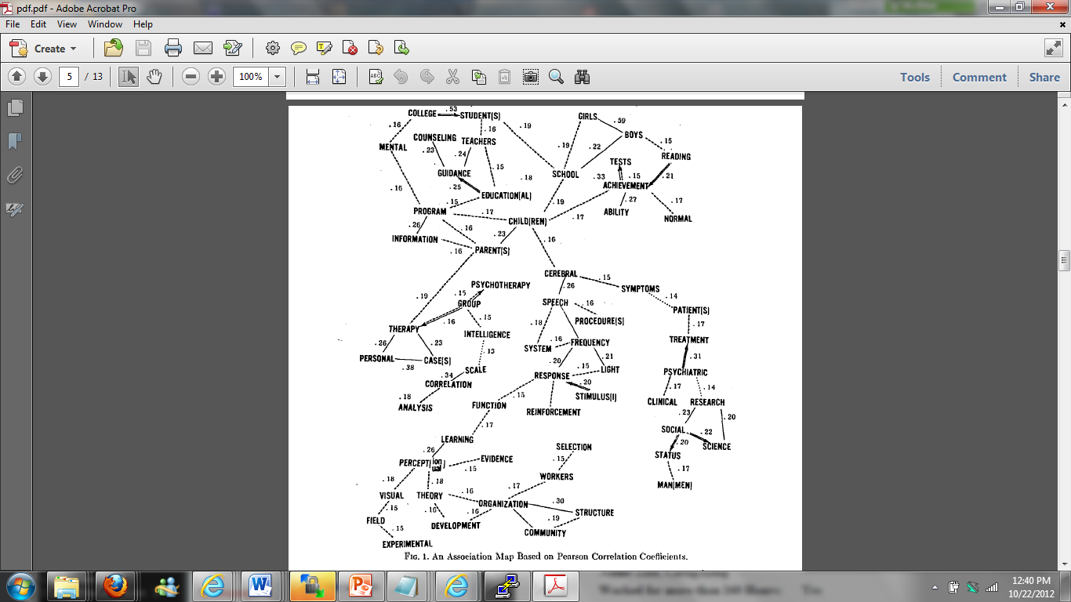
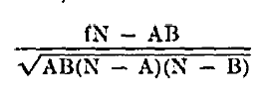
Statistical Analysis of Word Associations: Addressing Vocabulary Gap
Doyle, Lauren B, American Documentation (pre-1986); Oct 1962;
Co-occurrence-based
association measure
A: count of word A
B: count of word B
f: count of docs with “A and B”
N: total # of documents
Doyle, Lauren B. "Indexing and abstracting by association." American documentation 13.4 (1962): 378-390.

Slide 9
And many attempts have been made on improving IR with NLP techniques since then…
Beyond Bag-of-Words Representation
Word Sense Disambiguation
Deep Semantic Matching
Exploitation of Knowledge Graphs

Slide 10
NLP for IR 1: Beyond bag-of-words Representation
Motivation: single words have many problems
Different words, same meaning: car vs. vehicle
Same words, different meaning: Venetian Blinds vs. blind venetians
Different perspectives on single concept:
“The accident” vs. “the unfortunate incident”
Different meanings for the same words in different domains:
“sharp” can mean “pain intensity” or “the quality of a cutting tool”
[Smeaton’s ESSIR’95 tutorial]

Slide 11
Many different phrases explored
Statistical phrases [Fagan 88]
  Phrases are frequent n-grams
Linguistic phrases [Fagan 88, Zhai & Evans 96]
  Phrases are obtained from parsing
Lexical atoms [Zhai et al. 95; Zhai 97]
  “Sticky phrases”/non-compositional phrases (e.g., “hot dog”, “blue chip”)
Head-modifier pairs [Strzalkowski & Vauthey 95, Zhai 97]
  “fast algorithm for parsing context-free languages”
  {“fast algorithm”, “parsing algorithm”, “parsing language”, “context-free language”}
  …

Slide 12
Phrase Indexing: Results
Mostly mixed results
  Some reported insignificant improvement over single word baseline
  Others reported degradation of retrieval accuracy
While on average, using phrases may help, it doesn’t help all queries
Even when adding phrases helps, adding “too many” phrases can hurt the performance
Mixing phrases with single words is generally necessary to improve robustness

Slide 13
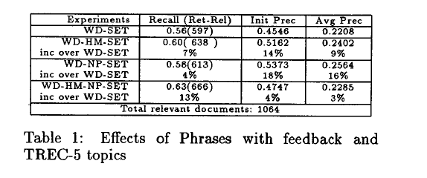
Sample Phrase Indexing Results [Zhai 97]
Too many phrases hurt performance!
Zhai, Chengxiang. "Fast statistical parsing of noun phrases for document indexing." Proceedings of ANLP 1997.

Slide 14
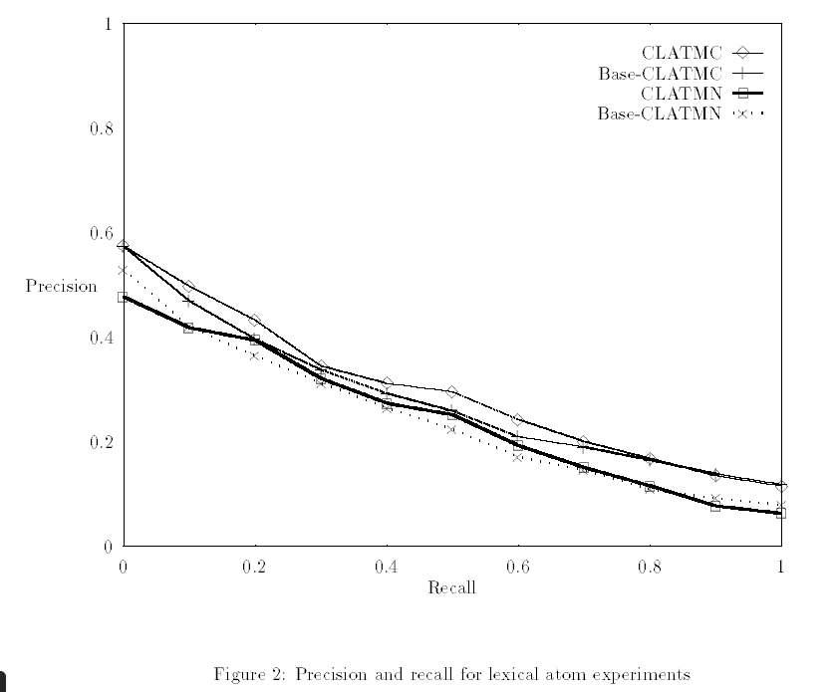
Mixed results on lexical atoms [Zhai 95, Zhai et al. 97]
Zhai, Chengxiang. "Exploiting context to identify lexical atoms--A statistical view of linguistic context." arXiv preprint cmp-lg/9701001 (1997).
Zhai, Chengxiang, Xiang Tong, Natasa Milic-Frayling, and David A. Evans. "Evaluation of syntactic phrase indexing-CLARIT NLP track report." In The Fifth Text REtrieval Conference (TREC-5. 1997.

Slide 15
NLP for IR 2: Sense Disambiguation
Motivation
  Terms are often ambiguous, causing mismatches
  What about using term disambiguation?
Many studies
  Krovetz and Croft 1992
  Voorhees 1993
  Sanderson 1994
  Schultz and Pedersen 1995
  Stokoe et al. 2003
  …

Slide 16
Disambiguation Results: Non-Promising
Manual sense disambiguation [Korvetz & Croft 92]
  Very little improvement (<=2% improvement)
  Possibly degrade performance
  Explanation: coordination of terms; skewed distribution of senses
Automatic sense disambiguation based on WordNet [Voorhees 93]
  No improvement
“pseudo sense” experiments [Sanderson 94]
IR performance is very sensitive to erroneous disambiguation …
Only when it gets to 90% accuracy it is as good as no disambiguation…
Beyond that, it yields improvement, but only when the query is short

Slide 17
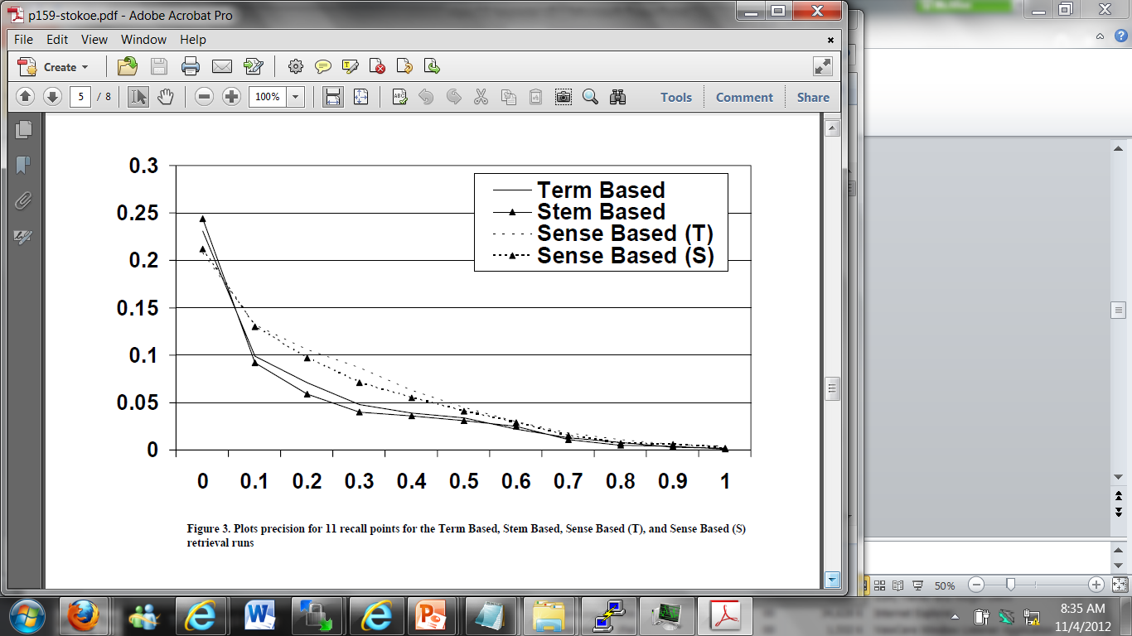
Disambiguation Results: More Promising
Corpus-based senses [Schultz & Pedersen 92]
  Senses are acquired by clustering word context
  Multiple senses are assigned to combat uncertainty
Semcor 1.6 + careful weighting [Stokoe et al. 03]

Slide 18
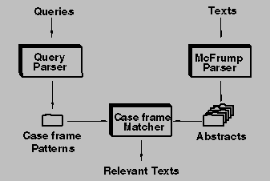
NLP for IR 3: Deep Semantic Matching: FERRET [Mauldin 91]
  using knowledge representation to represent text
  works for a very small data set in astronomy domain
  but, doesn’t scale up, possibly not outperforming stronger baseline

Slide 19
NLP for IR 4: Exploit Knowledge Graphs
Bridge the vocabulary gap by leveraging a knowledge graph
  Interactive sense feedback [Kotov & Zhai 11]
  Automatic query expansion using ConceptNet [Kotov & Zhai 12]
Knowledge graph as a representation language
  Explicit semantic matching [Xiong et al. 17]

Slide 20
Sense feedback improves retrieval accuracy on difficult topics [Kotov & Zhai 11]
 |  | KL | KL-PF | SF
AP88-89 | MAP | 0.0346 | 0.0744 | 0.0876
 | P@10 | 0.0824 | 0.1412 | 0.2031
ROBUST04 | MAP | 0.04 | 0.067 | 0.073
 | P@10 | 0.1527 | 0.1554 | 0.2608
AQUAINT | MAP | 0.0473 | 0.0371 | 0.0888
 | P@10 | 0.1188 | 0.0813 | 0.2375
Sense feedback outperforms PRF in terms of MAP and particularly in terms of Pr@10 (boldface = statistically significant (p<.05) w.r.t. KL; underline = w.r.t. to KL-PF)
Notes:
Boldface indicates statistical significance relative to KL baseline (95% confidence level, Wilcoxon signed rank test), underline indicates statistical significance relative to KL-PF

Slide 21
Research so far in using NLP for improving ad hoc IR hasn’t really made significant impact… Why?
Bag-of-words representation is powerful!
NLP hasn’t addressed any “big pain”
Robustness concerns
Walk around possible

Slide 22
Explanation 1: The Power of Bag of Words Representation
Retrieval problem is mostly a simple language processing task
“Matching” is sufficiently useful for finding relevant documents
Ideal query hypothesis: given any subset of documents that we assume a user is interested in, there exists a query that would produce near-ideal ranking
Finding an ideal query doesn’t necessarily need deep NLP

Slide 23
Explanation 2: NLP wasn’t used to solve a big pain
feedback & expansion
can take care of this
Different words, same meaning: car vs. vehicle
Same words, different meaning: Venetian Blinds vs. blind venetians
Different perspectives on single concept:
“The accident” vs. “the unfortunate incident”
Different meanings for the same words in different domains:
“sharp” can mean “pain intensity” or “the quality of a cutting tool”
How likely does this happen?
Some times domain restriction solves the problem naturally. Other words in the query help providing disambiguation.

Slide 24
Explanation 3: Lack of consideration of robustness
Standard IR models are optimized for bag of terms representation
When incorporating phrases, we no longer have optimal term weighting
  e.g., how to optimize phrase weighting when single words are also used for indexing?
Need to tolerate NLP errors

Slide 25
Explanation 4: Workaround possible
Frequency of queries
Bypass difficult NLP problems
Difficult tail queries require more NLP!
Clickthrough
Feedback,
vocabulary gap; need user interactions
Pseudo feedback
Statistical term weighting, probabilistic models
Queries

Slide 26
Would deep learning, embedding, and BERT make a difference? Yes, but …

Slide 27
Word embedding is beneficial for query expansion
Local (topic-specific) embedding is beneficial [Diaz et al. 16]
Relevance-based embedding (instead of co-occurrence-based) is beneficial [Zamani & Croft 17]
However,
  the ideas exploited have been known in IR for many years(pseudo feedback [Xu & Croft 96], relevance model [Lavrenko & Croft 01])
  Many traditional methods can achieve a similar effect

Slide 28
Neural Ranking Models are struggling to succeed
Many published neural ranking models don’t really outperform traditional retrieval models [Lin 19]
Some “well-crafted” neural ranking models seem to be promising, but their robustness remains being tested [Guo et al. 20]
The traditional retrieval models (e.g., BM25) remain robust and competitive
Lin, Jimmy. "The neural hype and comparisons against weak baselines." In ACM SIGIR Forum, vol. 52, no. 2, pp. 40-51. New York, NY, USA: ACM, 2019.
Guo, Jiafeng, Yixing Fan, Liang Pang, Liu Yang, Qingyao Ai, Hamed Zamani, Chen Wu, W. Bruce Croft, and Xueqi Cheng. "A deep look into neural ranking models for information retrieval." Information Processing & Management 57, no. 6 (2020): 102067.

Slide 29
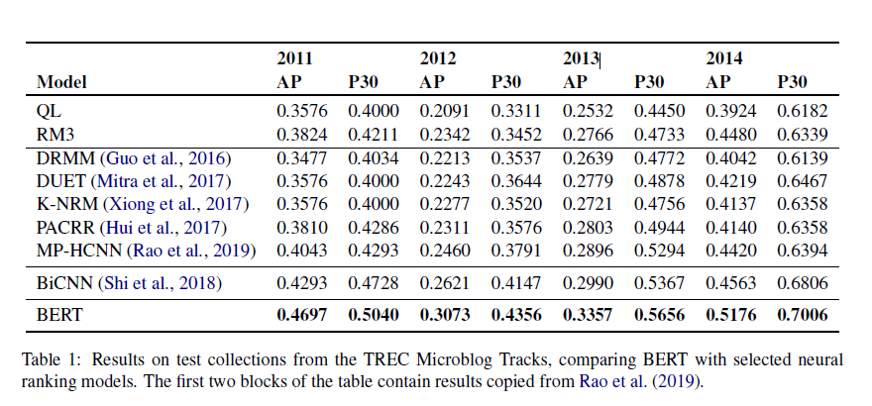
BERT works well, but the baselines could be stronger [Yang et al. 19]
“… For evaluation on each year’s dataset, we used the remaining years for fine tuning, e.g., tuning on 2011–2013 data, testing on 2014 data.”
Yang, Wei, Haotian Zhang, and Jimmy Lin. "Simple applications of BERT for ad hoc document retrieval." arXiv preprint arXiv:1903.10972 (2019).

Slide 30
How could NLP make more significant impact on IR?
Bag-of-words representation is powerful!
NLP hasn’t addressed any “big pain”
Robustness concerns
Walk around possible
Focus on cases where the bag-of-words representation is clearly insufficient (e.g., vocabulary gap)
Address a “big pain”
Long-tail difficult queries
Need a solid strategy to accommodate errors of NLP
Interactive IR
Accurate semantic representation, knowledge base, reasoning

Slide 31
NLP for IR Opportunity 1: Long-tail queries
NLP for query understanding in context
  Query segmentation
  Query parsing
  Query interpretation
  Do all these in the context of search session and user interaction history
NLP for document browsing (with human in the loop)
  When querying fails, browsing helps
  How to create a multiresolution topic map?
NLP for interactive search
  How to generate clarification questions? (Did you mean “Jaguar” as a car or animal?)

Slide 32
More opportunities for NLP in interactive IR
Retrieval Decision-Making
2. Query/Intent
Understanding
(Pragmatics)
Text Representation
Query Representation
1. Document
Understanding
(Human-in-Loop)
3. Result
Presentation
(Interactive
summarization)
Natural Language Processing
Query
Retrieval Results
4. Query
Formulation
(Scaffolding,
Clarification)
Text
collection
5. Content Digestion
(Explanation)

Slide 33
NLP for IR Opportunity 2: Beyond Topical Relevance
Traditional IR work has focused on exclusively topical relevance
Real users care about other dimensions of relevance as well
  Sentiment/Opinion retrieval [Pang & Lee 02]: find positive opinions about X
  Readability [Collins-Thompson & Callan 05]: find documents with readability level of elementary school students
  Trustworthiness [Vydiswaran et al. 10]
  Many other opportunities!
Pang, Bo, Lillian Lee, and Shivakumar Vaithyanathan. "Thumbs up? Sentiment classification using machine learning techniques." arXiv preprint cs/0205070 (2002).
Collins‐Thompson, Kevyn, and Jamie Callan. "Predicting reading difficulty with statistical language models." Journal of the American Society for Information Science and Technology 56, no. 13 (2005): 1448-1462.

Slide 34

NLP for IR Opportunity 3+: Beyond Search
Search
Information Synthesis
& Analysis
Task Completion
Search 1
Search 2
…
Decision Making
Learning
…
Information Interpretation
Information Synthesis
Potentially iterate…
Multiple Searches

Slide 35
How can we build a general text analysis engine?
Task Completion
Search
Information Synthesis & Analysis
Search 1
Search 2
…
Decision Making
Learning
…
Analysis Engine

Slide 36







Growing opportunities for “big text data” applications
How can we turn “big text data” into “big knowledge”?
WWW
Email
Government
Personal
Enterprise
Literature
News
Social Media
…

Slide 37
Big Data-Enabled Artificial Intelligence
Autonomous AI: Intelligent systems to replace humans
Training Data
(Supervised) Machine Learning
Big Data
Observations of World
Human
(Unsupervised) Machine Learning
Data Mining
Intelligence
Assistive AI: Intelligent systems to assist humans

Slide 38
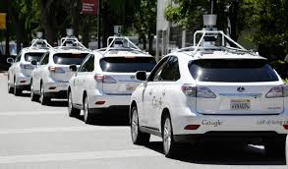

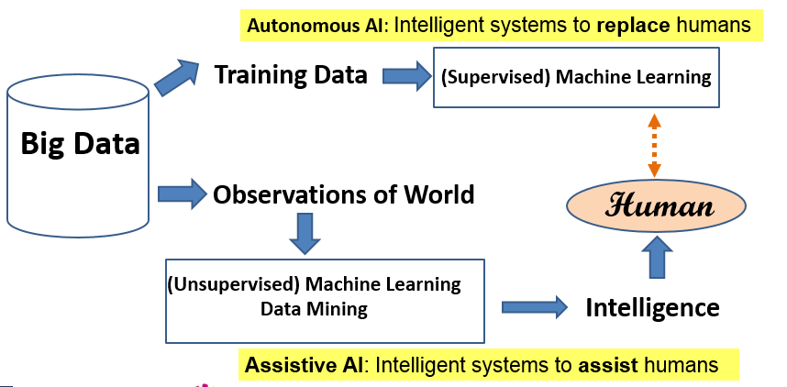


Autonomous AI vs. Assistive AI
Autonomous AI
Simple tasks, Big training data available, Limited domain
Intelligence(Machine) ≤ Intelligence (Human) [Upper Bound]
Any domain, All kinds of data
Text Data
Decision Support
TextScope
“Data Scope” to enhance human perception, Complex tasks
Intelligence (Machine + Human) > Intelligence(Human) [Lower Bound]
Human in the Loop
Assistive AI
Tasks that humans can’t (easily) do

Slide 39




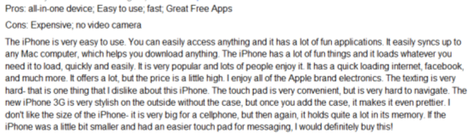

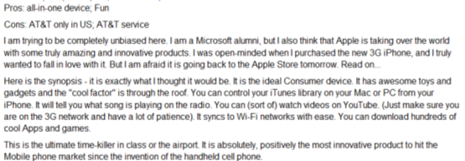
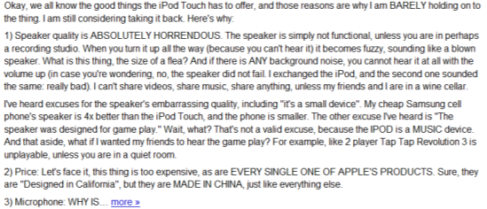
Humans as Subjective & Intelligent “Sensors”
Sense
Report
Real World
Sensor
Data
Weather
Thermometer
3°C , 15°F, …
Locations
Geo Sensor
41°N and 120°W ….
Network Sensor
01000100011100
Networks
Perceive
Express
“Human Sensor”

Slide 40
Unique Value of Text Data
Useful in all big data applications (since humans are involved in all application domains and they generate text data)
Especially useful for mining knowledge about people’s behavior, attitude, and opinions
  The subjectivity of human sensors creates both challenges in accurately understanding the truth behind text data and also opportunities to mine properties about the sensors themselves.
Directly express knowledge about our world ➔ Small text data are also useful!

Slide 41
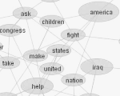

Opportunities of Text Mining Applications
+ Non-Text Data
4. Infer other real-world variables
(predictive analytics)
2. Mining content of text data
Real World
Observed World
Text Data
+ Context
Perceive
Express
(Perspective)
(English)
3. Mining knowledge
about the observer
1. Mining knowledge
about language

Slide 42


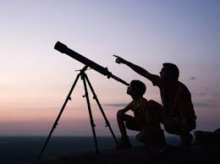
TextScope to enhance human perception
TextScope
Microscope
Telescope
  Intelligent Interactive Retrieval & Text Analysis
  for Task Support and Decision Making

Slide 43


TextScope in Action: intelligent interactive decision support
TextScope
Prediction of
Decision Factors
(Current & Future)
Predictive
Model
Multiple
Predictors
(Features)
Learning to interact
Domain Knowledge
…
Optimal Decision Making
Prediction
…
Text + Non-Text
Sensor 1
Joint Mining of Non-Text
and Text
Real World
Non-Text
Data
Interactive
text analysis
Sensor k
…
Text
Data
Interactive information retrieval
Natural language processing

Slide 44
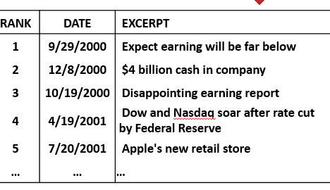
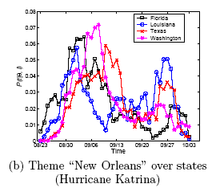
Envisioned Interface of TextScope:
Intelligent & Interactive Information Retrieval + Text Mining
Task Panel
TextScope
…
Topic Analyzer
Opinion
Prediction
Event Radar
Search Box
Microsoft (MSFT,) Google, IBM (IBM) and other cloud-computing rivals of Amazon Web Services are bracing for an AWS "partnership" announcement with VMware expected to be announced Thursday. …
TrainableFilter1
TrainableFilter2
…
Select Time
Select Region
MyWorkSpace
Project 1
Alert A
Alert B ...

Slide 45
Beyond TextScope: From Assistive AI to Autonomous AI
DataScope
Autonomous AI
Assistive AI
TextScope
...
Intelligent
Task Agents
…
…
Prediction of
Decision Factors
(Current & Future)
Predictive
Model
Multiple
Predictors
(Features)
Learning to interact
Domain Knowledge
…
Learning to explore
Optimal Decision Making
Prediction
Learning to collaborate
…
Text + Non-Text
Sensor 1
Joint Mining of Non-Text
and Text
Real World
Non-Text
Data
Many NLP + IR Challenges!
Understand text in context
User-assisted NLP
NLP for HCI (user modeling)
Analysis of
non-text data
Interactive
text analysis
Sensor k
…
Text
Data
Interactive information retrieval
Natural language processing

Slide 46
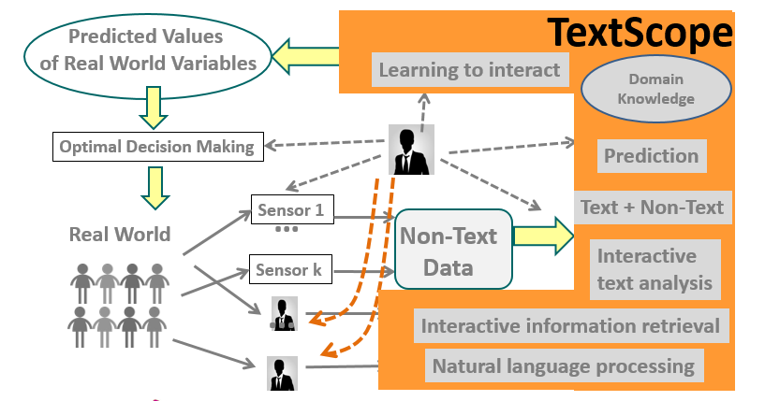
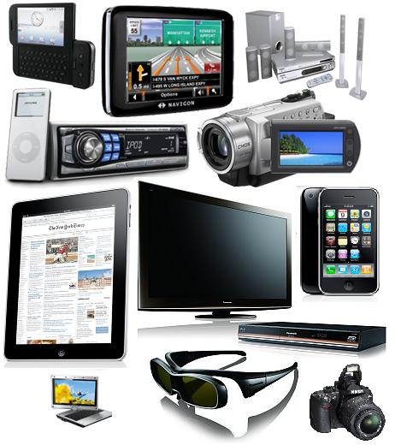
Application 3: Business intelligence
TextScope Application 1: Business Intelligence
Business intelligence
Consumer trends…
Business analysts, Market researcher…
Products

Slide 47




Latent Aspect Rating Analysis (LARA) [Wang et al. 10]
TextScope
How to infer aspect ratings?
How to infer aspect weights?
Value Location Service …
Value Location Service …
Hongning Wang, Yue Lu, ChengXiang Zhai. Latent Aspect Rating Analysis on Review Text Data: A Rating Regression Approach, Proceedings of the 17th ACM SIGKDD International Conference on Knowledge Discovery and Data Mining (KDD'10), pages 115-124, 2010.

Slide 48
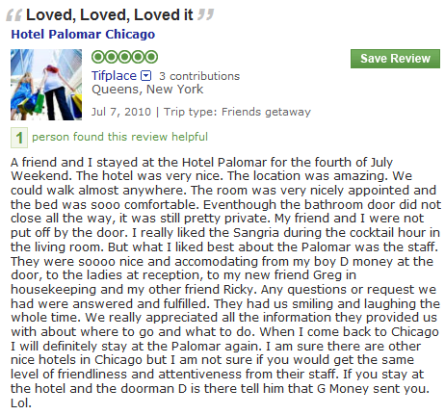
Solving LARA in two stages:
Aspect Segmentation + Rating Regression
Aspect Segmentation
+
Latent Rating Regression
Reviews + overall ratings
Aspect segments
Term Weights
Aspect Rating
Aspect Weight
location:1
amazing:1
walk:1
anywhere:1
0.0
2.9
0.1
0.9
3.9
0.2
room:1
nicely:1
appointed:1
comfortable:1
0.1
1.7
0.1
3.9
4.8
0.2
nice:1
accommodating:1
smile:1
friendliness:1
attentiveness:1
2.1
1.2
1.7
2.2
0.6
5.8
0.6
Observed
Latent!

Slide 49

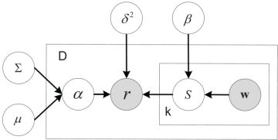


Latent Rating Regression [Wang et al. 2010]
Aspect segments
Term Weights
Aspect Rating
Aspect Weight
location:1
amazing:1
walk:1
anywhere:1
0.0
0.9
0.1
0.3
1.3
0.2
room:1
nicely:1
appointed:1
comfortable:1
0.1
0.7
0.1
0.9
1.8
0.2
nice:1
accommodating:1
smile:1
friendliness:1
attentiveness:1
0.6
0.8
0.7
0.8
0.9
3.8
0.6
Conditional likelihood
Hongning Wang, Yue Lu, ChengXiang Zhai. Latent Aspect Rating Analysis on Review Text Data: A Rating Regression Approach, Proceedings of the 17th ACM SIGKDD International Conference on Knowledge Discovery and Data Mining (KDD'10), pages 115-124, 2010.

Slide 50




A Unified Generative Model for LARA
Entity
Review
Aspect Rating
Aspect Weight
Location
location
amazing
walk
anywhere
Excellent location in walking distance to Tiananmen Square and shopping streets. That’s the best part of this hotel! The rooms are getting really old. Bathroom was nasty. The fixtures were falling off, lots of cracks and everything looked dirty. I don’t think it worth the price. Service was the most disappointing part, especially the door men. this is not how you treat guests, this is not hospitality.
0.86
Room
room
dirty
appointed
smelly
Aspects
0.04
Service
terrible
front-desk
smile
unhelpful
0.10
Hongning Wang, Yue Lu, ChengXiang Zhai, Latent Aspect Rating Analysis without Aspect Keyword Supervision, Proceedings of KDD 2011, pages 618-626.

Slide 51
Decomposed ratings show difference between hotels with the same overall rating
(All 5 Stars hotels, ground-truth in parenthesis.)
Hotel | Value | Room | Location | Cleanliness
Grand Mirage Resort | 4.2(4.7) | 3.8(3.1) | 4.0(4.2) | 4.1(4.2)
Gold Coast Hotel | 4.3(4.0) | 3.9(3.3) | 3.7(3.1) | 4.2(4.7)
Eurostars Grand Marina Hotel | 3.7(3.8) | 4.4(3.8) | 4.1(4.9) | 4.5(4.8)

Slide 52
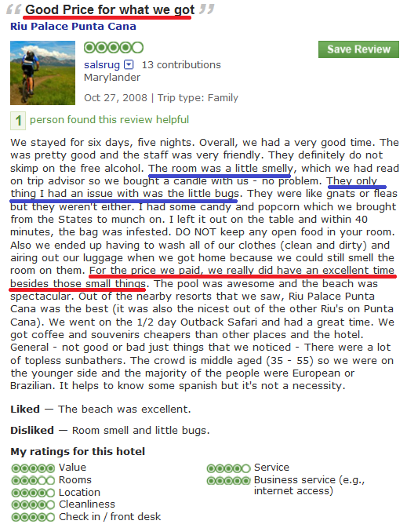
Decomposed ratings show detailed opinions of reviewers
Good price for what we got
Hotel Riu Palace Punta Cana
Reviewer | Value | Room | Location | Cleanliness
Mr.Saturday | 3.7(4.0) | 3.5(4.0) | 3.7(4.0) | 5.8(5.0)
Salsrug | 5.0(5.0) | 3.0(3.0) | 5.0(4.0) | 3.5(4.0)
“… For the price we paid,
we did have a good time besides those small things…. “

Slide 53
“By-product”: Aspect-Specific Sentiment Lexicon
Useful for tagging new review text (e.g., tweets)
Value | Rooms | Location | Cleanliness
resort 22.80 | view 28.05 | restaurant 24.47 | clean 55.35
value 19.64 | comfortable 23.15 | walk 18.89 | smell 14.38
excellent 19.54 | modern 15.82 | bus 14.32 | linen 14.25
worth 19.20 | quiet 15.37 | beach 14.11 | maintain 13.51
bad -24.09 | carpet -9.88 | wall -11.70 | smelly -0.53
money -11.02 | smell -8.83 | bad -5.40 | urine -0.43
terrible -10.01 | dirty -7.85 | road -2.90 | filthy -0.42
overprice -9.06 | stain -5.85 | website -1.67 | dingy -0.38
Positive
Negative

Slide 54
Enable comparative analysis of rating behavior & preferences
 | Expensive Hotel |  | Cheap Hotel
 | 5 Stars | 3 Stars | 5 Stars | 1 Star
Value | 0.134 | 0.148 | 0.171 | 0.093
Room | 0.098 | 0.162 | 0.126 | 0.121
Location | 0.171 | 0.074 | 0.161 | 0.082
Cleanliness | 0.081 | 0.163 | 0.116 | 0.294
Service | 0.251 | 0.101 | 0.101 | 0.049
People liking cheap hotels care most about “Value”
People liking expensive hotels
care most about “Service”
Less/no difference when they didn’t like a hotel:
All care a lot about “Cleanliness”

Slide 55
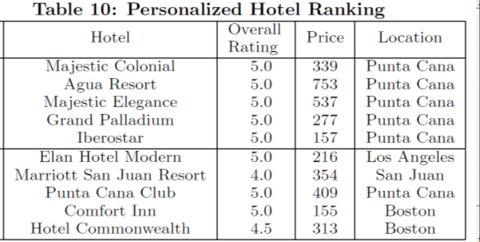
Enable personalized recommendation of entities
Non-Personalized:
Using all reviewers
Query: 0.9 value
0.1 others
Personalized: Using reviewers with similar weighting

Slide 56

TextScope Application 2: Stock Market
Market volatility
Stock trends, …
Stock traders, financial analysts,…
Events in Real World

Slide 57
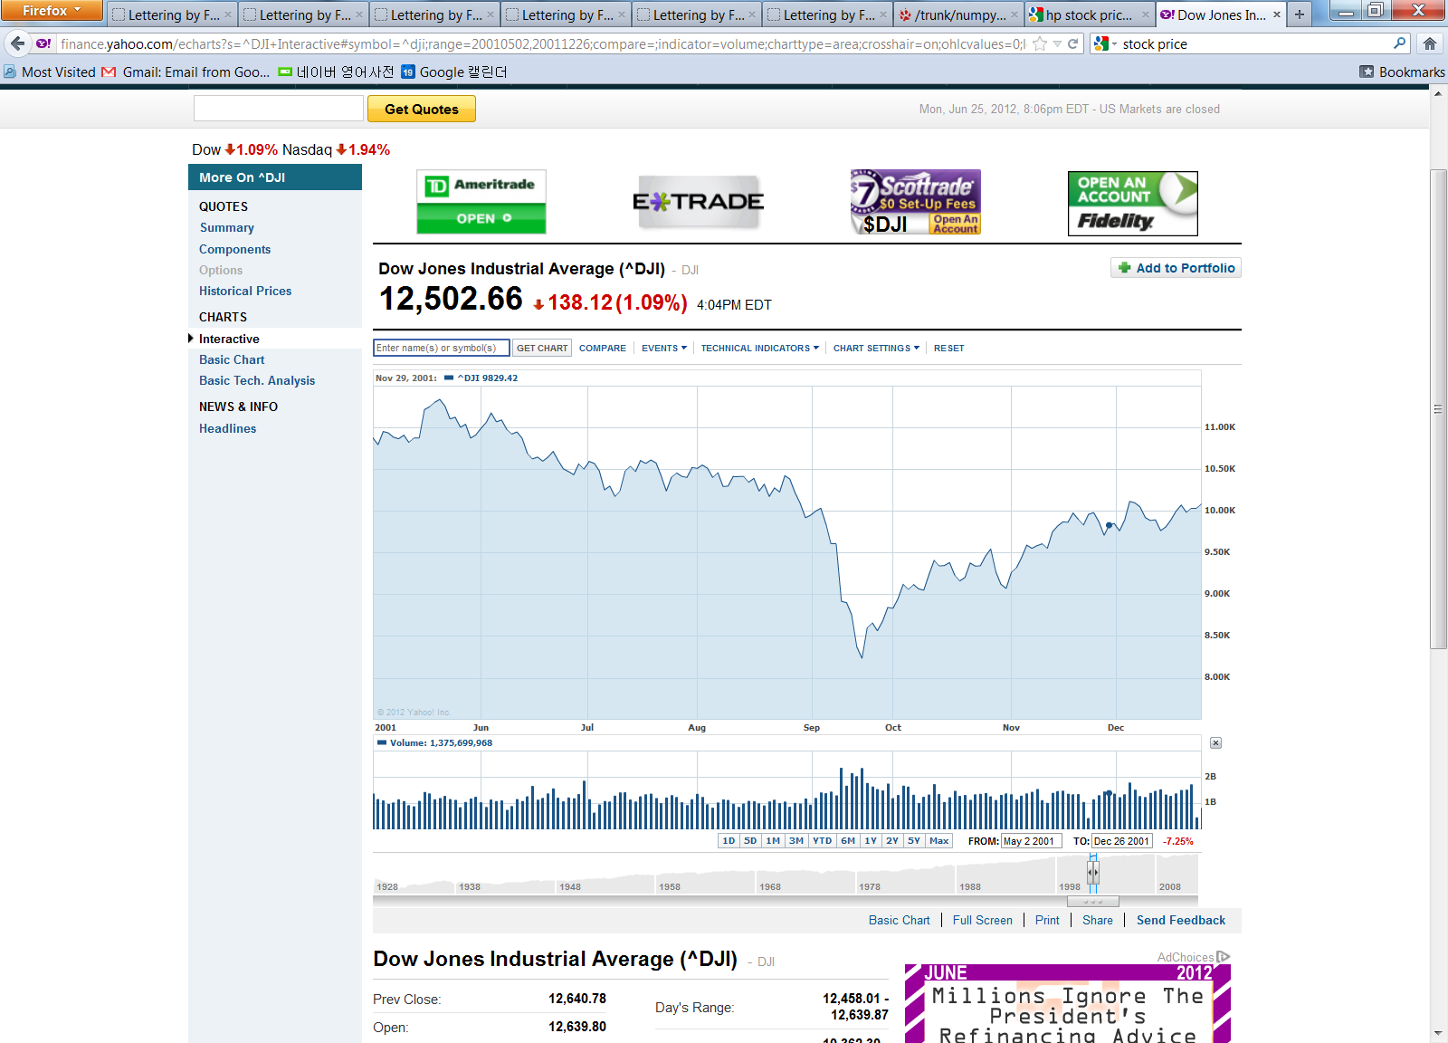
Text Mining for Understanding Time Series [Kim et al. CIKM’13]
What might have caused the stock market crash?
Sept 11 attack!
TextScope
Dow Jones Industrial Average [Source: Yahoo Finance]
…
Time
…
Time
Any clues in the companion news stream?
H. Kim, M. Castellanos, M. Hsu, C. Zhai, T. A. Rietz, D. Diermeier. Mining causal topics in text data: iterative topic modeling with time series feedback, Proceedings of ACM CIKM 2013, pp. 885-890, 2013.
Notes:
If we consider external factor, there are additional challenges.
For example, this is Dow Jones Industrial Average, average stock price.
Near September, stock price crash. Actually, this is 2001, and September 11 terrorist attack happened at that time.
Like this, these days, need for analyzing text data jointly with external temporal factor is increasing.
If we can understand why this happen, automatically find reasons, it would be very useful.

Slide 58
A General Framework for Causal Topic Modeling [Kim et al. CIKM’13]
Text Stream
Topic Modeling
Causal Topics
Topic 1
Topic 2
Topic 1
Topic 2
Sep
2001
Oct …
2001
Topic 3
Topic 4
Topic 3
Topic 4
Non-text
Time Series
Zoom into
Word Level
Feedback
as Prior
Split Words
Topic 1
W1 +
W2 --
W3 +
W4 --
W5
…
Topic 1-1
W1 +
W3 +
Causal
Words
Topic 1-2
W2 --
W4 --
H. Kim, M. Castellanos, M. Hsu, C. Zhai, T. A. Rietz, D. Diermeier. Mining causal topics in text data: iterative topic modeling with time series feedback, Proceedings of ACM CIKM 2013, pp. 885-890, 2013.

Slide 59
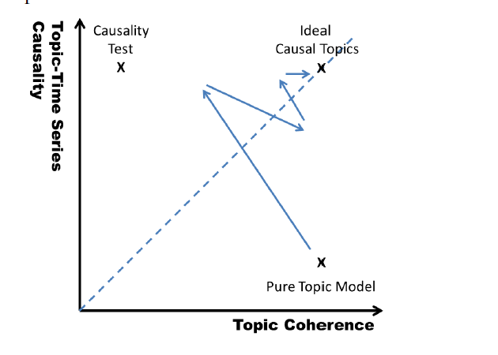
Heuristic Optimization of Causality + Coherence

Slide 60
Stock-Correlated Topics in New York Times: June 2000 ~ Dec. 2011
AAMRQ (American Airlines) | AAPL (Apple)
russia russian putin europe european germany bush gore presidential police court judge airlines airport air united trade terrorism food foods cheese nets scott basketball tennis williams open awards gay boy moss minnesota chechnya | paid notice st russia russian europe olympic games olympics she her ms oil ford prices black fashion blacks computer technology software internet com web football giants jets japan japanese plane …
Topics are biased toward each time series
Hyun Duk Kim, Malu Castellanos, Meichun Hsu, ChengXiang Zhai, Thomas A. Rietz, Daniel Diermeier. Mining causal topics in text data: iterative topic modeling with time series feedback, Proceedings of the 22nd ACM international conference on Information
and knowledge management (CIKM ’13), pp. 885-890, 2013.

Slide 61
“Causal Topics” in 2000 Presidential Election
Top Three Words in Significant Topics from NY Times
tax cut 1 screen pataki guiliani enthusiasm door symbolic oil energy prices news w top pres al vice love tucker presented partial abortion privatization court supreme abortion gun control nra
Text: NY Times (May 2000 - Oct. 2000)
Time Series: Iowa Electronic Market
http://tippie.uiowa.edu/iem/
Issues known to be
important in the
2000 presidential election

Slide 62
Retrieval with Time Series Query [Kim et al. ICTIR’13]
News
2000
2001 …
RANK | DATE | EXCERPT
1 | 9/29/2000 | Expect earning will be far below
2 | 12/8/2000 | $4 billion cash in company
3 | 10/19/2000 | Disappointing earning report
4 | 4/19/2001 | Dow and Nasdaq soar after rate cut by Federal Reserve
5 | 7/20/2001 | Apple's new retail store
… | … | …
Hyun Duk Kim, Danila Nikitin, ChengXiang Zhai, Malu Castellanos, and Meichun Hsu. 2013. Information Retrieval with Time Series Query. In Proceedings of the 2013 Conference on the Theory of Information Retrieval (ICTIR '13).

Slide 63
Summary
NLP is the foundation for IR, but NLP hasn’t made any significant impact so far when IR is defined as “ad hoc retrieval”:
  Most queries are too “easy” to see any impact of NLP; simple NLP + statistical learning are sufficient, but harder queries are also hard for the current NLP technologies (robustness)
Opportunities for more impactful NLP on IR
  Tackle long-tail difficult queries with knowledge, reasoning, and interaction with users (human-in-loop NLP, interactive sum. , explanation, scaffolding, clarification, …)
  Beyond topical-relevance: opinion retrieval, readability, trustworithiness, ….
  Beyond search to support user tasks, especially decision making: TextScope
Think about NLP for not just autonomous AI, but also assistive AI
  Aim to deliver functions that cannot be performed by humans (augment human intelligence)
  Joint analysis of text and non-textual (context) data
  Optimization of the combined intelligence of computer and humans
TREC + TAC = TRAC (Text Retrieval and Analysis Conference)? Text-based Prediction?
Jiang, Shan, Chengxiang Zhai, and Qiaozhu Mei. "Exploiting knowledge graph to improve text-based prediction." In 2018 IEEE International Conference on Big Data (Big Data), pp. 1407-1416. IEEE, 2018.

Slide 64
Looking forward to opportunities for collaboration!
Thank You!
czhai@Illinois.edu

