Slide 1
IBM Research AI Systems for TAC 2020 KBP: RUFES Track
Parul Awasthy*, Ken Barker*, Jian Ni, Taesun Moon, Radu Florian

Slide 2
Outline
Introduction
Data
RUFES
KLUE
DBpedia Abstract Corpus
Fine Grained Typing Methods
Supervised System
Weakly Supervised System
Synthetic Data System
Coreference Resolution
Results and Discussion

Slide 3
Task Overview
LEVEL 1 Type
APP
ConsumerGoods
Document
FAC
GPE
IllHealth
LAW
LOC
ORG
Pathogen
PER
Publication
VEH
WEA
RUFES: Recognize Ultra Fine-grained EntitieS
Fine-Grained Entity Extraction and Coreference Detection
Type decided based on paragraph context
265 Hierarchical Types
14 main Types
NAM, NOM, PRO types of mentions
Josue Aguiluz, 21, a Honduran student from Colesville, MD.
PER.Student-NAM
PER.Student-NOM
GPE.ProvinceState-NAM
GPE.Country-NAM
LOC.Region-NAM

Slide 4
Outline
Introduction
Data
RUFES
KLUE
DBpedia Abstract Corpus
Fine Grained Typing Methods
Supervised System
Weakly Supervised System
Synthetic Data System
Coreference Resolution
Results and Discussion

Slide 5
Data
Approaches for low-data tasks
Figure out how to do it without data
Transfer a model from another task
Make your own data
KLUE dataset: within-genre, within-domain, similar (top-level) type system
DBpedia Abstract dataset: different genre, encompassing domain, different type system

Slide 6
Data: RUFES
100,000 unannotated documents corpus
50 annotated sample documents
After phase 1 submission
10 partially annotated feedback documents
Tested on 106 annotated evaluation documents

Slide 7
Data: KLUE
In-house annotated data with mention and coreference annotations
12 out of 14 types overlap with RUFES coarse types
1130 train documents, 280 dev/test documents
Used for Coreference and some cascaded models
LEVEL 1 Type | KLUE
APP | PRODUCT
ConsumerGoods | SUBSTANCE, FOOD
Document | --
FAC | FAC
GPE | GPE
IllHealth | DISEASE
LAW | LAW
LOC | LOCATION
ORG | ORGANIZATION
Pathogen | --
PER | PERSON, PEOPLE
Publication | TITLEWORK
VEH | VEHICLE
WEA | WEAPON

Slide 8
Data: DBpedia Abstract Corpus
Wikipedia abstracts (introductory section of Wikipedia articles)
Hyperlinks replaced with DBpedia resources (URIs)
Seven languages
English
4,415,993 abstracts
39,650,948 entity mentions linked to DBpedia

Slide 9
<http://dbpedia.org/resource/Lambic/abstract#offset_0_790>
a nif:String, nif:OffsetBasedString, nif:Context ;
nif:isString """Lambic is a type of beer traditionally brewed in the Pajottenland region of Belgium (southwest of Brussels) and in Brussels itself at the Cantillon Brewery and museum. Lambic is now mainly consumed after refermentation, resulting in derived beers such as Gueuze or Kriek lambic. Unlike conventional beers, which are fermented by carefully cultivated strains of brewer's yeasts, lambic is produced by spontaneous fermentation: it is exposed to the wild yeasts and bacteria that are said to be native to the Zenne valley, in which Brussels lies. It is this unusual process which gives the beer its distinctive flavour: dry, vinous, and cidery, usually with a sour aftertaste."""^^xsd:string;
nif:beginIndex "0"^^xsd:int;
nif:endIndex "790"^^xsd:int;
nif:sourceUrl <http://en.wikipedia.org/wiki/Lambic> .
<http://dbpedia.org/resource/Lambic/abstract#offset_20_24>
a nif:String, nif:OffsetBasedString ;
nif:referenceContext <http://dbpedia.org/resource/Lambic/abstract#offset_0_790> ;
nif:anchorOf """beer"""^^xsd:string ;
nif:beginIndex "20"^^xsd:int ;
nif:endIndex "24"^^xsd:int ;
prov:wasAttributedTo <http://wikipedia.org> ;
a nif:Word ;
itsrdf:taIdentRef <http://dbpedia.org/resource/Beer> .
<http://dbpedia.org/resource/Lambic/abstract#offset_53_72>
nif:referenceContext <http://dbpedia.org/resource/Lambic/abstract#offset_0_790> ;
nif:anchorOf """Pajottenland region"""^^xsd:string ;
nif:beginIndex "53"^^xsd:int ;
nif:endIndex "72"^^xsd:int ;
prov:wasAttributedTo <http://wikipedia.org> ;
a nif:Phrase ;
itsrdf:taIdentRef <http://dbpedia.org/resource/Pajottenland> .
<http://dbpedia.org/resource/Lambic/abstract#offset_138_155>
nif:referenceContext <http://dbpedia.org/resource/Lambic/abstract#offset_0_790> ;
nif:anchorOf """Cantillon Brewery"""^^xsd:string ;
nif:beginIndex "138"^^xsd:int ;
nif:endIndex "155"^^xsd:int ;
prov:wasAttributedTo <http://wikipedia.org> ;
a nif:Phrase ;
itsrdf:taIdentRef <http://dbpedia.org/resource/Cantillon_Brewery> .
...

Slide 10
<http://dbpedia.org/resource/Lambic/abstract#offset_0_790>
a nif:String, nif:OffsetBasedString, nif:Context ;
nif:isString """Lambic is a type of beer traditionally brewed in the Pajottenland region of Belgium (southwest of Brussels) and in Brussels itself at the Cantillon Brewery and museum. Lambic is now mainly consumed after refermentation, resulting in derived beers such as Gueuze or Kriek lambic. Unlike conventional beers, which are fermented by carefully cultivated strains of brewer's yeasts, lambic is produced by spontaneous fermentation: it is exposed to the wild yeasts and bacteria that are said to be native to the Zenne valley, in which Brussels lies. It is this unusual process which gives the beer its distinctive flavour: dry, vinous, and cidery, usually with a sour aftertaste."""^^xsd:string;
nif:beginIndex "0"^^xsd:int;
nif:endIndex "790"^^xsd:int;
nif:sourceUrl <http://en.wikipedia.org/wiki/Lambic> .
<http://dbpedia.org/resource/Lambic/abstract#offset_20_24>
a nif:String, nif:OffsetBasedString ;
nif:referenceContext <http://dbpedia.org/resource/Lambic/abstract#offset_0_790> ;
nif:anchorOf """beer"""^^xsd:string ;
nif:beginIndex "20"^^xsd:int ;
nif:endIndex "24"^^xsd:int ;
prov:wasAttributedTo <http://wikipedia.org> ;
a nif:Word ;
itsrdf:taIdentRef <http://dbpedia.org/resource/Beer> .
<http://dbpedia.org/resource/Lambic/abstract#offset_53_72>
nif:referenceContext <http://dbpedia.org/resource/Lambic/abstract#offset_0_790> ;
nif:anchorOf """Pajottenland region"""^^xsd:string ;
nif:beginIndex "53"^^xsd:int ;
nif:endIndex "72"^^xsd:int ;
prov:wasAttributedTo <http://wikipedia.org> ;
a nif:Phrase ;
itsrdf:taIdentRef <http://dbpedia.org/resource/Pajottenland> .
<http://dbpedia.org/resource/Lambic/abstract#offset_138_155>
nif:referenceContext <http://dbpedia.org/resource/Lambic/abstract#offset_0_790> ;
nif:anchorOf """Cantillon Brewery"""^^xsd:string ;
nif:beginIndex "138"^^xsd:int ;
nif:endIndex "155"^^xsd:int ;
prov:wasAttributedTo <http://wikipedia.org> ;
a nif:Phrase ;
itsrdf:taIdentRef <http://dbpedia.org/resource/Cantillon_Brewery> .
...
Lambic O
is O
a O
type O
of O
beer B-ConsumerGoods.Food
traditionally O
brewed O
in O
the O
Pajottenland B-LOC.Region
region I-LOC.Region
of O
Belgium B-GPE.Country
( O
southwest O
of O
Brussels B-GPE.City
) O
and O
in O
Brussels O
itself O
at O
the O
Cantillon B-ORG.CommercialOrg.Manufacturer
Brewery I-ORG.CommercialOrg.Manufacturer
and O
museum O
. O

Slide 11
Map RUFES Types to DBpedia Ontology Classes
Area
Food
Beverage
Wine
ControlledDesignationOfOriginWine
Vodka
Beer
Cheese
MeanOfTransportation
Tram
SpaceShuttle
MilitaryVehicle
Locomotive
Automobile
Rocket
TrainCarriage
Train
Motorcycle
Ship
SpaceStation
Aircraft
MilitaryAircraft
On-SiteTransportation
Escalator
ConveyorSystem
MovingWalkway
Spacecraft
Tank
ConsumerGoods.Food
…
VEH
VEH.Aircraft
VEH.Aircraft.CivilAircraft
VEH.Aircraft.MilitaryAircraft
VEH.Rocket
VEH.Spacecraft
VEH.Spacecraft.Satellite
VEH.Spacecraft.SpaceStation
VEH.Watercraft
VEH.Watercraft.Boat
VEH.Watercraft.CargoShip
VEH.Watercraft.CruiseShip
VEH.Watercraft.Warship
VEH.Watercraft.Yacht
VEH.WheeledVehicle
VEH.WheeledVehicle.ArmoredVehicle
VEH.WheeledVehicle.HumanPoweredVehicle
VEH.WheeledVehicle.MotorVehicle
VEH.WheeledVehicle.RailedVehicle
~1.8M noisy DBP resources mapped to RUFES types

Slide 12
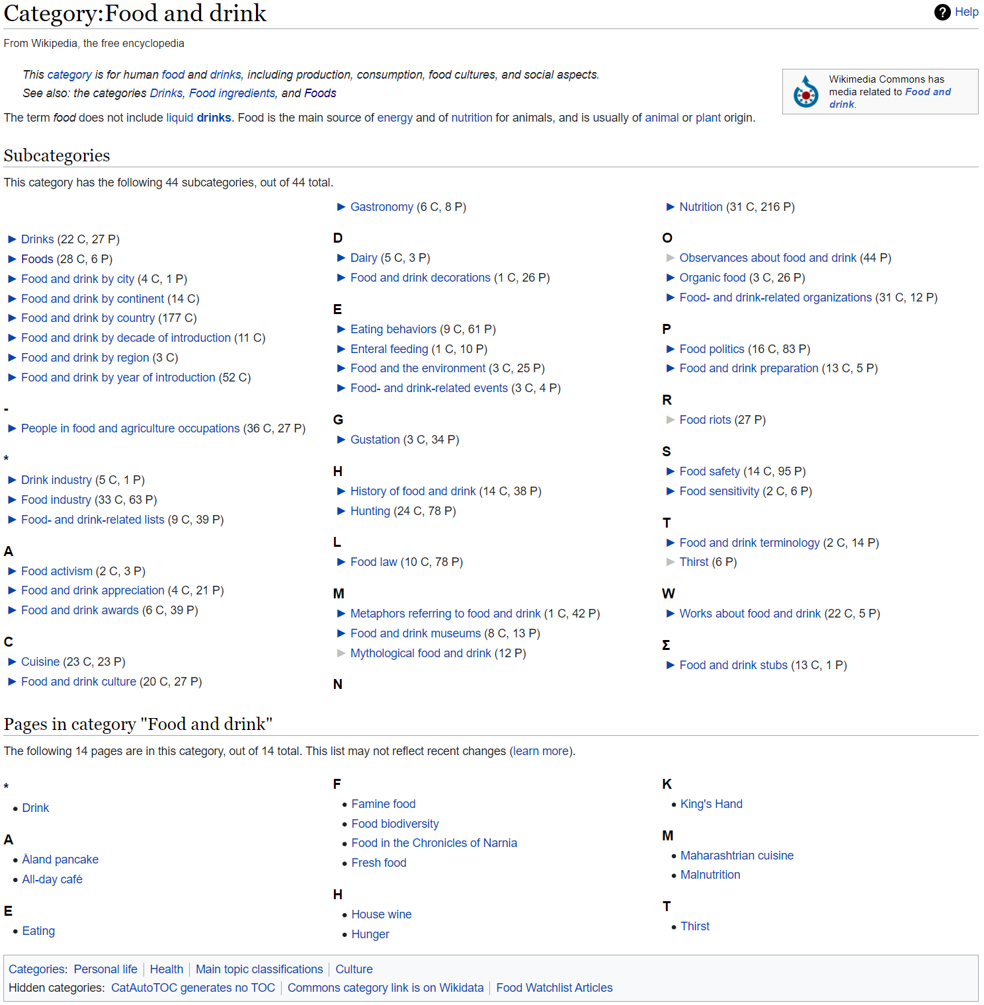
Map RUFES Types to Wikipedia Categories
ConsumerGoods.Food
https://en.wikipedia.org/wiki/Category:Food_and_drink
https://en.wikipedia.org/wiki/Category:Food_and_drink
https://en.wikipedia.org/wiki/Category:Foods
https://en.wikipedia.org/wiki/Baby_food
https://en.wikipedia.org/wiki/Flight_attendant
https://en.wikipedia.org/wiki/French_mother_sauces
...
https://en.wikipedia.org/wiki/Category:Drinks
https://en.wikipedia.org/wiki/Category:Alcoholic_drinks
https://en.wikipedia.org/wiki/Auberge_Sutton_Bobonom
https://en.wikipedia.org/wiki/History_of_alcoholic_drinks
https://en.wikipedia.org/wiki/National_Vodka_Day
https://en.wikipedia.org/wiki/Vampiro_(cocktail)
<https://dbpedia.org/resource/Baby_food> Baby food ConsumerGoods.Food
<https://dbpedia.org/resource/Flight_attendant> Flight attendant ConsumerGoods.Food
<https://dbpedia.org/resource/French_mother_sauces> French mother sauces ConsumerGoods.Food
<https://dbpedia.org/resource/Auberge_Sutton_Bobonom> Auberge Sutton Bobonom ConsumerGoods.Food
<https://dbpedia.org/resource/Vampiro_(cocktail)> Vampiro (cocktail) ConsumerGoods.Food
~200K extremely noisy DBP resources mapped to RUFES types

Slide 13
Map RUFES Types to WordNet
S: (n) motor vehicle, automotive vehicle
direct hyponym / full hyponym
S: (n) amphibian, amphibious vehicle
S: (n) swamp buggy, marsh buggy
S: (n) bloodmobile
S: (n) car, auto, automobile, machine, motorcar
S: (n) ambulance
S: (n) funny wagon
S: (n) beach wagon, station wagon, wagon, estate car
S: (n) bus, jalopy, heap
S: (n) cab, hack, taxi, taxicab
S: (n) motorcycle, bike
S: (n) minibike, motorbike
S: (n) moped
S: (n) trail bike, dirt bike, scrambler
S: (n) snowplow, snowplough
S: (n) truck, motortruck
S: (n) dump truck, dumper, tipper truck, tipper lorry, tip truck, tipper
S: (n) fire engine, fire truck
S: (n) ladder truck, aerial ladder truck
S: (n) garbage truck, dustcart
S: (n) lorry, camion
S: (n) pickup, pickup truck
S: (n) technical
S: (n) sound truck
S: (n) tow truck, tow car, wrecker
S: (n) tractor
VEH.WheeledVehicle.MotorVehicle
“motor vehicle”
<http://dbpedia.org/resource/Motor_vehicle> Motor vehicle VEH.WheeledVehicle.MotorVehicle
<http://dbpedia.org/resource/Automotive_vehicle> Automotive vehicle VEH.WheeledVehicle.MotorVehicle
<http://dbpedia.org/resource/Car> Car VEH.WheeledVehicle.MotorVehicle
<https://dbpedia.org/resource/Auto> Auto VEH.WheeledVehicle.MotorVehicle
<https://dbpedia.org/resource/Automobile> Automobile VEH.WheeledVehicle.MotorVehicle
<http://dbpedia.org/resource/Snow_plow> Snow plow VEH.WheeledVehicle.MotorVehicle
<http://dbpedia.org/resource/Snow_plow> Snowplow VEH.WheeledVehicle.MotorVehicle
<http://dbpedia.org/resource/Snow_plow> Snowplough VEH.WheeledVehicle.MotorVehicle
<https://dbpedia.org/resource/Pickup_truck> Pickup truck VEH.WheeledVehicle.MotorVehicle
<https://dbpedia.org/resource/Pickup_truck> Pickup VEH.WheeledVehicle.MotorVehicle
~1.5K clean, nominal DBP resources mapped to RUFES types

Slide 14
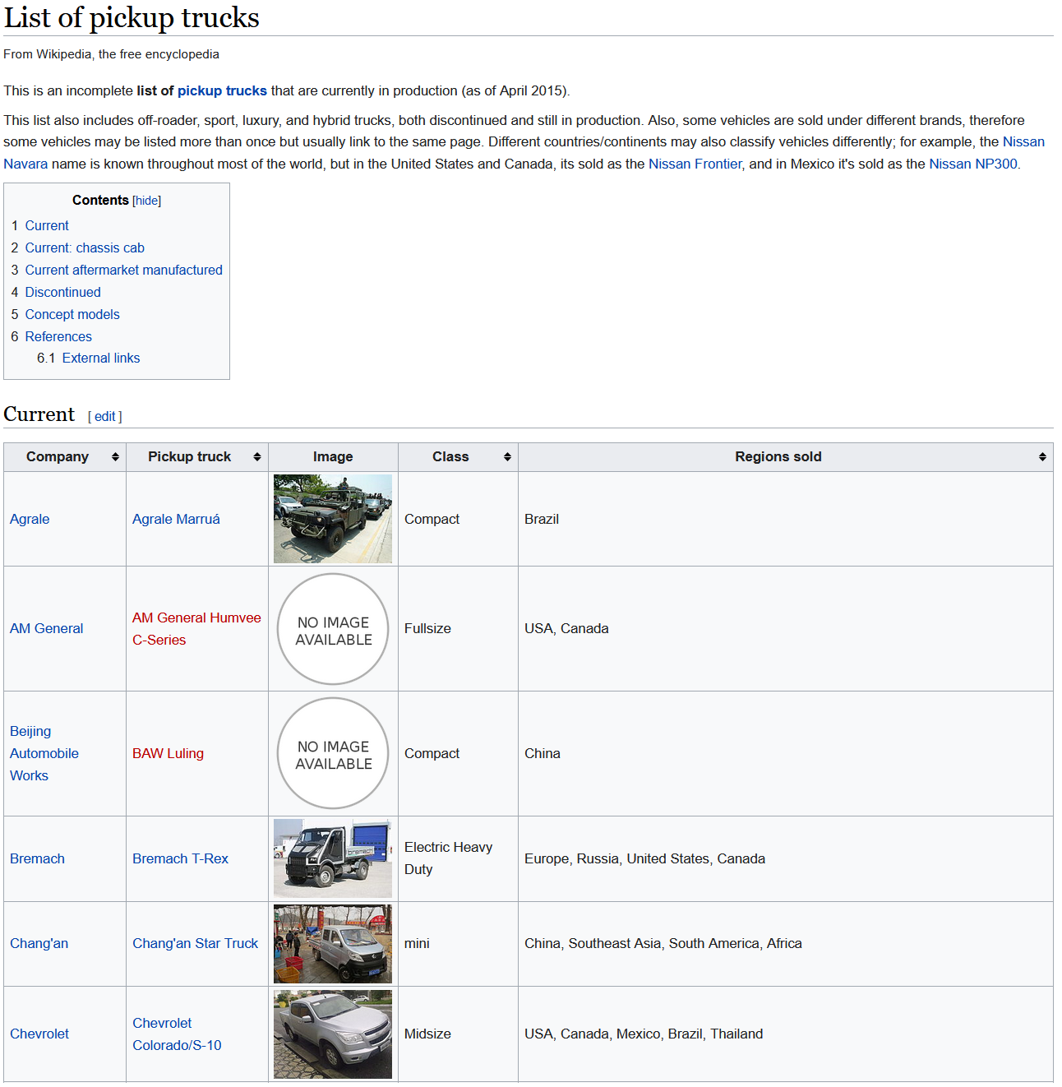
Populate RUFES Types from Lists
VEH.WheeledVehicle.MotorVehicle
“List of motor vehicle”
“List of pickup truck”
PER.Politician.HeadOfNation
“List of head of nation”
<http://dbpedia.org/resource/Agrale_Marruá> Agrale Marruá VEH.WheeledVehicle.MotorVehicle
<http://dbpedia.org/resource/Bremach_T-Rex> Bremach T-Rex VEH.WheeledVehicle.MotorVehicle
<http://dbpedia.org/resource/Chevrolet_Colorado> Chevrolet Colorado VEH.WheeledVehicle.MotorVehicle
<http://dbpedia.org/resource/Chevrolet_Silverado> Chevrolet Silverado VEH.WheeledVehicle.MotorVehicle
<http://dbpedia.org/resource/Chevrolet_Montana> Chevrolet Montana VEH.WheeledVehicle.MotorVehicle
<http://dbpedia.org/resource/Daihatsu_Hijet> Daihatsu Hijet VEH.WheeledVehicle.MotorVehicle
<http://dbpedia.org/resource/Yoweri_Museveni> Yoweri Museveni PER.Politician.HeadOfNation
<http://dbpedia.org/resource/Azali_Assoumani> Azali Assoumani PER.Politician.HeadOfNation
<http://dbpedia.org/resource/Moon_Jae-in> Moon Jae-in PER.Politician.HeadOfNation
<http://dbpedia.org/resource/Anas_Al-Abdah> Anas Al-Abdah PER.Politician.HeadOfNation
~350K DBP resources mapped to RUFES types

Slide 15
Final DBpedia Abstract Dataset
~2.4M mappings from DBpedia resource to RUFES type
(~1.98M unique resources after redirects)
Replace DBR links in corpus with RUFES type
~12.4M RUFES annotations on ~10G of Wikipedia text

Slide 16
Outline
Introduction
Data
RUFES
KLUE
DBpedia Abstract Corpus
Fine Grained Typing Methods
Supervised System
Weakly Supervised System
Synthetic Data System
Coreference Resolution
Results and Discussion

Slide 17
Methods for Fine-Grained Entity Typing
Supervised System
train a transformer-based model on the 50 sample documents
Weakly Supervised System
train a transformer-based model on the adapted DBpedia Abstract corpus
Synthetic Data System
train a transformer-based model on data automatically generated from unannotated documents in the RUFES development corpus

Slide 18
Supervised System
O
O
O
B-LOC.Region
I-LOC.Region
O
B-GPE.Country
O
O
Linear Classifier Layer
T_{[CLS]}
…
U₁₀
U₁₁
U₁₂
U₁₃
U₁₄
U₁₅
U₁₆
U₁₇
U₁₈
T_{[SEP]}
Context Representation Layers
E_{[CLS]}
…
E₁₀
E₁₁
E₁₂
E₁₃
E₁₄
E₁₅
E₁₆
E₁₇
E₁₈
E_{[SEP]}
[CLS]
…
t₁₀
t₁₁
t₁₂
t₁₃
t₁₄
t₁₅
t₁₆
t₁₇
t₁₈
[SEP]
brewed
in
the
Pajottenland
region
of
Belgium
since
1702

Slide 19
Weakly Supervised System
DBpedia Abstract corpus not well suited to entity span detection
Not all mentions are annotated (just those spans that were hyperlinks)
Cascaded system:
Train a supervised model to detect spans and top-level types using the KLUE data
Use the span boundaries and top-level types as features to the weakly supervised model, trained on adapted DBpedia Abstracts
~1M training instances, ≤ 10,000 instances per RUFES type
Further fine-tune the model with the 50 sample documents

Slide 20
Weakly Supervised System
[unused12]
Lambic
[unused2]
is
a
type
of
[unused12]
beer
[unused2]
traditionally
brewed
in
the
[unused18]
Pajottenland
region
[unused2]
of
[unused15]
Belgium
[unused2]
(
southwest
of
[unused15]
Brussels
[unused2]
)
and
in
Brussels
itself
at
the
[unused19]
Cantillon
Brewery
[unused2]
Lambic B-ConsumerGoods
is O
a O
type O
of O
beer B-ConsumerGoods
traditionally O
brewed O
in O
the O
Pajottenland B-LOC
region I-LOC
of O
Belgium B-GPE
( O
southwest O
of O
Brussels B-GPE
) O
and O
in O
Brussels O
itself O
at O
the O
Cantillon B-ORG
Brewery I-ORG
DBpedia Abstract corpus not well suited to entity span detection
Not all mentions are annotated (just those spans that were hyperlinks)
Cascaded system:
Train a supervised model to detect spans and top-level types using the KLUE data
Use the span boundaries and top-level types as features to the weakly supervised model, trained on adapted DBpedia Abstracts
~1M training instances, ≤ 10,000 instances per RUFES type
Further fine-tune the model with the 50 sample documents

Slide 21
Weakly Supervised System
O
O
O
B-LOC.Region
I-LOC.Region
O
B-GPE.Country
O
O
Linear Classifier Layer
→
→
→
→
→
→
U₁₀
∅
U₁₁
∅
U₁₂
d[t₁₂+t₁₃ ]
U₁₃
d[t₁₂+t₁₃ ]
U₁₄
∅
U₁₅
∅
U₁₆
∅
U₁₇
d[t₁₇ ]
U₁₈
∅
T_{[CLS]}
…
U₁₀
U₁₁
U₁₂
U₁₃
U₁₄
U₁₅
U₁₆
U₁₇
U₁₈
T_{[SEP]}
Context Representation Layers
E_{[CLS]}
…
E₁₀
E₁₁
E₁₂
E₁₃
E₁₄
E₁₅
E₁₆
E₁₇
E₁₈
E_{[SEP]}
[CLS]
…
t₁₀
t₁₁
t₁₂
t₁₃
t₁₄
t₁₅
t₁₆
t₁₇
t₁₈
[SEP]
the
[unused18]
Pajottenland
region
[unused2]
of
[unused15]
Belgium
[unused2]

Slide 22
Synthetic Data Augmentation
KNN model and a supervised model trained on a small, labeled corpus
Small
labeled
corpus
kNNG
Supervised
Model

Slide 23
Synthetic Data Augmentation
Given a new large unlabeled corpus, create labeled corpus as follows
Decode with supervised model: l¹
Decode mention spans with k-NNG: {l²}
Choose one based on a threshold
k-NNG
{l²}
Large
unlabeled
corpus
Supervised
Model
Large
labeled
corpus
l¹
Yes: l¹
max(count(l²)) < t
No: argmax(count(l²))

Slide 24
Synthetic Data Augmentation
Train a supervised model on the large, newly created corpus
k-NNG
{l²}
Large
unlabeled
corpus
Supervised
Model
Large
labeled
corpus
Supervised
Model
l¹
Yes: l¹
max(count(l²)) < t
No: argmax(count(l²))

Slide 25
Outline
Introduction
Data
RUFES
KLUE
DBpedia Abstract Corpus
Fine Grained Typing Methods
Supervised System
Weakly Supervised System
Synthetic Data System
Coreference Resolution
Results and Discussion

Slide 26
Coreference Resolution
Implementation of Bell-Tree mention synchronous coreference algorithm (Luo et al., 2004)
Trained on in-house KLUE data
Generalizes to unseen types
Post-processing to improve performance
Use canonical entity text instead of entity ids
Link each PRO mention to the closest antecedent on PER or non-PER type depending on pronoun
Copy antecedent’s entity text and types
John DeGioia said that Georgetown has realized … impact it has had …. The new agreement, he said, …
PER.Executive.AcademicAdministrator
LOC.Neighborhood
PER
ORG.EducationalInstitution.College

Slide 27
Coreference Resolution
Implementation of Bell-Tree mention synchronous coreference algorithm (Luo et al., 2004)
Trained on in-house KLUE data
Generalizes to unseen types
Post-processing to improve performance
Use canonical entity text instead of entity ids
Link each PRO mention to the closest antecedent on PER or non-PER type depending on pronoun
Copy antecedent’s entity text and types
John DeGioia said that Georgetown has realized … impact it has had …. The new agreement, he said, …
PER.Executive.AcademicAdministrator
ORG.EducationalInstitution.College
ORG.EducationalInstitution.College
PER.Executive.AcademicAdministrator

Slide 28
Outline
Introduction
Data
RUFES
KLUE
DBpedia Abstract Corpus
Fine Grained Typing Methods
Supervised System
Weakly Supervised System
Synthetic Data System
Coreference Resolution
Results and Discussion

Slide 29
Results
10 Feedback Documents as Held-out Test Set
System | Fine-Grain F1
Supervised | 0.4453
Weakly Supervised | 0.4144
Synthetic Data | 0.4189
Phase 2 Scores
System | StrongMention | CEAF | Fine-Grain F1
Supervised | 0.839 | 0.591 | 0.4162
Weakly Supervised | 0.792 | 0.570 | 0.3553
Synthetic Data | 0.825 | 0.580 | 0.3937
Median | 0.805 | 0.578 | 0.2313
Max | 0.868 | 0.689 | 0.4162

