Slide 1
GAIA at SM-KBP 2020 - A Dockerized Multi-media Multi-lingual Knowledge Extraction, Clustering, Temporal Tracking and Hypothesis Generation System
Manling Li, Sha (Zoey) Li, Heng Ji (UIUC)
Brian Chen, Amith Ananthram, Shih-Fu Chang, Kathleen McKeown (Columbia)
Marjorie Freedman (ISI)
Haodi Ma, Tony Bai Yang, Daisy Zhe Wang (U. Florida)
Notes:
GAIA at SM-KBP 2020 TA1: Multi-media Multi-lingual Knowledge Extraction System
Document-Level Knowledge Extraction from Multimedia Multilingual Data

Slide 2
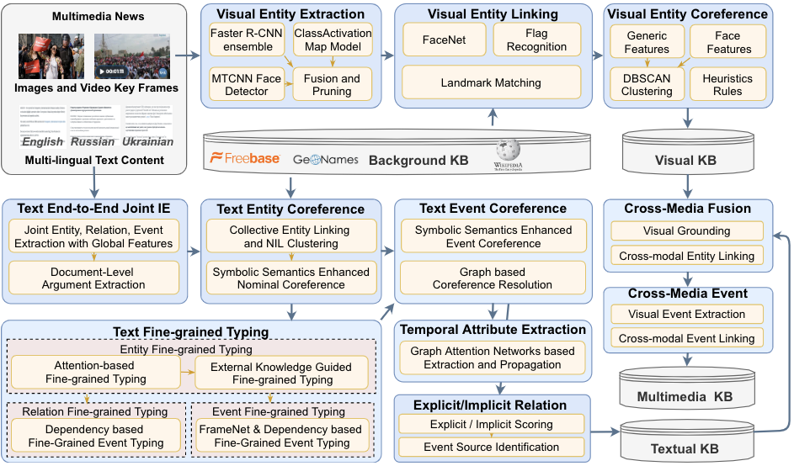
TA1 System Overview
Notes:
Ying Lin, Heng Ji, Fei Huang, Lingfei Wu. A Joint Neural Model for Information Extraction with Global Features. ACL 2020.
Manling Li, Alireza Zareian, Ying Lin, Xiaoman Pan, Spencer Whitehead, Brian Chen, Bo Wu, Heng Ji, Shih-Fu Chang, Clare Voss, Daniel Napierski and Marjorie Freedman. GAIA: A Fine-grained Multimedia Knowledge Extraction System. ACL 2020 Best Demo Paper.

Slide 3
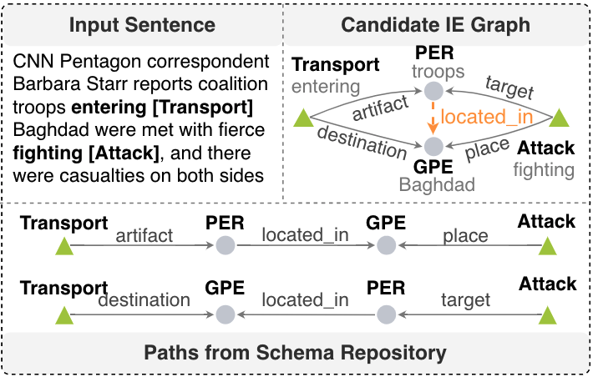
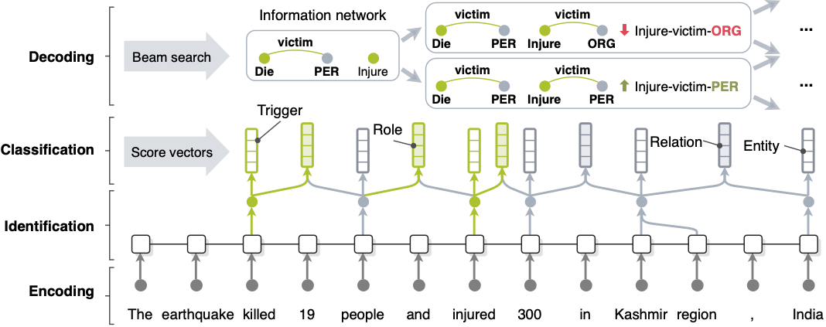
Schema-Guided Joint Information Extraction [Lin et al., ACL2020; Li et al., EMNLP2020]
[Lin et al., ACL2020]
Dataset | Entity | Event Trigger Identification | Event Trigger Classification | Event Argument Identification | Event Argument Classification | Relation
Baseline | 90.3 | 75.8 | 72.7 | 57.8 | 55.5 | 44.7
+PathLM | 90.2 | 76.0 | 73.4 | 59.0 | 56.6 | 60.9
F-scores (%) on ACE2005 data [Li et al., EMNLP2020]

Slide 4
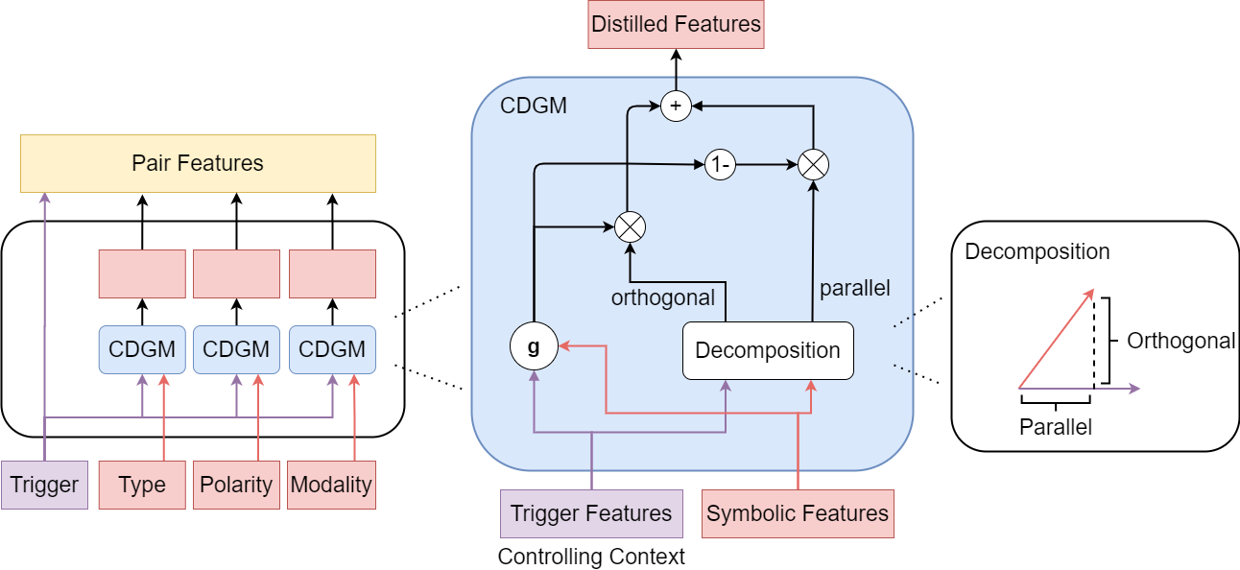
Event Coreference Resolution
Use a single XLM-RoBERTa to encode event trigger features
Incorporate symbolic features such as event types and attributes [Lai et al., 2021 submission]
A novel gated component to adaptively control the information flows from the features.
A noisy training method that randomly adds noise to the features during training.
ACE 2005 (English) and ERE-ES (Spanish) for training
 | CoNLL | AVG
SSED + MSEP (Peng et al. 2016) | 53.80 | 51.38
Baseline (no additional feature) | 58.93 | 55.78
Simple Concatenation | 57.55 | 54.79
Ours | 62.07 | 59.76
Performance of ACE 2005 dataset (on predicted mentions)

Slide 5
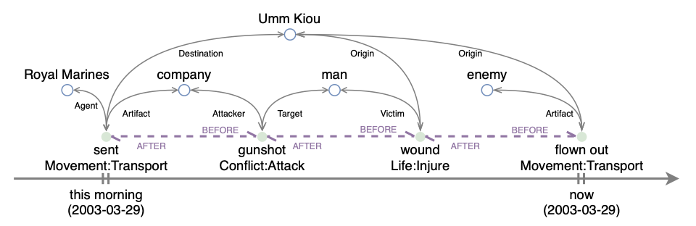
Event Graph-based Time Propagation
A new benchmark
182 documents, 2,084 event mentions in ACE 2005 with 4-tuple temporal representation annotation
Event graph construction and time propagation [Wen et al., 2021submission]
Two relations: Event arguments and temporal relations
Propagation through graph attention networks
Message aggregation from neighbors with attention mechanism
Model | Exact Match (%) | Approximate Match (%)
Document Creation Time | 26.90 | 27.58
Time Argument Annotation | 39.21 | 39.55
Longformer | 48.84 | 52.41
Temporal Relation based Propagation | 55.56 | 58.62
Argument based Propagation | 55.84 | 59.18
Experiment results on our new benchmark
Meanwhile Blair arrived in Washington late Wednesday₂₀₀₃₋₀₃₋₂₆ for two days of talks with Bush at the Camp David presidential retreat.
Element | BERT | Argument based GAT | Propagation path
Latest Start Date | 2003-03-27 | 2003-03-26 | arrive→Blair→talks

Slide 6
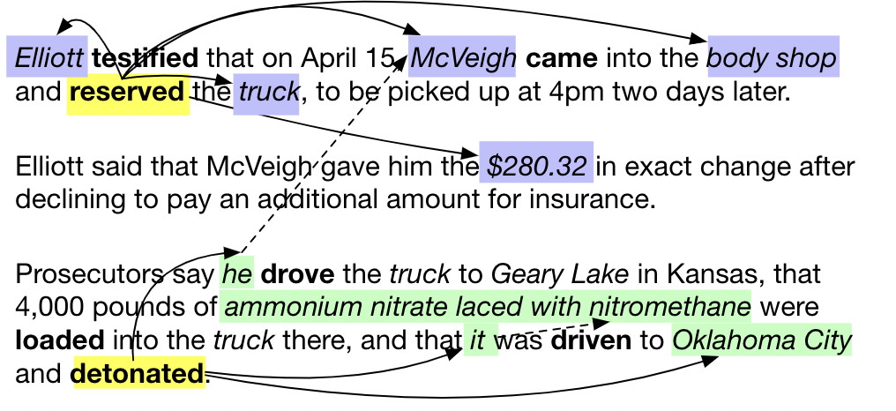
Document-Level Argument Extraction
Current event extraction models usually operate on the sentence level
However, Sentence boundaries do not naturally exist in human information seeking behavior
Sentence-level event extraction leads to incomplete and uninformative results
Notes:
Examples from the AIDA evaluation

Slide 7
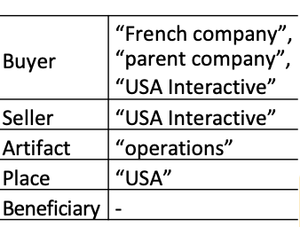
Existing Work: Argument Extraction as QA
[Du et al. EMNLP 2020]
Extracted Answers
Context
Questions
As part of ... sale of ... film and television operations to the French company and its parent company ...
Buyer: Who is the buying agent in sale?
Artifact: What was bought in sale?
Seller: Who is the selling agent in sale?
Place: Where the event takes place in sale?
Questions are constructed for each role and the predicted answer serves as the extracted argument.
Notes:
Mention Claire’s keynote

Slide 8
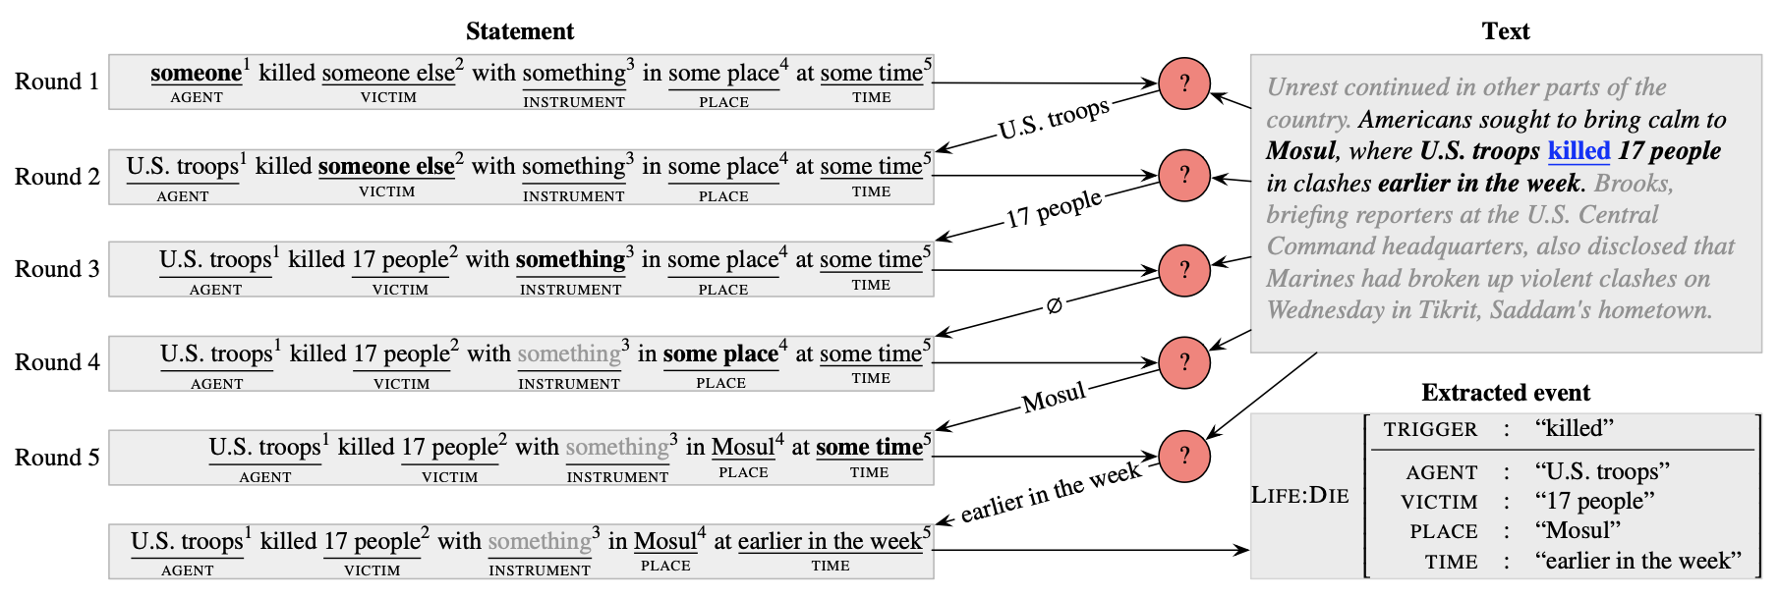
Existing Work: Argument Extraction as Definition Comprehension
[Chen et al. ACL Workshop]
Using the definition statement as the “question”, the statement is incrementally filled in with the predicted answers.

Slide 9
Our Work: Argument Extraction as NLG
We formulate argument extraction as a conditional generation problem with a blank event template as part of the input and a filled template as the desired output.
For AIDA, this template is readily available as part of the ontology
All arguments for one event can be extracted in a single pass

Slide 10
Handling Missing Arguments and Multiple Arguments
Unlike the standard QA setting, for the argument extraction task, we often face missing arguments and multiple arguments for the same role
Missing arguments: output the placeholder token <arg>
Multiple arguments: use “and” to connect the arguments
Model output: Trump and Japanese bankers communicated remotely about <arg> topic at <arg> place
Notes:
Add example here

Slide 11
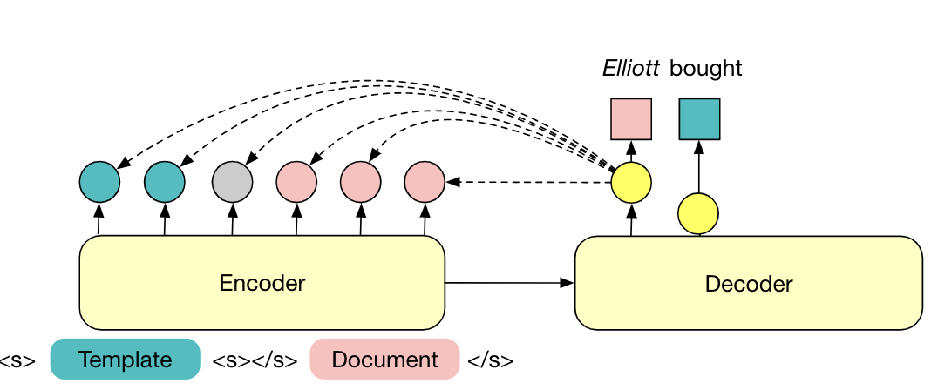
Model Details
Base model: Pretrained encoder-decoder language model BART[Lewis et al. ACL 2020]
Trigger information: The trigger is marked using the [TGR] special token
Tackling hallucination: At the time of inference, we restrict the generation output to select tokens that have been seen in the input

Slide 12
Soft Entity Type Constraints
We append “entity type statements” to the end of the generation output and measure the language model probability
Set of valid entity types (according to ontology)
Entity type statement:
“<entity> is a <type name>”

Slide 13
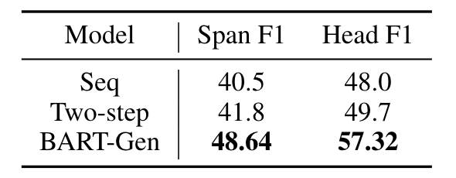
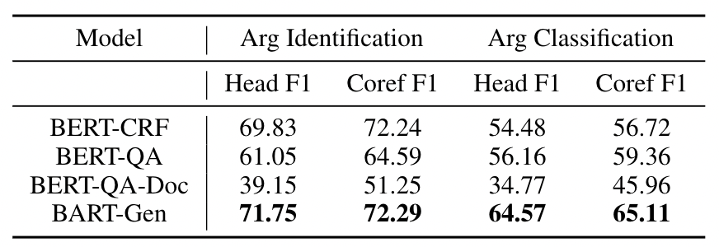
Evaluation
We evaluate our model on three datasets:
ACE05 (sentence-level)
RAMS [Ebner et al. ACL 2020] (document-level)
WikiEvents (document-level)
Argument extraction results on RAMS.
 | Arg Identification Head F1 | Arg Classification Head F1
BERT-QA | 65.74 | 63.34
BART-Gen | 69.92 | 66.67
Argument extraction results on WikiEvents.
Argument extraction results on ACE05 with gold triggers.
Notes:
Clean up ACE table

Slide 14
Case Study
For the Contact event E1, BERT-QA over-generates answers for the participant span.
QA models produce a ranking over possible answers, producing the optimal threshold is hard
For the IdentifyCategorize event, only our model can successfully extract all arguments.
Sequence labeling model struggle with types with few training examples

Slide 15
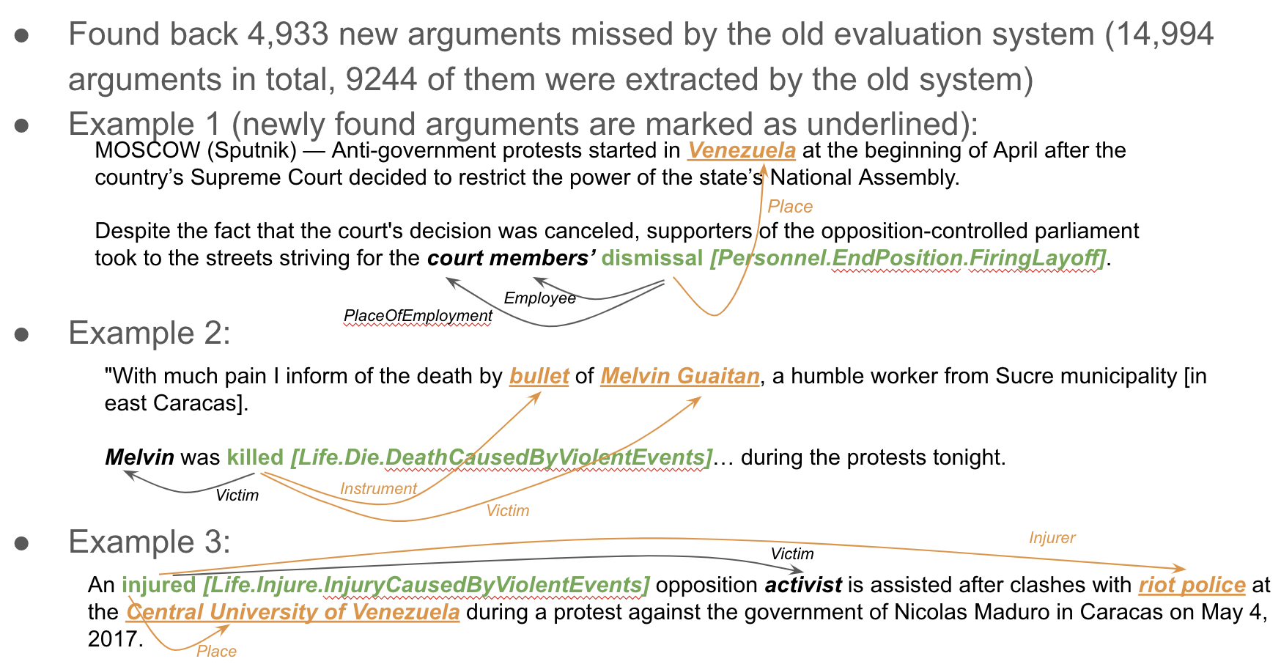
Performance on AIDA Eval Data

Slide 16
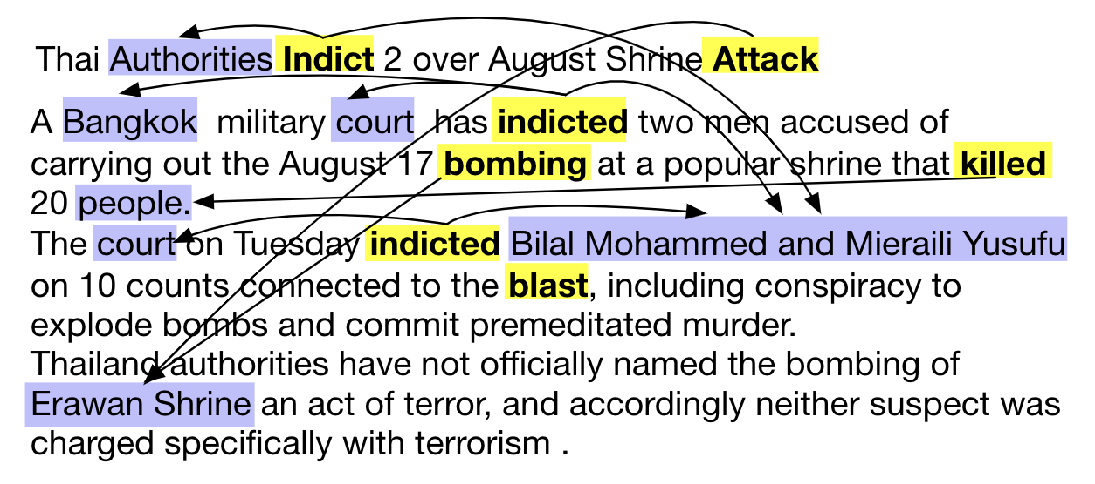
Extension: Informative Argument Extraction
Results on WikiEvents
Instead of looking for the nearest mention, find the most informative mention of the argument within the document.
Requires implicit coreference resolution.
Our proposed model has a larger advantage over baselines in informative argument extraction compared to conventional argument extraction

Slide 17
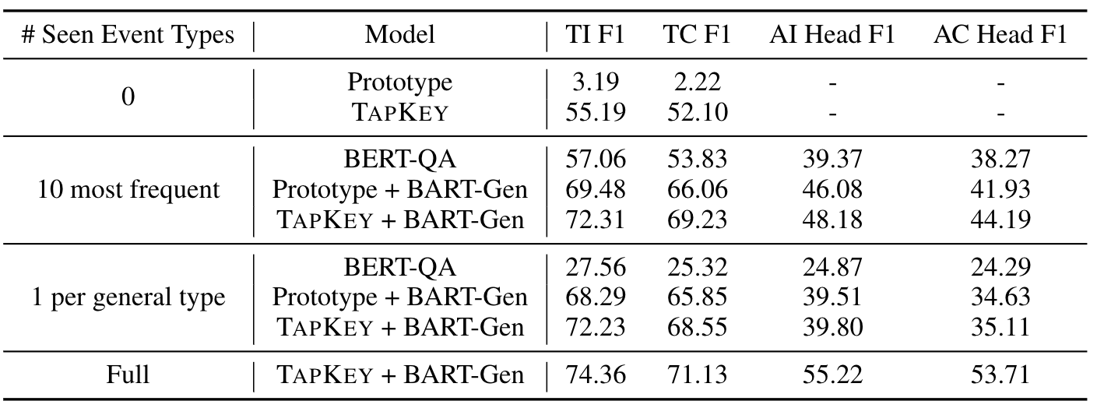
Extension: Zero-shot Event Extraction
(8 types)
Tested on ACE 2005, 33 event types
To apply the model to new event types, we can replace the event template with that of the new type without retraining the model

Slide 18
Explicit & Implicit Relations
sponsorship, blame, deliberateness, legitimacy, hoaxfraud, sentiment
data scarce relations (no training data)
identify the source for all events for use in TA3 perspective generation
explicit: “Maduro blamed the protestors
for the attack.”
implicit: “Maduro had the protestors
arrested for the attack”

Slide 19
Extracting explicit relations – Event Guided Denoising
train a neural language encoder to generate dense relation representations from sentences with marked entities
❌
4/16: Italy has more time for entrepreneurs than France, and its northern third is one of the most productive areas in the world.
7/9: Italy won its fourth World Cup title today, defeating France, 5-3, in a penalty-kick shootout after overtime ended with the score tied at 1-1.
7/10: More than 150,000 people celebrate Italy's victory over France with a huge party in Rome's Circus Maximus
✓
✓
“Event Guided Denoising for
Multilingual Relation Learning”,
COLING 2020: link

Slide 20
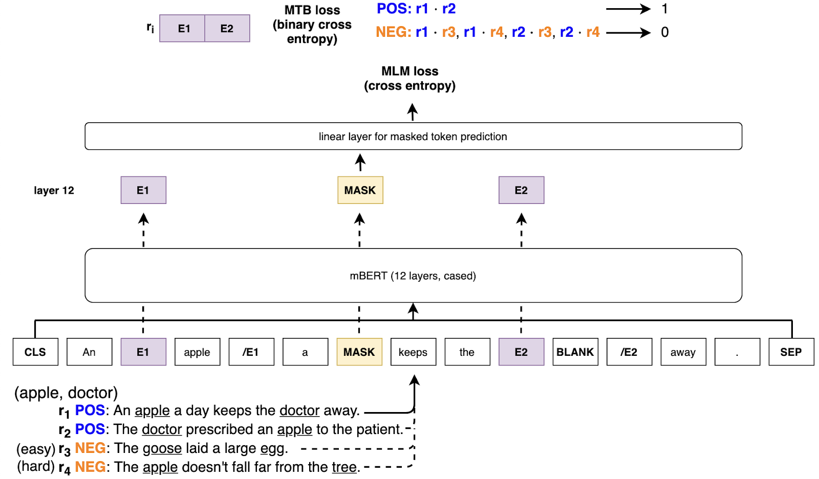
Training – Event Guided Denoising

Slide 21
Results – Event Guided Denoising
Zero-Shot Accuracy on FewRel
 | n = 5, k = 1 |  | n = 10, k = 1
 | en | es | en | es
BERT large | 72.9 |  | 62.3
BERT large + MTB | 80.4 |  | 71.5
mBERT + Event Guided Denoising | 78.7 | 76.7 | 69.0 | 64.4
SOA
300mil+ training ex
70k training ex
Few-Shot F1 on SemEval 2010 Task 8, TAC KBP 2016
 | SemEval (en) | TAC KBP (es)
 | 1% of training corpus | 1% | 10%
BERT large / mBERT | 28.6 | 33.0 | 72.8
BERT large + MTB | 31.2
mBERT + Event Guided Denoising | 33.3 | 41.5 | 76.8
SOA
300mil+ training ex
70k training ex

Slide 22
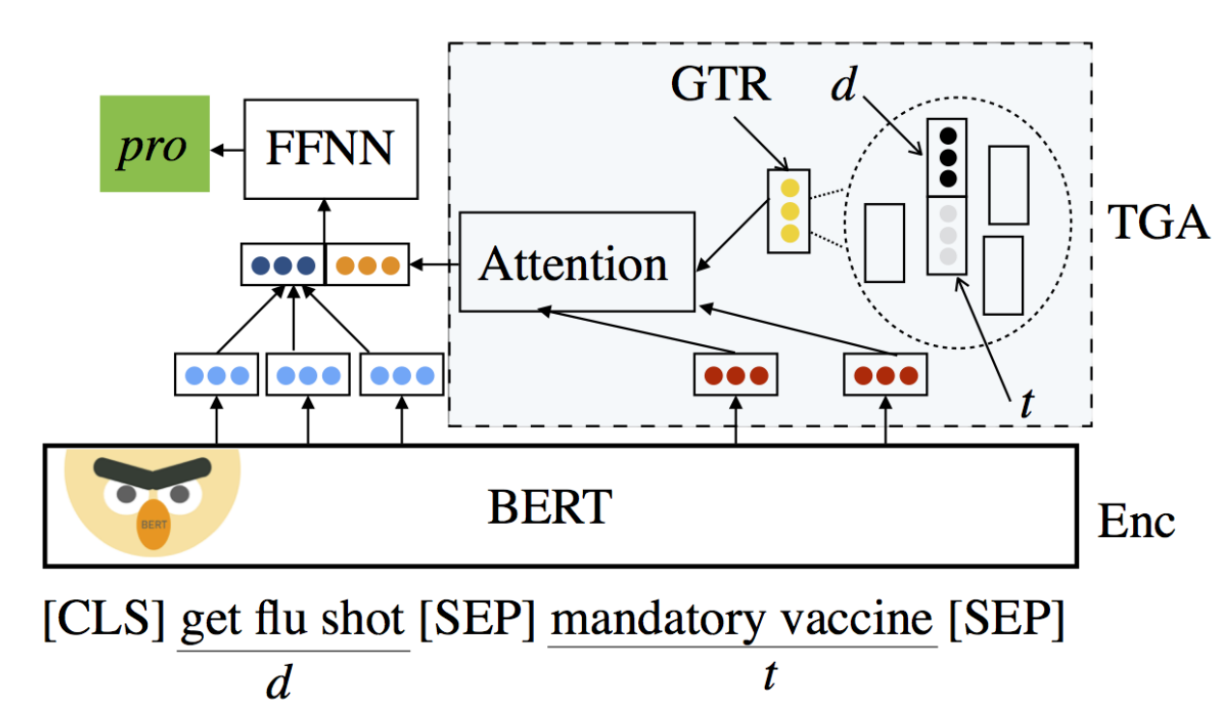
Extracting implicit relations – Topic Grouped Attention (TGA) Net
augment relation candidates with stance (neutral, positive, negative) scores meant to capture implicit valence
“Zero-Shot Stance Detection: A Dataset and Model
using Generalized Topic Representations,
EMNLP 2020: link

Slide 23
Results – TGA Net
Macro-Averaged F1 on VAST Test Set
 | F1 All |  |  | F1 Zero-Shot |  |  | F1 Few-Shot
 | pro | con | all | pro | con | all | pro | con | all
Cross-Net | .486 | .471 | .455 | .462 | .434 | .434 | .508 | .505 | .474
BERT-joint | .545 | .591 | .653 | .546 | .584 | .661 | .544 | .597 | .646
TGA Net | .573 | .590 | .665 | .554 | .585 | .666 | .589 | .595 | .663
SOA

Slide 24
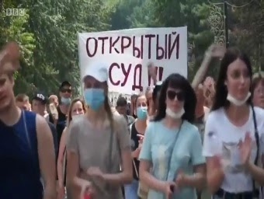
Multimodal Event Extraction and Argument Role Labeling
(1) High grounding score
Multimodal event coreference:
Image and sentence have high grounding score
Event type detected by image and event mention in text are the same
No contradiction in the entity types for the same argument role
Tens of thousands of Russians have taken to the streets in the far eastern city of Khabarovsk to demand the release of their local governor...
Text IE: UIUC
Visual IE: JSL
(2) Match event types
Event type:
Conflict.Demonstrate
Conflict.Demonstrate
Argument role:
Demonstrator
Place
Demonstrator
VisualDisplay
Entity mention:
Russian
streets
Entity type:
PER
FAC
PER
COM
Pratt, Sarah, et al. "Grounded Situation Recognition." ECCV 2020.
(3) No conflict on entity type

Slide 25
Statistics for event extraction / coreference
Image event detected:
Out of 2K news article (with 6K images), we detected 707 events
Event coreference:
206 multimodal event coreference pairs
54 coreference pairs with additional arguments besides text
With 94 additional arguments detected.
Precision:
62% of the events are fully correct
Both text event, image event, and coreference
Text event
Visual event (60% precision)
4022
707
Coreference matching
206
Coreference Multimodal event
62% precision
Events with additional argument
54
With 94 additional argument

Slide 26
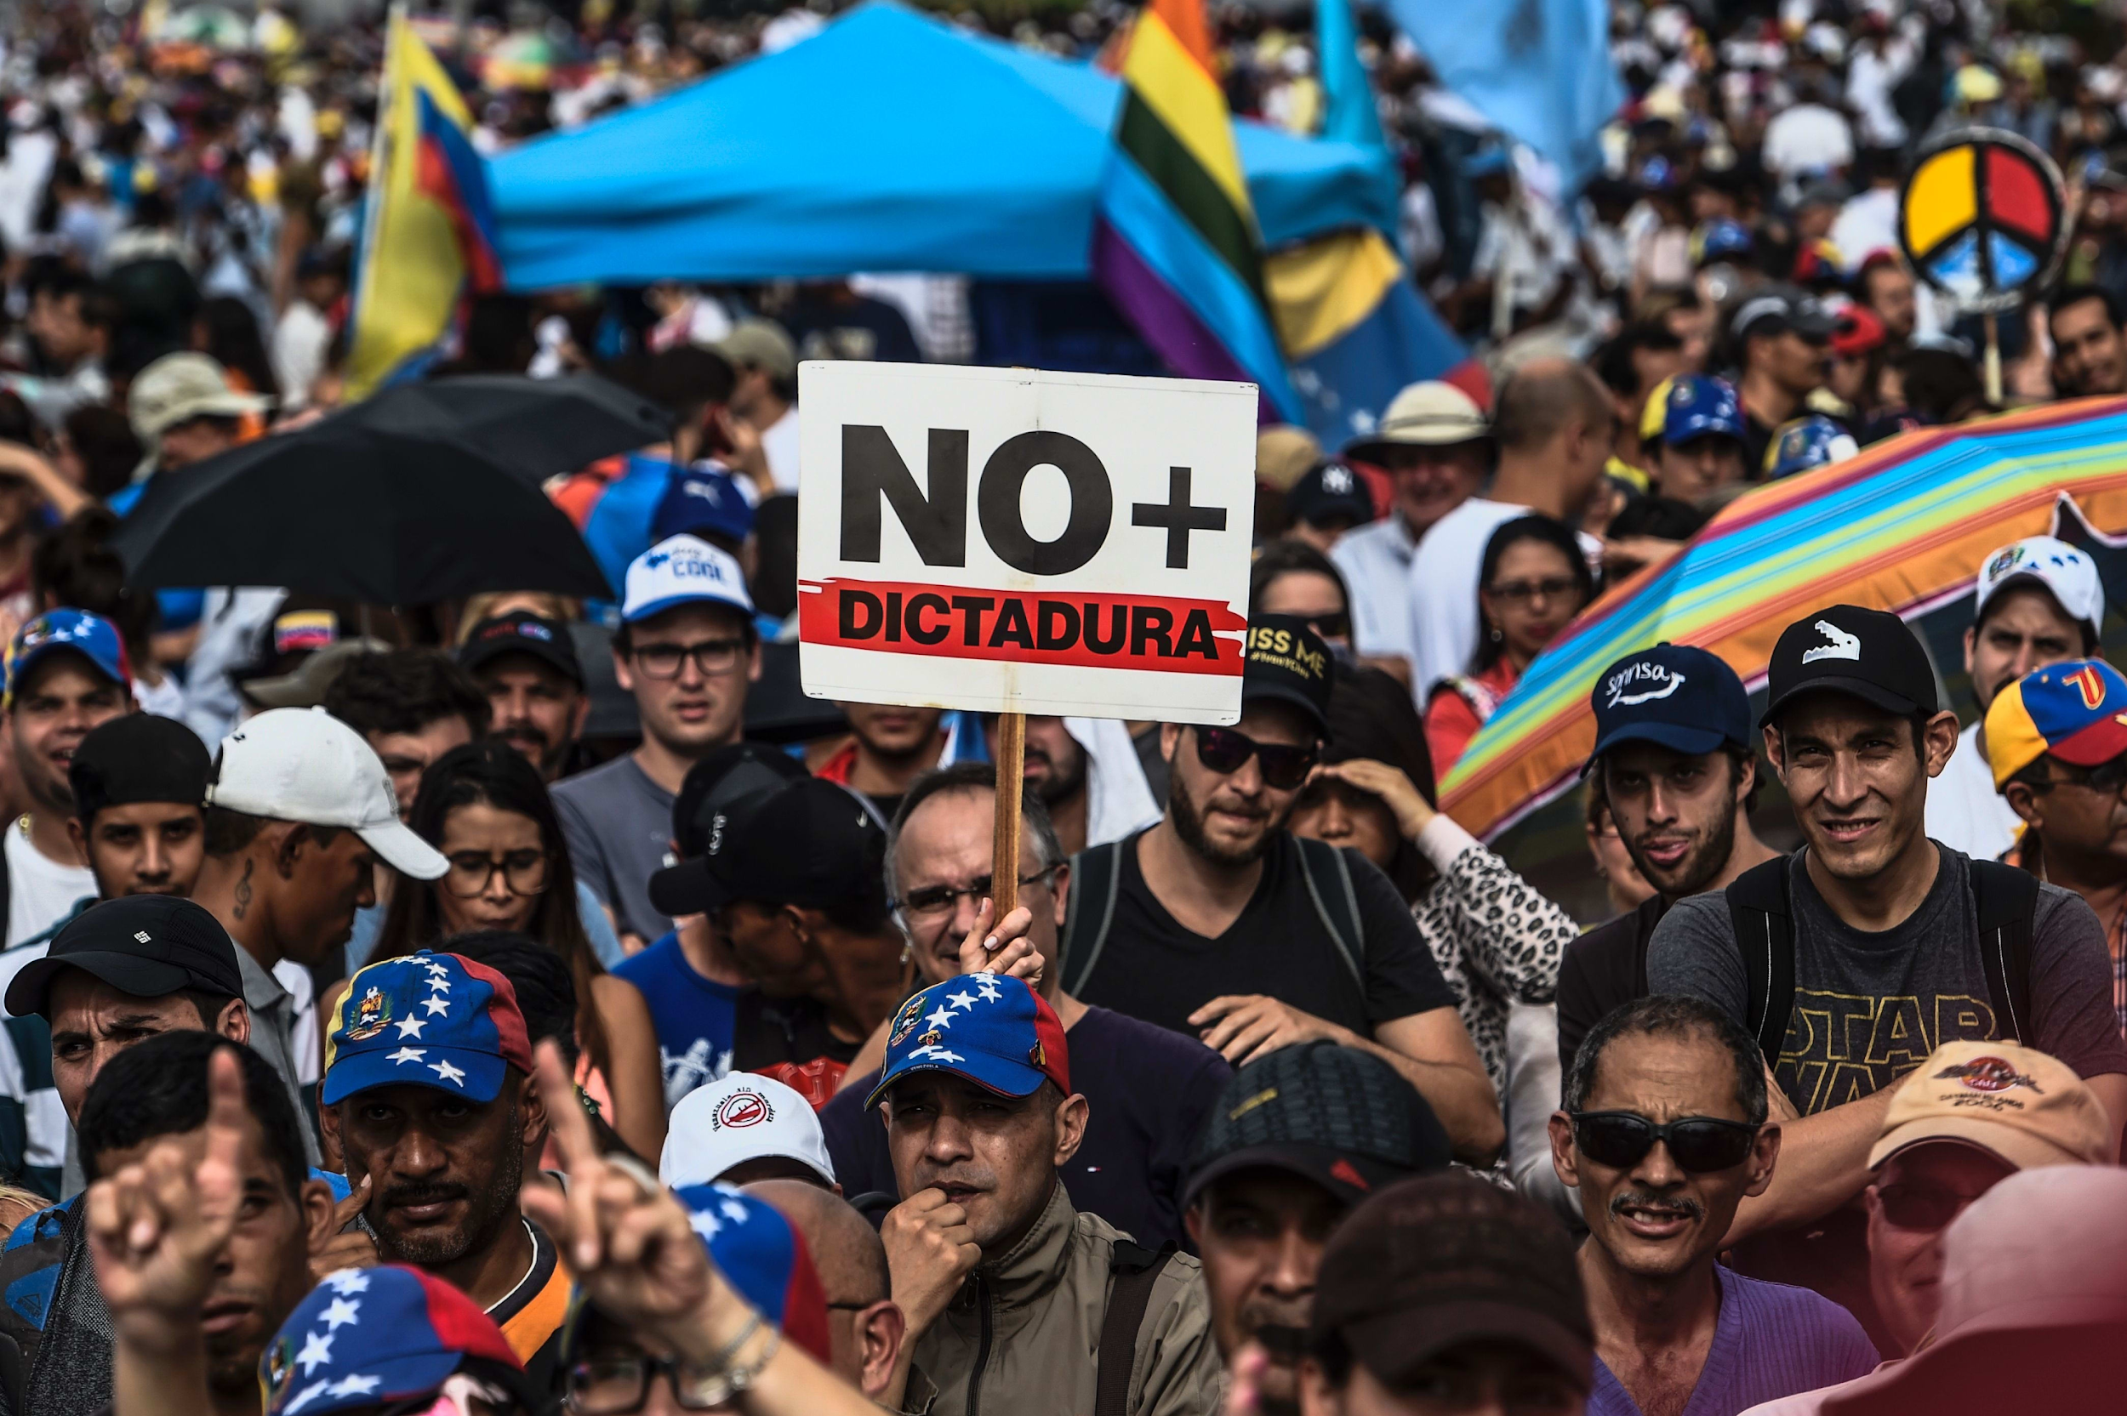
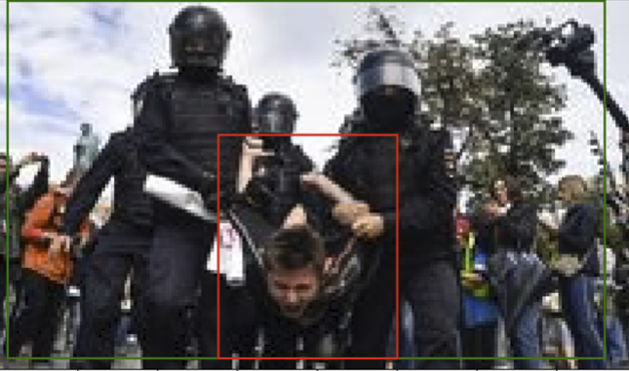
Examples for events with new visual argument
Venezuelan opposition activists protest against the government of President Nicolas Maduro in the capital Caracas on May 15 2017
Sus familiares aseguran que la mayoría son presos políticos.
Conflict.Demonstrate.MarchProtestPoliticalGathering
Justice.ArrestJailDetain
 |  | Entity mention | Entity type
Text Arguments Image Arguments | Demonstrator | Venezuelan opposition activists | PER. Protester
 | Place | Caracas | GPE.UrbanArea
 | Demonstrator | people | PER
 | VisualDisplay | board | COM
 | Place | outdoors | LOC
 |  | Entity mention | Entity type
Text Arguments Image Arguments | Detainee | presos | PER
 | Jailer | policeman | PER.Police
 | Detainee | man | PER

Slide 27
What’s Next for TA1
Support TA3 by incorporating more feedback and query knowledge
Complex event schema guided conditioned NLG for corpus-level event extraction
Lifelong learning to support new knowledge element types for COVID-19 scenario
Developing prototype for multi-view claim frame construction
Cross-media entity and event coreference resolution across text, images and videos
Explicit / implicit relation extraction: automatic training corpus augmentation, improved cross-lingual learning via code-switching, “document aware” relation extraction (by conditioning on entity participation in events across all document modalities)

Slide 28
GAIA TA2
Marjorie Freedman, Yixiang Yao, Pedro Szekely

Slide 29
High Precision Clustering Of Entities Across Documents
AVAILABLE INFORMATION:
name
KB identifier
Freebase identifiers
confidences
vectors (not used)
APPROACH:
map all entities with identifiers to Wikidata
initialize clusters using KB identifiers
compute trusted labels for entities in cluster
assign entities without KB ids to clusters using type conformance and trusted labels
select prototype with most trusted labels (extraction confidence, prevalence in cluster)
CHALLENGES:
missing information
noisy extractions
aggregating confidences
Wikidata labels:
Nicolás Maduro
Nicolás Maduro Moros
Nicolas Maduro Moros
Nicolas Maduro
Maduro
Николас Мадуро
Мадуро, Николас
Николас Мадуро Морос
Trusted GAIA labels:
Nicolás Maduro
+
EMBEDDINGS?:
not sufficiently discriminative
insufficient training data to finetune
use labels of GAIA entities with high confidence identifiers

Slide 30
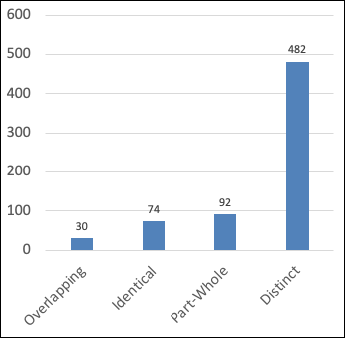
Limitations & Why
Maintain document-level clusters for knowledge elements that couldn’t be linked to Wikidata, but don’t link further
Non-named entities → the drones; the crowd; insurgents
Events → drone attacks
Why
Observationally,
Identity coreference is less frequent
TA2 does not have the context to make high precision decisions
Also, evaluation specific incentives
No data for tuning a system
TA2 metric ignores these classes
Internal Annotation of Coreference Relation for Underspecified Entity Pairs
Clustering is a “Destructive operation” → Errorful clusters will be difficult for TA3 to recover from

Slide 31
TA2: Scoring Thoughts
GAIA TA2 scores look low, still yielded top performing TA3 output
Why: an illustration on the Miguel Castillo entity
Reference
GAIA TA2
Issues:
GAIA chooses a single prototype for cluster; NIST queries require that all documents are included as prototypes
NIST query requires exact string match (including capitalization)--> our second cluster is not found
MAP metric does not recognize the difference between
Representational difference, may not impact TA3
And
May not be well calibrated for TA3 accuracy

Slide 32
HypoGator: M36 and Remedial Hackathon Evaluation
Daisy Zhe Wang
Yang Bai, Yifan Wang, Haodi Ma, and Ali Sadeghian
UF-GAIA TA3 • 2021 Feb
‹#›

Slide 33
HypoGator Pipeline Architecture(M36)
Query-Processor
Information need (Query)
Entry Point Extraction
Alias Extraction
Query decomposition
Candidate Hypothesis Generator
Coherence feature extraction
Ranking and Selection
Local Graph Expansion
2-level Graph Search
Query-Driven Link Prediction
……
Temporal Coherence
Candidate Hypothesis Scoring
Document-based sampling
Containment Filtering
TA2 KG
Hypothesis Enrichment
Hypothesis Clustering
Hypothesis Composition
AIDA Hypothesis
Subgraph expansion
with contextual relations
Cluster-lever Enrichment
Customized
Graph Edit Distance Based Graph Clustering
……
Single-lineage Constraint
Containment Filtering
‹#›
Notes:
So this is the current architecture of our pipeline
First, we extracted and made use of alias of entry points given the comments in the query file.
Then, instead of single-level graph search, we now use a 2-level graph search strategy. I won’t go into details due to time issue, but main idea is
First: mention level search: consistency
Second: cluster level: expend more info, achieve better recall
And, except from scoring functions on semantic coherence, to meet the new evaluation requirement of the temporal question answering, we added new scoring functions to evaluate temporal coherence of hypotheses.
In ranking and selection module, besides candidate hypo scoring and sampling based on doc id, we add a Containment Filtering component to filter out hypotheses that are logically contained by other candidate hypotheses.
This component helps improve the performance of hypothesis clustering which will later be applied to all candidate hypotheses to pick out alternative representatives.
In the next step, hypo composition, previously we simply joined atomic-hypotheses in all possible combinations.
But now we apply single-lineage constraint when joining atomic-hypotheses, which means we only join those atomic-hypotheses that come from the same information source.
After joining, we apply containment filter again to remove redundant sub-hypotheses.
Then in hypothesis clustering module, the original lexical similarity based clustering alg didn’t work well.
We did some experiments on different algs and (labeled our own evaluation dataset and did experiments to compare different clustering algorithms.)
(Eventually, we )selected a customized Graph Edit Distance Based Graph clustering algorithm.
Finally, to improve our hypothesis enrichment module, we develop the new cluster-level graph search algorithm which makes use of the entity cluster node when searching for relevant context information.

Slide 34
Query-Driven Link Prediction/Hallucination
TA2 KG is inevitably incomplete
General inference approaches over larger knowledge graphs require heavy computational cost
The cost is two-folds: 1) when performing inference over the whole KG, and 2) an after effect where the reset of the system needs to process the even larger KG+inferred edges
Query time inference is more efficient
Arguably more accurate too as it can be tailor made for the query (i.e. the statement of information need)

Slide 35
Remediation Hackathon Development and Improvements
New informaiton from TA1/TA2, including 1) Trigger strings, 2) Sponsorship relations and 3) Larger TA2 with more events and event arguments
Entity Matching expansion – use of clusters, strings, kbid
Query decomposion – better handle complex SINs
Ranking and filtering of atomic hypotheses
additional ranking function to handle larger set of atomic hypotheses
Ranking and clustering of composite hypotheses
clustering algorithm is fine-tuned to handle larger set of composite hypotheses
Notes:
Because KG from TA1/2 is more informative now, we can generate more atomic & composite hypos.

Slide 37
M36 vs. Hackathon Statistics

Slide 38
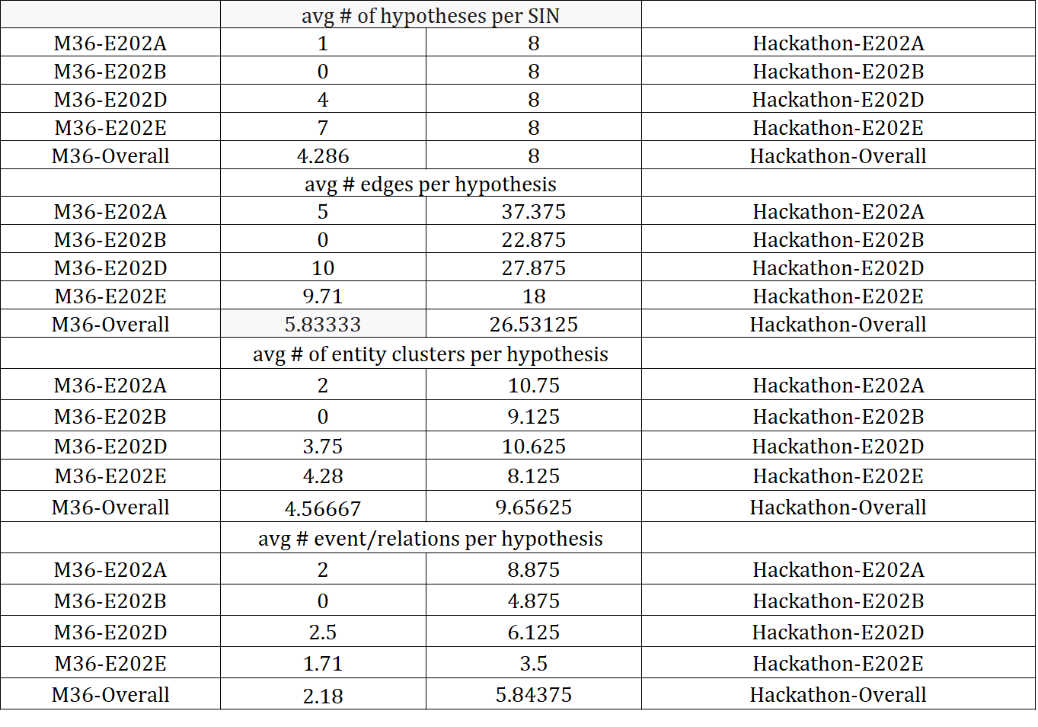

Slide 39
Future directions for TA3
Extract answer to facet level natural language questions in SINs from hypotheses
More Complex SINs (i.e., sequences of 2 or more related questions)
differentiate coherent and conflicting information within hypotheses and discover alternatives across hypotheses
Complex queries is where QA benchmarks are going
Compared to simple SINs, complex SINs take more advantage of the structured information in KBs constructed in AIDA

Slide 40
Publications
Manling Li, Qi Zeng, Ying Lin, Kyunghyun Cho, Heng Ji, Jonathan May, Nathanael Chambers and Clare Voss. Connecting the Dots: Event Graph Schema Induction with Path Language Modeling. EMNLP 2020
Sha Li, et al. Document-Level Event Argument Extraction by Conditional Generation. NAACL 2021 submission
Tuan Lai, Heng Ji, et al. A Context-Dependent Gated Module for Incorporating Symbolic Semantics into Event Coreference Resolution. NAACL 2021 submission
Haoyang Wen, Yanru Qu, Heng Ji, Qiang Ning, Jiawei Han, Avi Sil, Hanghang Tong, Dan Roth. Event Time Extraction and Propagation via Graph Attention Networks. NAACL 2021 submission
Zixuan Zhang, et al. Abstract Meaning Representation Guided Graph Encoding and Decoding for Joint Information Extraction. NAACL 2021 submission
Pengfei Yu, et al. Lifelong Learning with Knowledge Transfer: A Case Study on Event Detection. NAACL 2021 submission
Allaway, Emily, and Kathleen McKeown. "Zero-Shot Stance Detection: A Dataset and Model using Generalized Topic Representations." Proceedings of the 2020 Conference on Empirical Methods in Natural Language Processing (EMNLP). 2020.
Ananthram, Amith, Emily Allaway, and Kathleen McKeown. "Event Guided Denoising for Multilingual Relation Learning." Proceedings of the 28th International Conference on Computational Linguistics (COLING). 2020.
Brian Chen, Samuel Thomas, Andrew Rouditchenko, et al. Multimodal Clustering Networks for Self-supervised Learning from Unlabeled Videos. Submitted to CVPR 2021.
He, Chuanzi, Haidong Zhu, Jiyang Gao, Kan Chen, and Ram Nevatia. "CPARR: Category-based Proposal Analysis for Referring Relationships." In Proceedings of the IEEE/CVF Conference on Computer Vision and Pattern Recognition Workshops, pp. 948-949. 2020.
Zhu, Haidong, Arka Sadhu, Zhaoheng Zheng, and Ram Nevatia. "Utilizing Every Image Object for Semi-supervised Phrase Grounding." In Proceedings of the IEEE/CVF Winter Conference on Applications of Computer Vision, pp. 2210-2219. 2021.
Notes:
Ying Lin, Heng Ji, Fei Huang, Lingfei Wu. A Joint Neural Model for Information Extraction with Global Features. ACL 2020.
Manling Li, Alireza Zareian, Ying Lin, Xiaoman Pan, Spencer Whitehead, Brian Chen, Bo Wu, Heng Ji, Shih-Fu Chang, Clare Voss, Daniel Napierski and Marjorie Freedman. GAIA: A Fine-grained Multimedia Knowledge Extraction System. ACL 2020 Best Demo Paper.

Slide 41
BACKUP
Notes:
Sophisticated knowledge graph curation interface provides feedback to schema induction via active reinforcement learning and crowdsourcing
Incorporating schema-guided global constraints into learning deep models for and event prediction

