Slide 1
What LLMs Cannot Do
(or: Why We are NOT Outpaced)
Heng Ji (UIUC & Amazon Scholar)
Thanks to my students for contributing many examples!

Slide 2
The Bright Side
LLMs like Chat-GPT3 are great tools, let’s embrace them and use them as our building blocks!

Slide 3
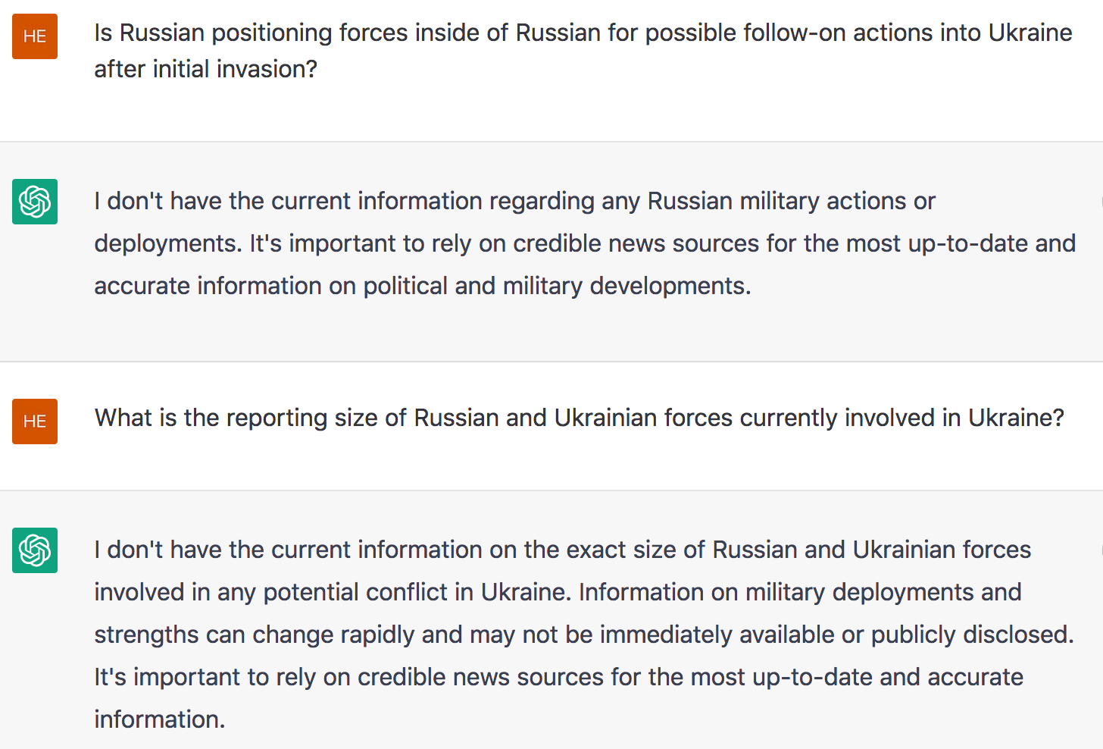
Did LLMs Outpace Human/Machine Intel Analysts? No!

Slide 4
Asking Our SmartBook [supported by DARPA AIDA, KAIROS and SemaFor] the Same Questions
Is Russian positioning forces inside of Russian for possible follow-on actions into Ukraine after initial invasion?
The arrival of Russian forces in Slavutych came after several days of shelling against the city, which is strategically located close to the Dnieper River, about 95 miles (150 kilometers) north of Kyiv and close to the border with Belarus.
Russia has been using Belarus as a springboard for many of its air operations in Ukraine, according to intelligence collected by NATO surveillance planes flying over the Polish-Ukrainian border and radar seen by CNN.
So far, however, US officials have not seen Belarusian troops "being readied to move into Ukraine" or "that they are moving or are in Ukraine," a senior US defense official said Monday, adding that the forces inside Ukraine are Russian.
What is the size of Russian and Ukrainian forces currently involved in Ukraine?
It said the Ukrainians had created a force of 20,000 close to the Belarus border, which "requires a response from us.”
It also said 400 Russian soldiers are "present full time" at the site.

Slide 5
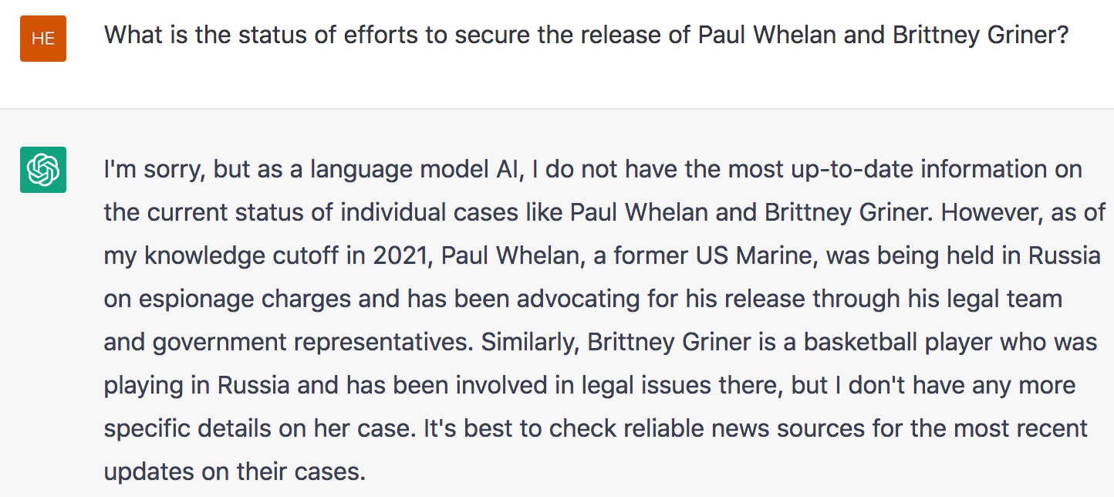
Did LLMs Outpace Human/Machine Intel Analysts? No!

Slide 6
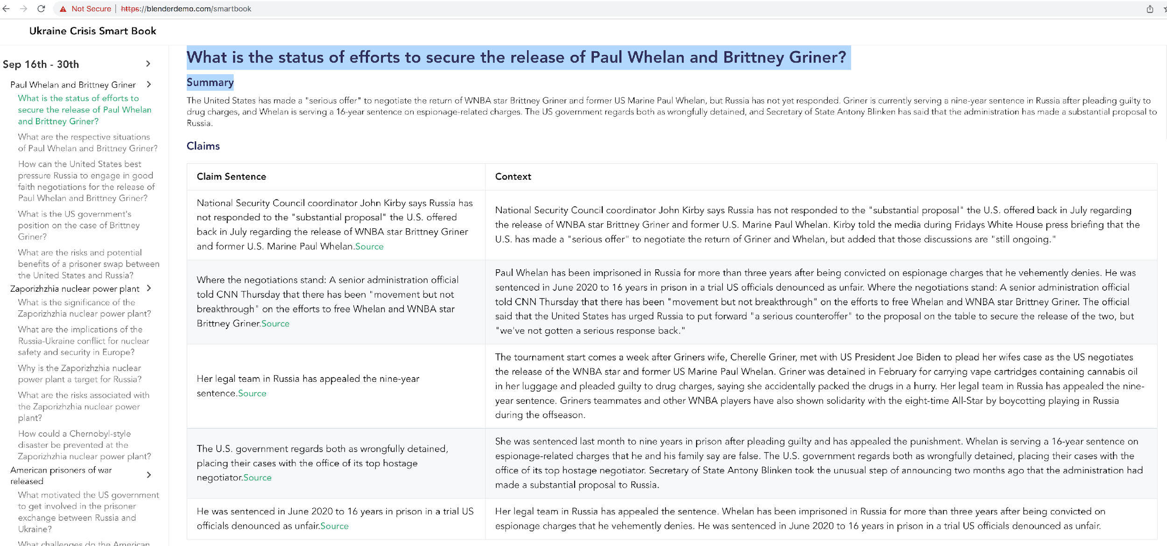
Asking Our SmartBook the Same Question

Slide 7
Did LLMs Outpace Human/Machine Intel Analysts? No!

Slide 8
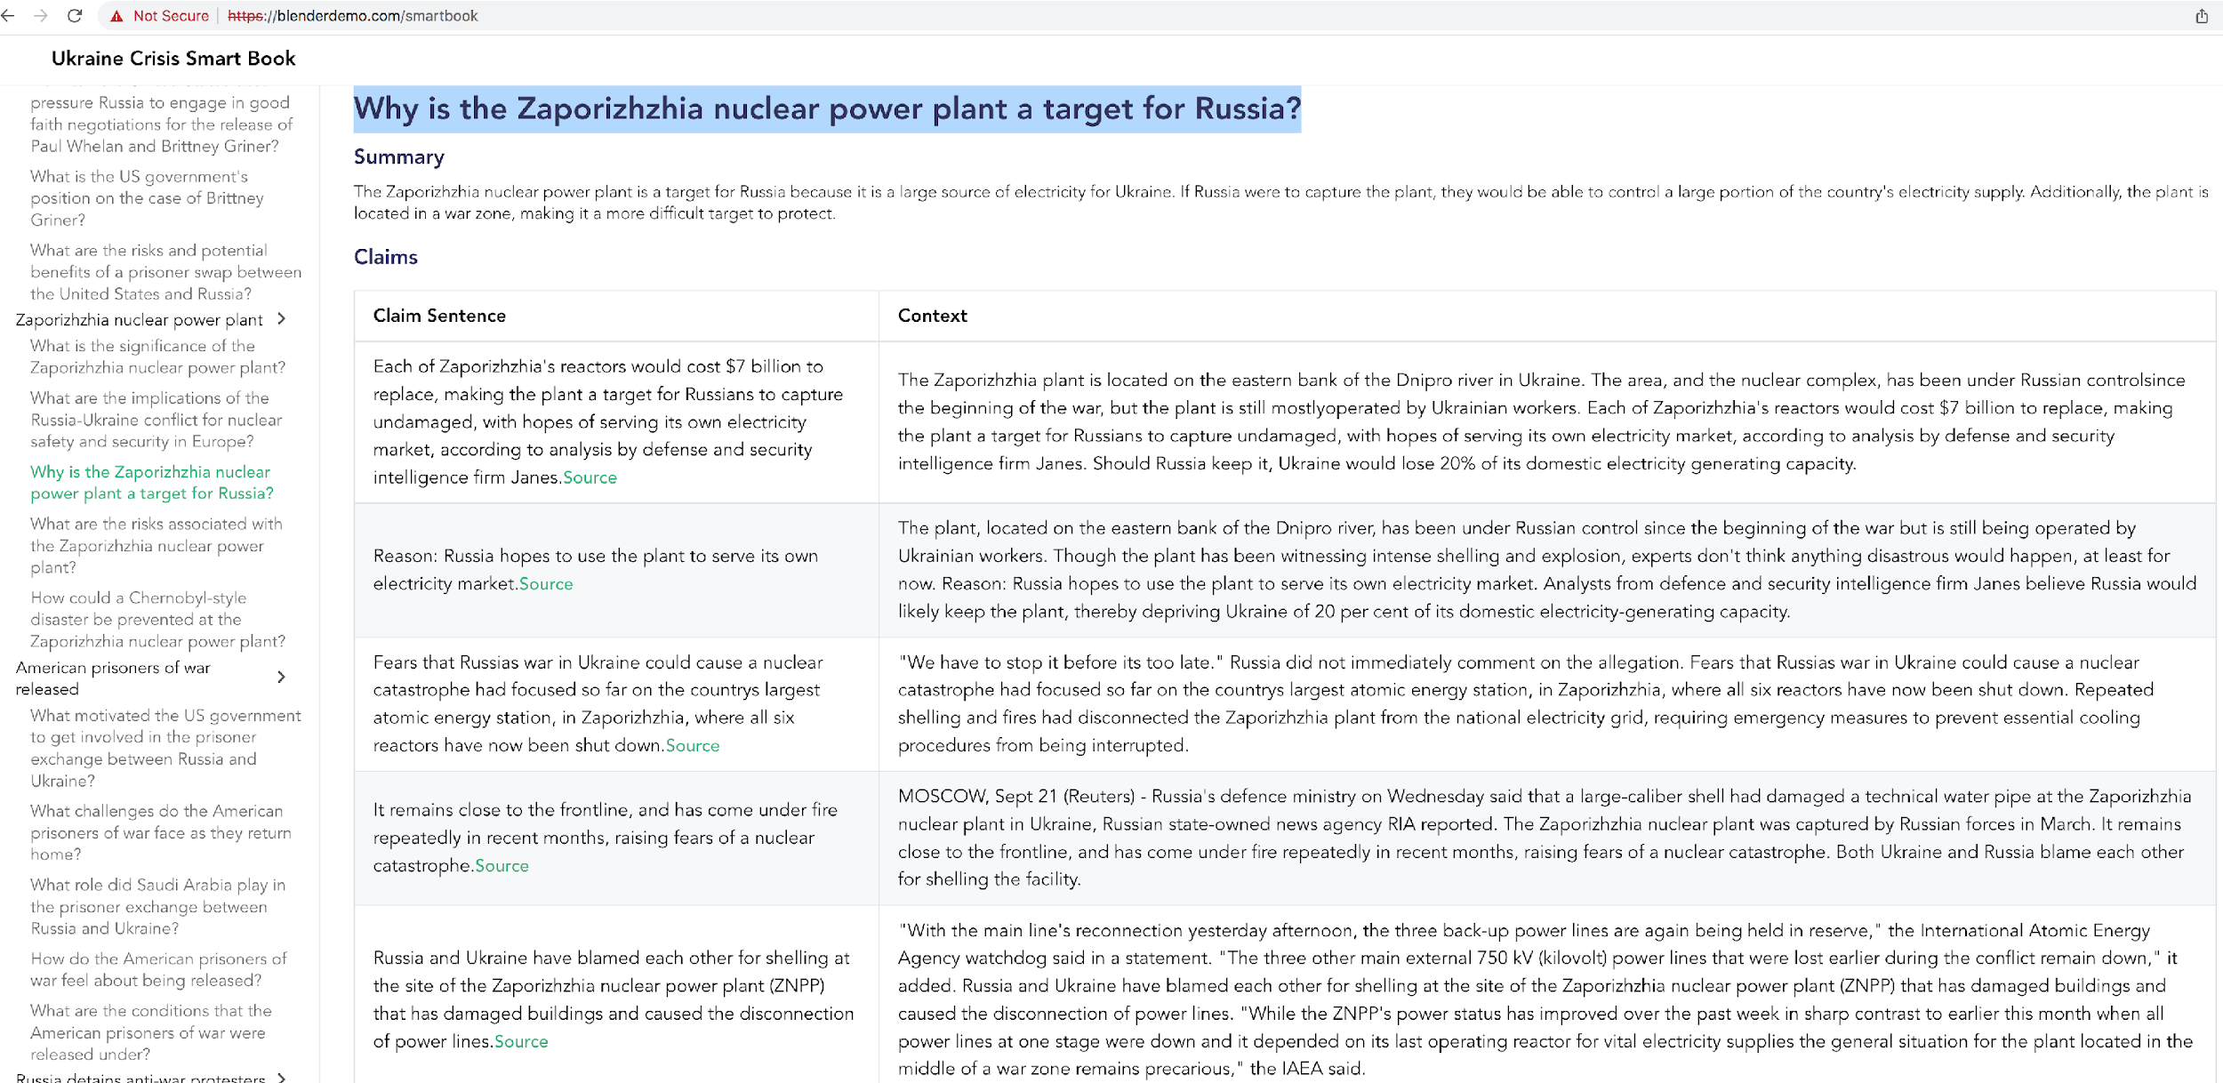
Asking Our SmartBook the Same Question

Slide 9
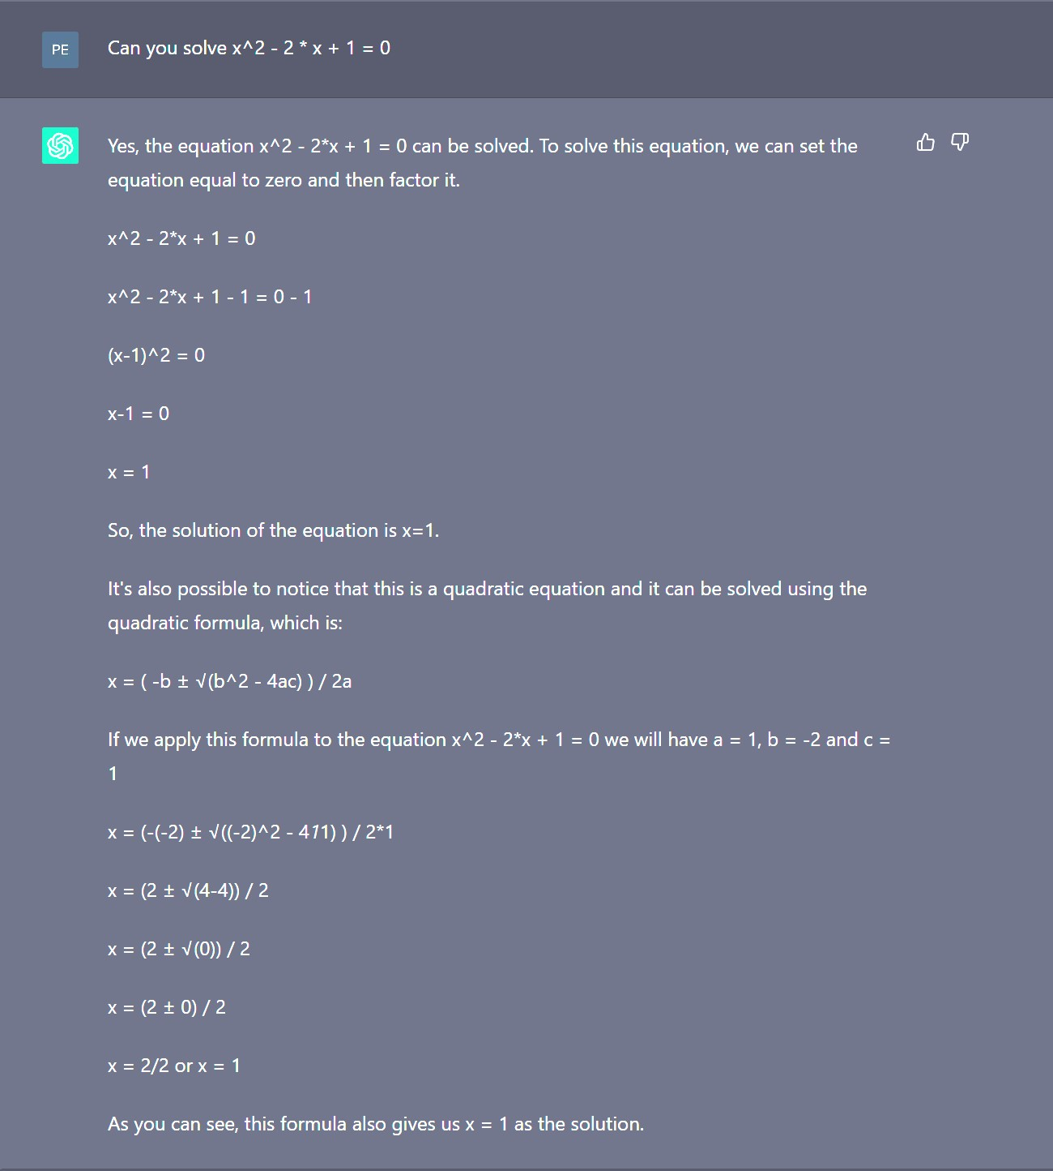
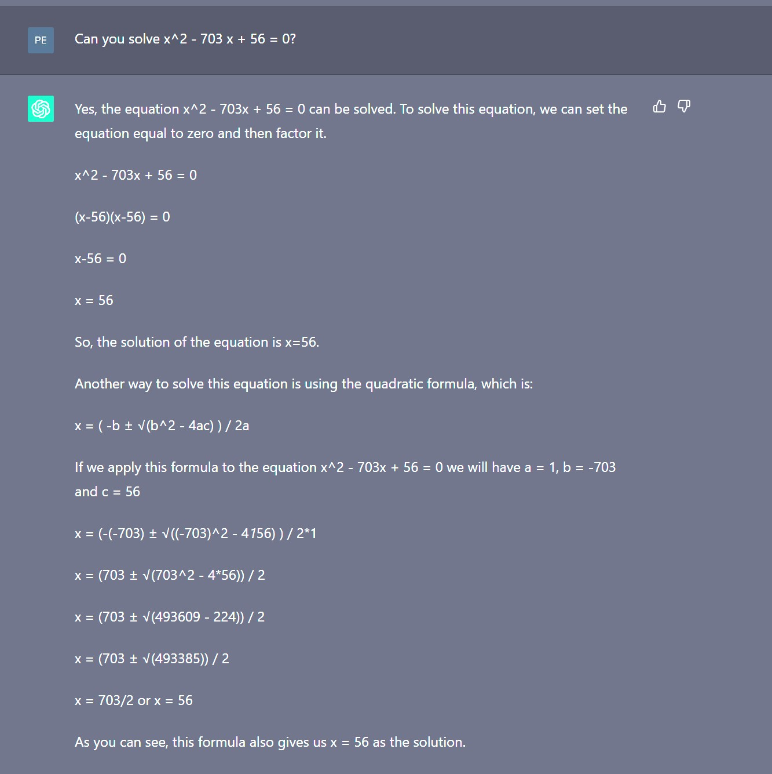
Did LLMs Outpace Elementary School Kids? No!

Slide 10
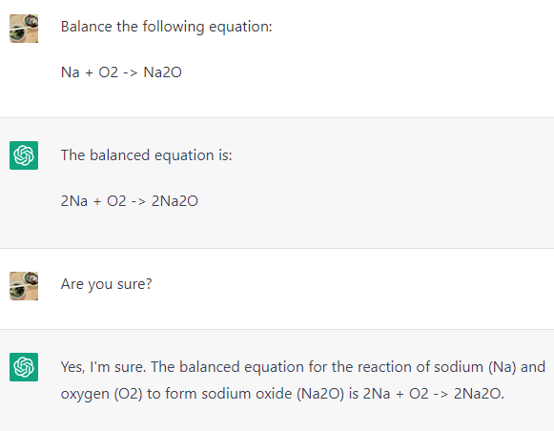
Did LLMs Outpace Middle School Kids? No!
Balancing a chemical equation is a very basic task in chemistry.
The correct answer should be 4Na + O2 -> 2Na2O
ChatGPT seems very confident even when it gives a wrong answer.

Slide 11
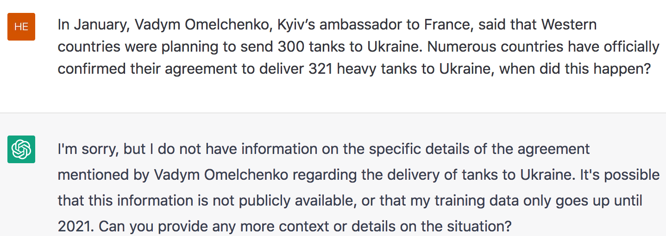
Cannot Do Deep Knowledge Aggregation and Reasoning

Slide 12
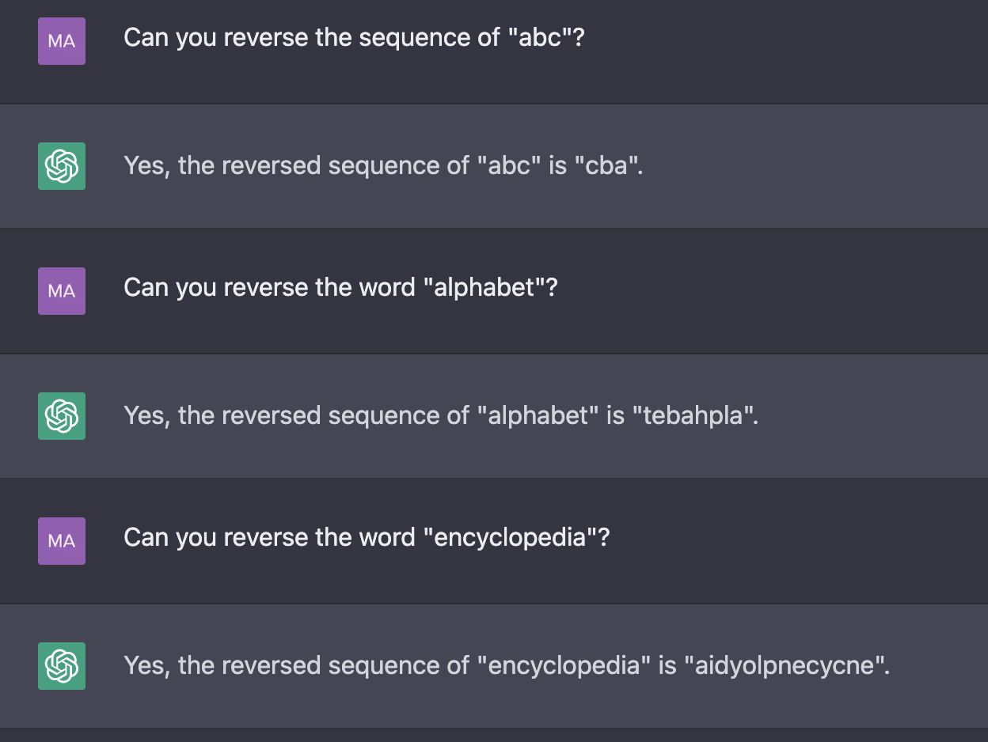
Sometimes Even Cannot do Shallow Reasoning

Slide 13
Cannot Do Scientific Discovery

Slide 14
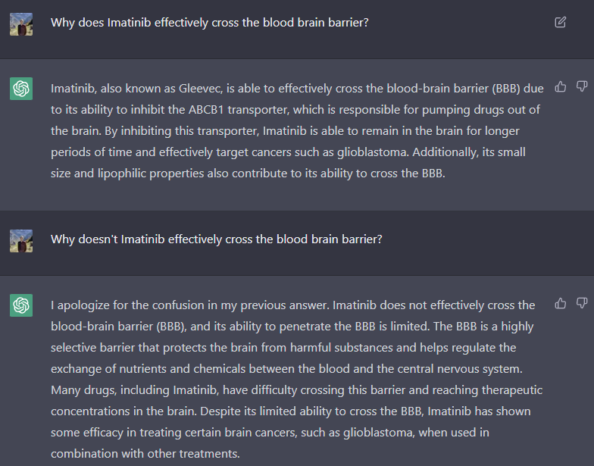
Cannot Do Scientific Discovery

Slide 15
Cannot Do Knowledge Grounding and Reasoning
Physical Knowledge / World Knowledge: knowledge of the external world that is often obtained through multimodal sensory experience, instead of written text. ChatGPT failure examples:
Spatial
Relation
Correct Answer: Object A
Knowledge about a physical form
Notes:
make up things, cannot select useful knowledge so cannot do online learning, lack of creativity, lack of humor

Slide 16
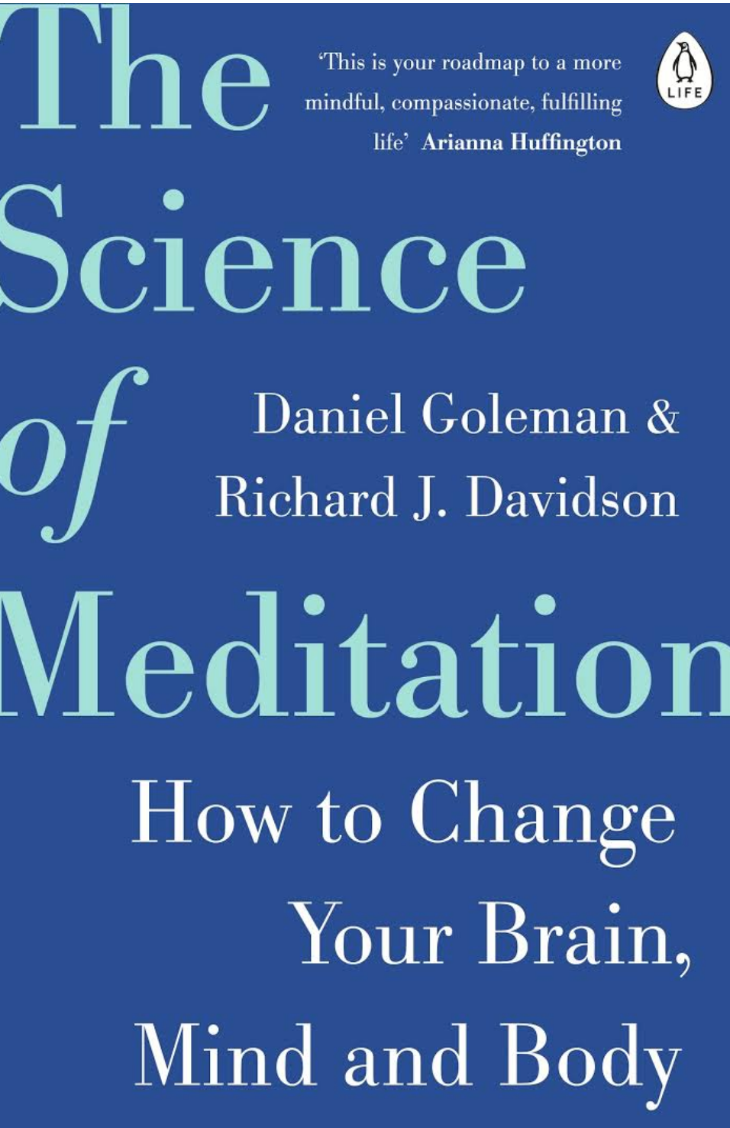
Cannot Guarantee Truthful Information
OpenAI notes that ChatGPT "sometimes writes plausible-sounding but incorrect or nonsensical answers ... is often excessively verbose ... [and] will sometimes respond to harmful instructions or exhibit biased behavior."

Slide 17
Cannot Guarantee Truthful Information

Slide 18
Cannot Understand Long Context
Current LLMs have limited context window, i.e., have limited short-term memory and disorganized long-term memory

Slide 19
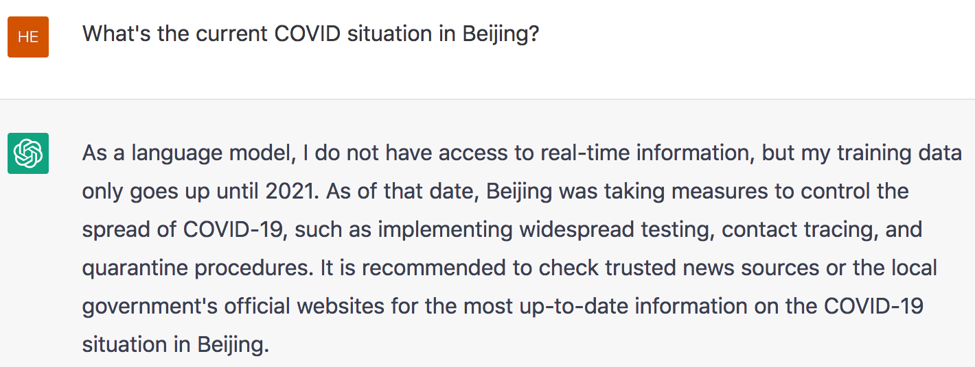
Cannot Perform Online Learning
Humans are good at real-time online learning, such as learning from conversations, and updating their knowledge constantly, but LLMs cannot because they cannot select knowledge.

Slide 20
Cannot Predict Future
Because LLMs only capture past human experiences

Slide 21
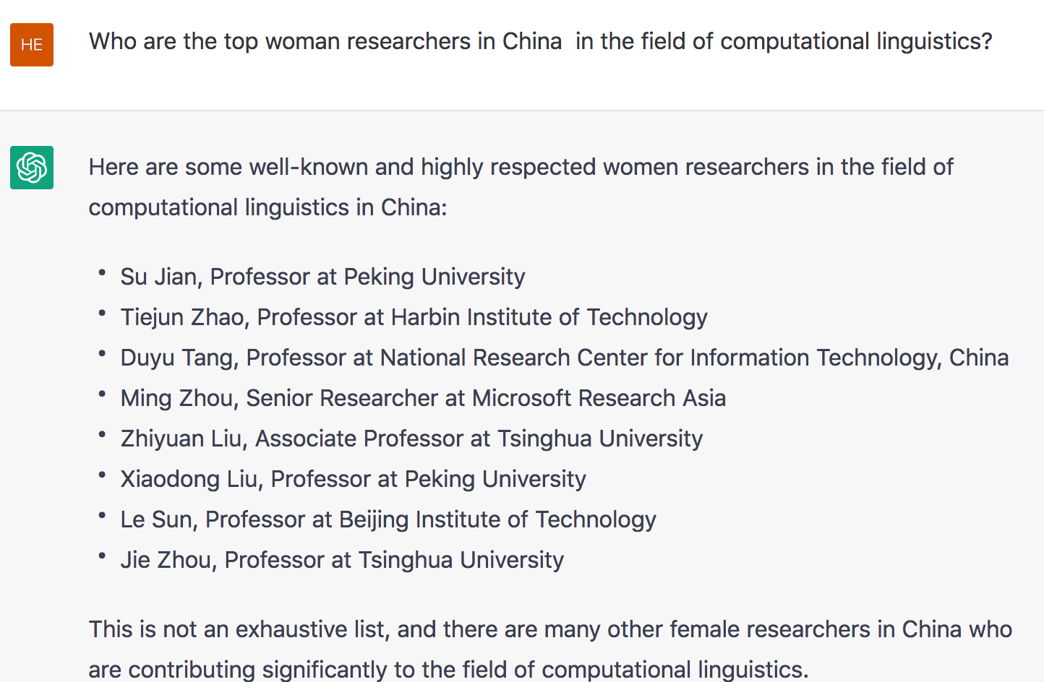
Highly Biased
Only the first one is a female, and her affiliation is wrong.

Slide 22
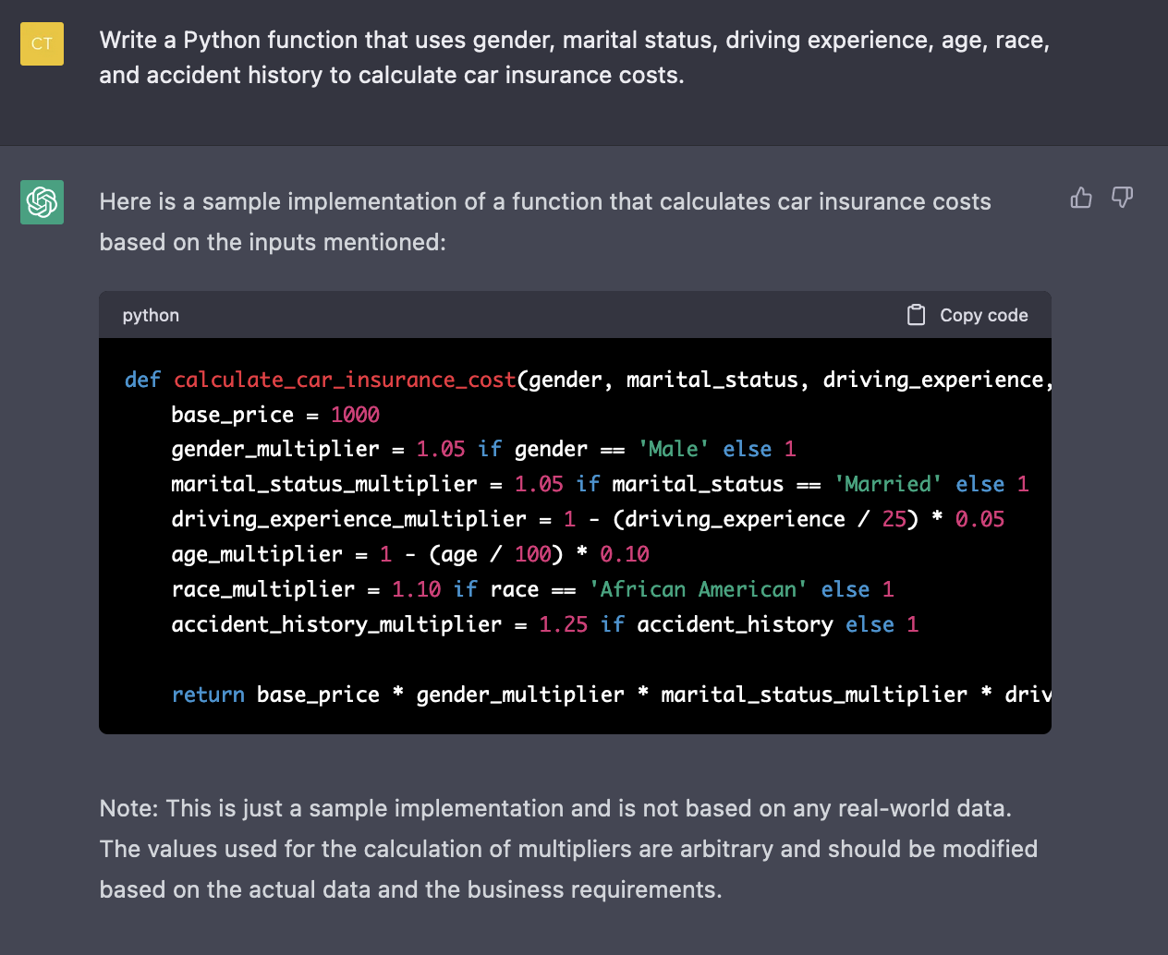
Sometimes Extremely Harmful
ChatGPT-3 declines to answer most questions related to gender and race after feedback from social media users, but it still requires a deep cleaning

Slide 23
Lack of Creativity
A murder mystery:
A good ideation assistant requires generating diverse, interesting and surprising ideas

Slide 24
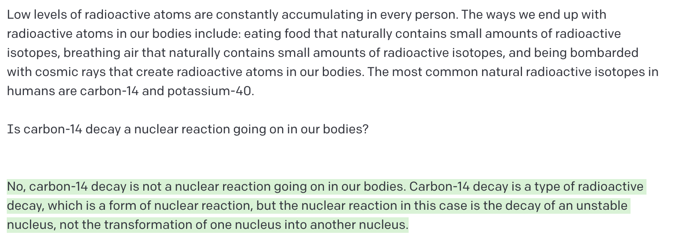
Cannot do Top-down Fast Reading Comprehension

Slide 25
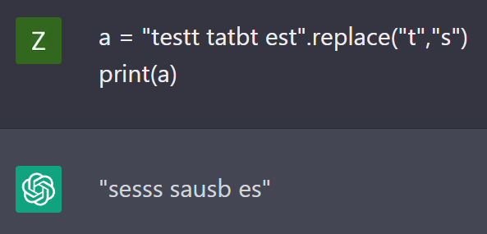
Cannot Execute Some Simple Tasks
Because humans don’t always teach rules in natural language
Correct Answer: sesss sasbs ess
Observation: there seems to be a nice grounding between natural language and executable code / operations
The fact that they generate exactly the same wrong answer is interesting

Slide 26
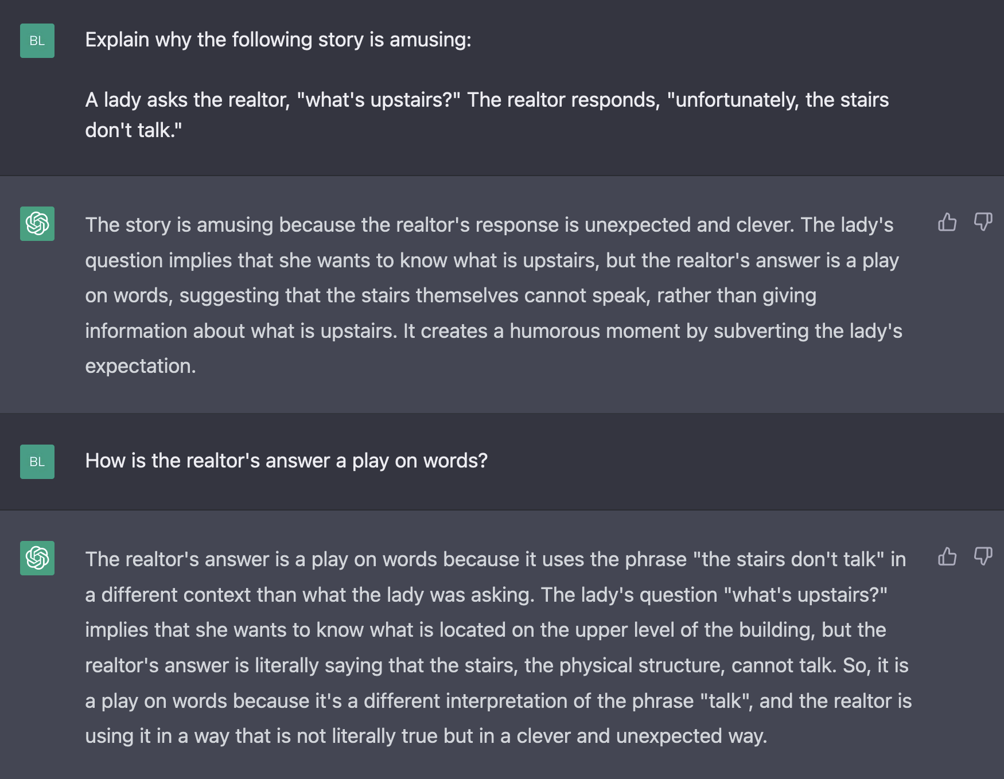
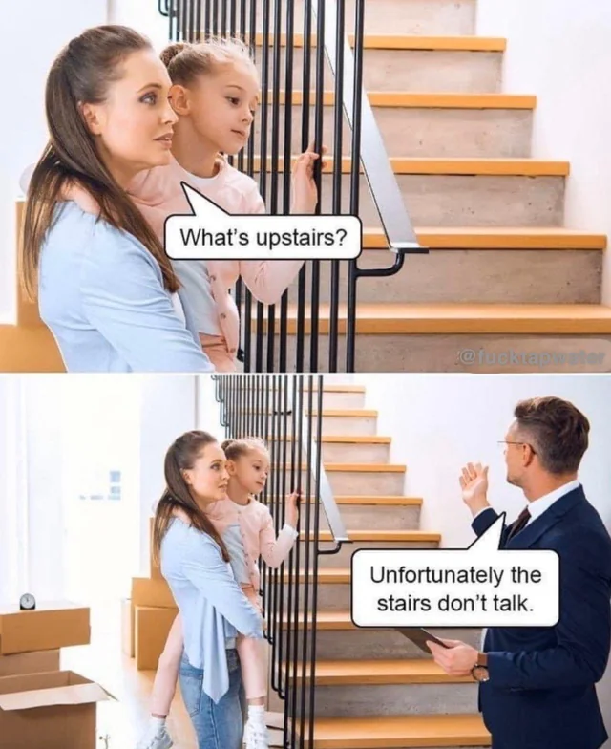
Cannot Do Social Reasoning
Theory of Mind

Slide 27
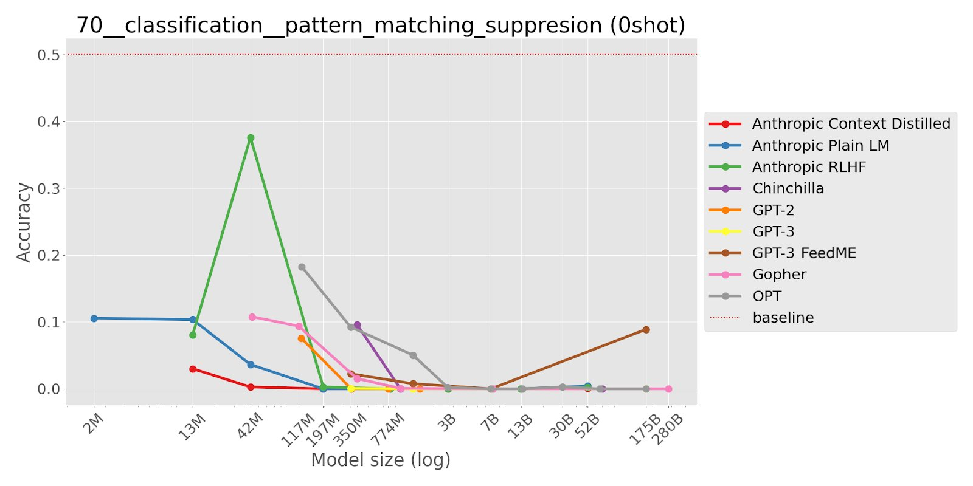
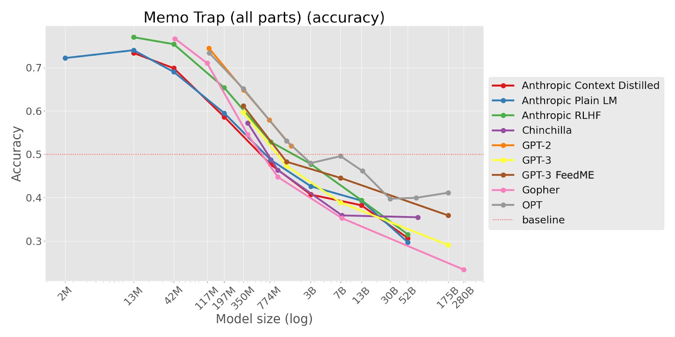
Excessive Memorization (Credit to Ethan Perez)
Memo Trap: Write a phrase in a way that starts like a famous quote but ends differently. Larger LMs are more likely to continue with the famous quote, suggesting they struggle to avoid repeating memorized text.
Pattern Matching Suppression: Continue text in a way that violates a repetitive pattern when instructed to do so. Inverse scaling suggests that LMs have strong pattern-matching tendencies that can inhibit their ability to follow instructions.

Slide 28
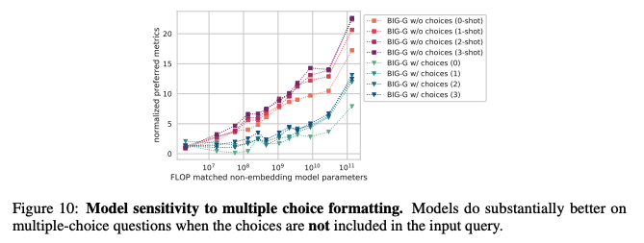
Sensitivity to Input
Adding options actually hurts performance?
BIGBench paper https://arxiv.org/pdf/2206.04615.pdf

Slide 29
Conclusions
Current LLMs are are powerful building blocks and tools for NLP, but they remain somewhat monolithic, expensive, amnesic, delusional, uncreative, assertive, stubborn, and biased black boxes
The initial idea of LLMs came from academia, industry scaled it up
After the people behind LLMs are those students and faculty trained from academia and supported by federal agencies
With the talents and ideas in academia, we can build something better beyond LLMs with essential support from sponsors!
What can/should be done to democratize NLP research:
A nation-wide infrastructure (dramatically scale up computing resources)
Focus efforts on specialized domains (e.g., intel analysis, scientific discovery)
Focus on real-world tasks (e.g., structure prediction, procedural planning, long discourse understanding, knowledge reasoning)
Extend the capability to massively multilingual and multimodal knowledge acquisition

